Slide 1
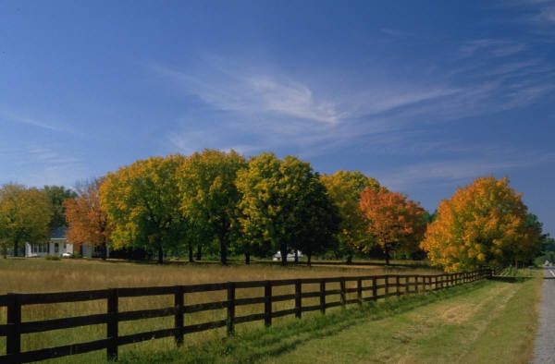
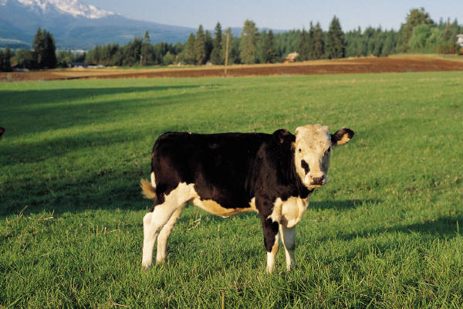
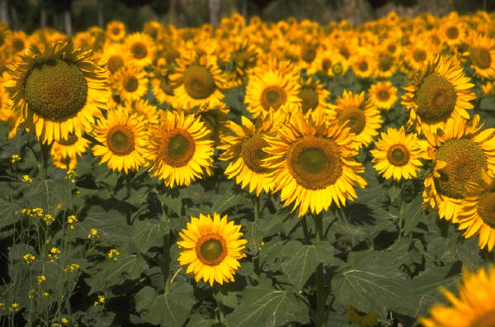
Georgia Soil and Water Conservation Commission AFY13 Budget

Slide 2
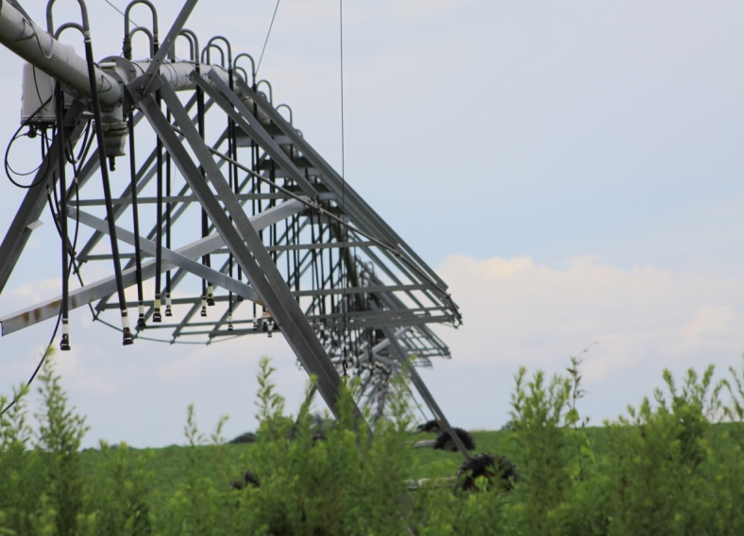
Georgia Soil and Water Conservation Commission Accomplishments
Ag Water Metering Program
Since 2004, over 11,500 water meters have been placed in all counties south of the Fall line.
Data from these meters is being used in the State Water Planning Process to ensure adequate water supplies for producing food and fiber.
The OneGeorgia Authority has allocated $500,000 in FY13 funding to continue collecting data, maintaining meters, and evaluating meter installation needs for landowners throughout Georgia.
During FY13, the Ag Water Metering program has eliminated telemetry systems and has begun making major meter repairs using GSWCC staff.
Approximately 1300 meters remain to be installed statewide at an estimated installation cost of $2.1 million.
The One Georgia Authority has allocated GSWCC’s Ag Water Metering Program over $18.3 million since 2004.
Mobile Irrigation Lab
Thru FY12– 1,708 irrigation audits and 563 irrigation system retrofits have been completed using federal funds, potentially saving over one billion gallons of water in 2012 alone.

Slide 3
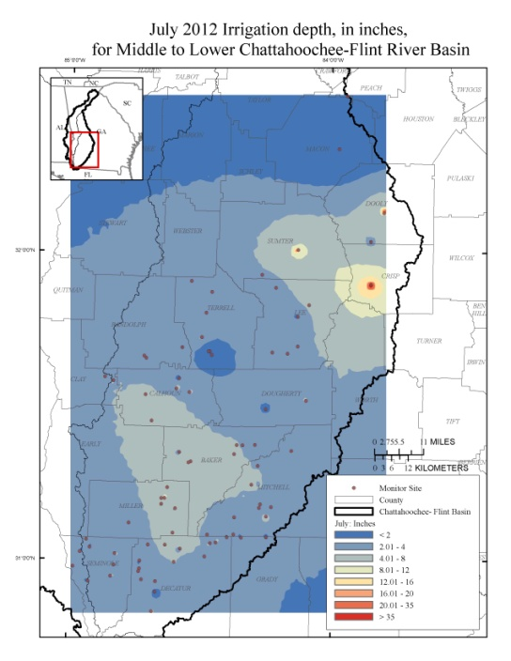
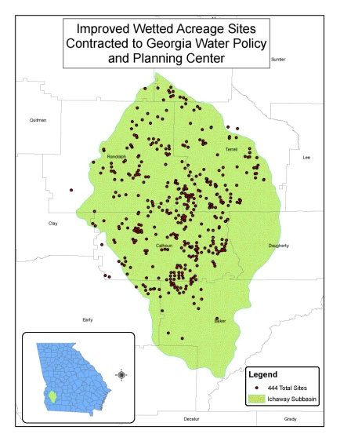
Georgia Soil and Water Conservation Commission Accomplishments
Quality Assurance and Analysis
of Agricultural Water Metering Data
In FY13, GSWCC contracted with the Georgia Water Planning and Policy Center at Albany State University to assist in the collection and compilation of wetted acreage associated with 444 installed surface water
meters. As part of its duties,
ASU will capture GIS acreage data, and record meter
readings and crop data.
GSWCC continues to work with the U.S. Geological Survey to estimate agricultural water use and growing season pumping rates in the Georgia Coastal Plain using annually and monthly reported agricultural water metering data.
To facilitate public access to water usage data, GSWCC and USGS have created a water usage website and a GIS mapping website.

Slide 4
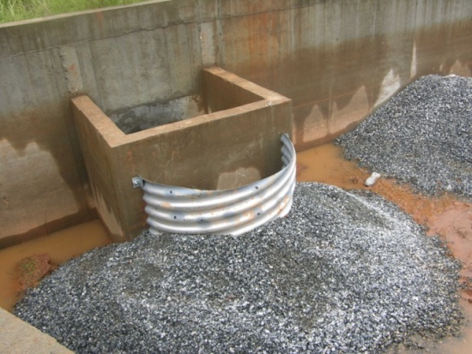
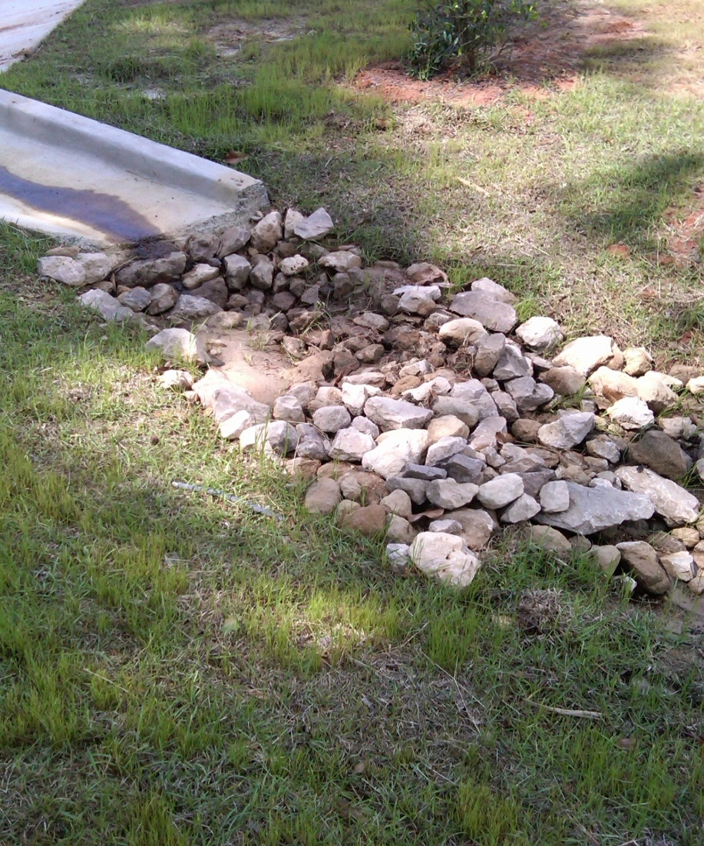
Georgia Soil and Water Conservation Commission Accomplishments
Erosion and Sedimentation Education & Certification Program
The GSWCC Certification Program serves to educate local governments and erosion and sediment control professionals about urban BMPs, while certifying individuals to meet Georgia's standards for land-disturbing activities. GSWCC staff reviewed and advised on 2305 Erosion, Sediment and Pollution Control Plans in FY2012.
During FY12 :
3,700 certifications for Subcontractor Awareness, Levels 1A, 1B and Level 2 courses were issued
8 certifications to trainers teaching 3rd party courses were issued
6,392 re-certifications were issued (Recertifications have decreased due to the recession.)

Slide 5
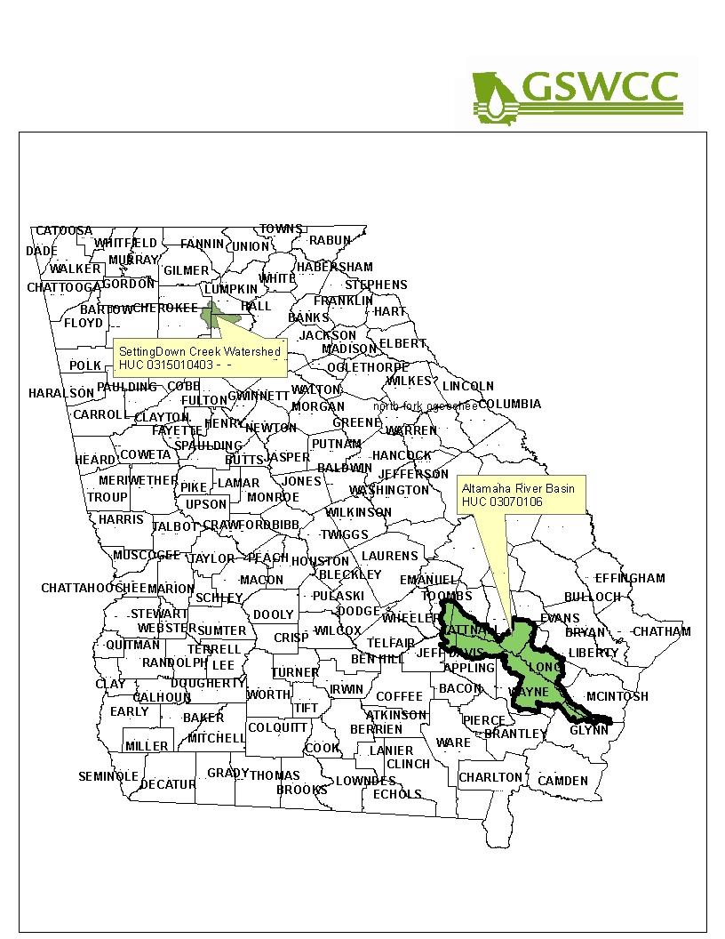
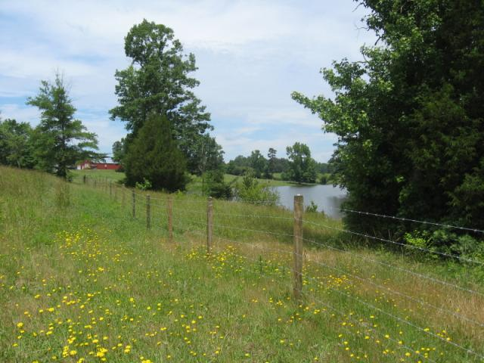
Georgia Soil and Water Conservation Commission Accomplishments
FY13 Agricultural Water Quality
Grants Awarded by Georgia EPD
Cedar Creek-Folsom Creek TMDL Project – Wilcox County
Objective - to effectively address elevated sediment levels in these creeks .
Nutrient Management Planning Initiative- Settingdown Creek Watershed and Altamaha River Basin
Objective - to implement a pilot project to revise and update nutrient management plans and to promote conservation practice implementation.

Slide 6
Georgia Soil and Water Conservation Commission AFY13 Administration program
Reduction of funds for operating expenses
$6,793
Travel, motor vehicle expenses and supplies will be cut.
The result will be fewer meetings attended by staff.
Partnerships with cooperating agencies could possibly be affected.
Staff will be asked to travel further distance without the opportunity for overnight travel reimbursement.

Slide 7
Georgia Soil and Water Conservation Commission AFY13 Conservation of Ag Water Supplies, Conservation of Soil & Water Resources and Water Resources & Land Use Planning programs
Replace state funds with other funds for personal services and leave one Regional Representative position vacant
$58,559
Competitive grant funding was awarded to the GSWCC .
The use of these funds to replace state funds will prevent the GSWCC from hiring part-time coordinators for these new best management practice projects as was originally planned.
Current staff will be reassigned from existing core responsibilities, such as irrigation testing, erosion and sediment control and conservation district support.
Existing staff has assumed additional duties in the absence of a Regional Representative.

Slide 8
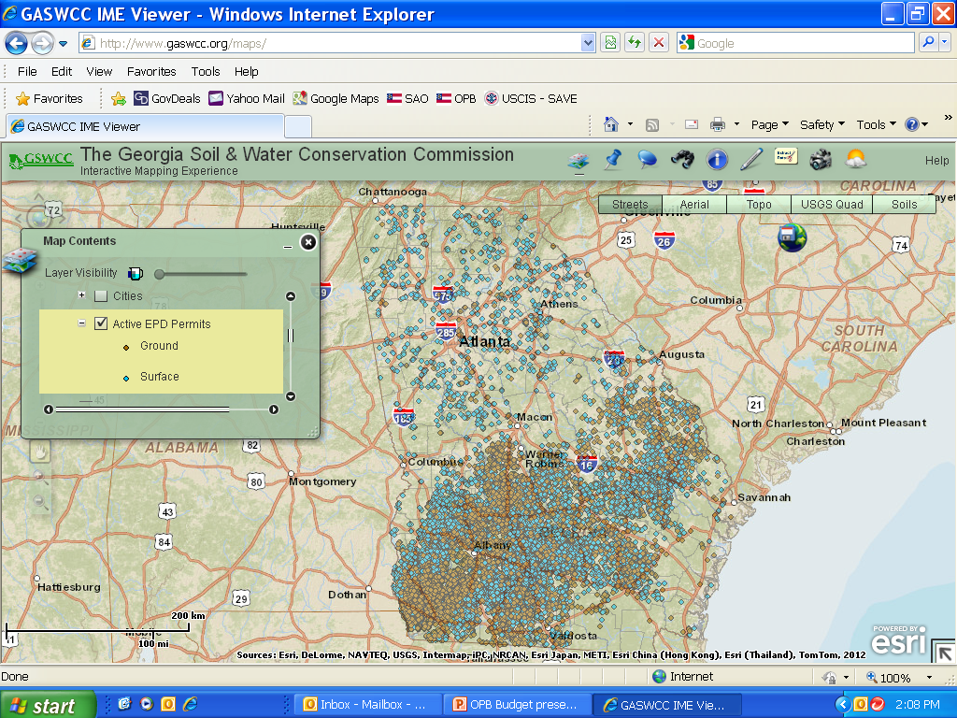
Georgia Soil and Water Conservation Commission AFY13
Water Resources & Land Use Planning program
Reduce funds for operating expenses
$21,669
Reduction of funds for annual GIS software maintenance
Annual maintenance fee for ArcGIS software was paid at the end of FY12 and will not be due again until September 2013.
Without adequate support and upgrades, users will not be using the latest edition of the software, thus preventing coordination with other supporting/cooperating agencies.

