Slide 1

Grant Writing and Administration 101
Prepared for the Georgia Soil and Water Conservation Commission February 26, 2016 | Jekyll Island

Slide 2
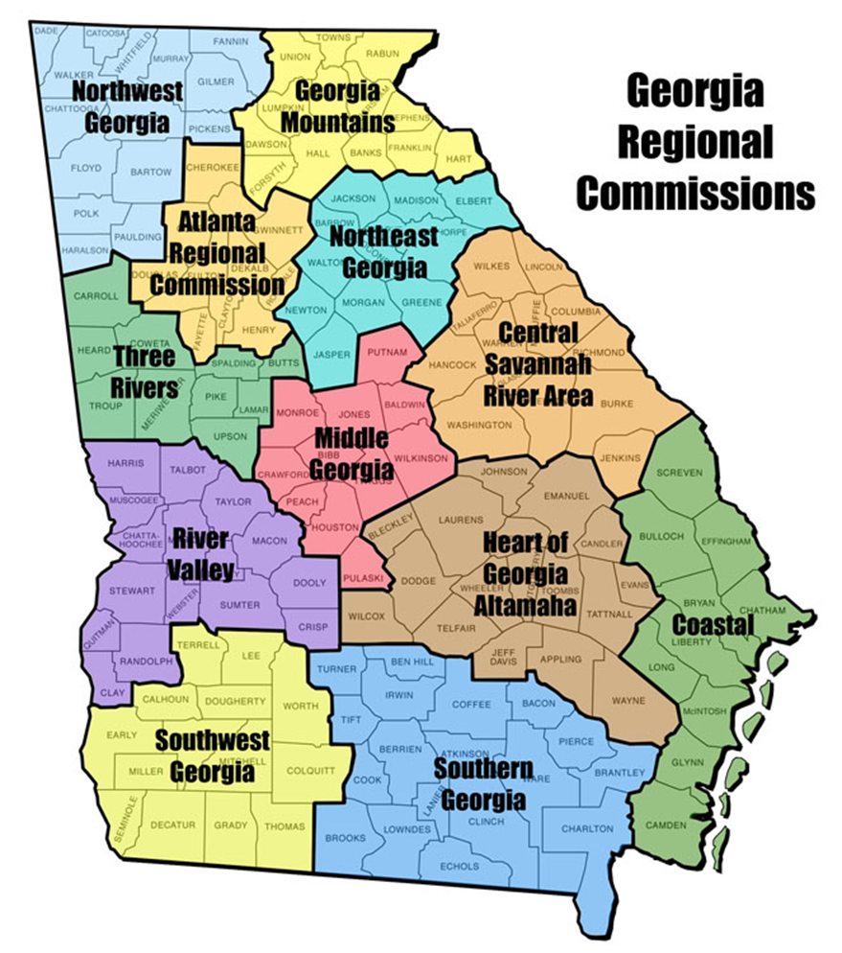
About the Regional Commissions
Currently 12 Regional Commissions in the State of Georgia.
Have been called APDCs, RDCs
Creation of the local governments, authorized by the State of Georgia under O.C.G.A. § 50-8-32.
Mission: advance efficient and effective service provision for local governments.

Slide 3

Aging Services
Technology Services
Local Government Assistance
Workforce Development
Planning
Transportation
Economic Development
Georgia Small Business Loans (GSBL)

Slide 4
Grant Preparation & Writing

Slide 5
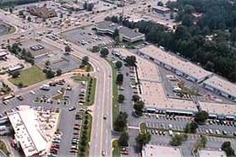
Step 0: Planning
Before you even consider applying for grants, invest in comprehensive community planning.
You may be able to head off some issues completely with a bit of proactive thinking.
If not, you can at least plan for future needs. Set aside funds or acknowledge your need for grants.
Consider designations like PlanFirst or WaterFirst to gain preferences for later grant/loan applications.

Slide 6
Step 1: Getting Started
Select your project.
Identify a clear need that exists for your community.
Grant funding may not cover exactly what you need.
Select your grant.
Money is available for your community.
You still need to justify why you should get it.
Get your key players on board early.
Check for possible alternatives, if necessary.

Slide 7
Step 1: Getting Started
How do you find grants?
Mailing lists (esp. state/federal agencies)
Personal relationships
Representatives & Senators
Mayors, Councilmembers, & Commissioners
Department heads
Funding partners
Catalogue of Federal Domestic Assistance & Grants.gov
Webinars, esp. of professional organizations
Regional Commissions & other grant writers
Google

Slide 8



Common Grants/Loans:
Community Development Block Grants
Regular Round Competition (Open to non-HUD Entitlement Communities)
Up to $500,000 in grant funding.
5 percent match on award amounts above $300,000.
Benefit to individuals who are low-to-moderate income.
United States Department of Agriculture
Rural Development (Open to rural communities served by USDA)
Mixture of grant and loan funding (based on need).
For rural communities (fewer than 10,000 people).
40-year low-interest loan repayment period.
Georgia Environmental Finance Authority
Georgia Fund
State loan funding for water and wastewater infrastructure.
Up to $3,000,000 in loan funding.
20-year low-interest loan repayment period.

Slide 9
Step 1: Getting Started
Determine your eligibility & competitiveness.
i.e. Read the directions.
Eligibility
What projects does the grant cover?
Can your agency apply?
Competitiveness
Does the grant have considerations for special preference?
Do community demographics matter?
YOU WILL WASTE TIME AND MONEY IF YOU DON’T CHECK THIS FIRST!

Slide 10
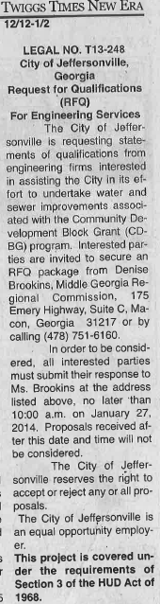
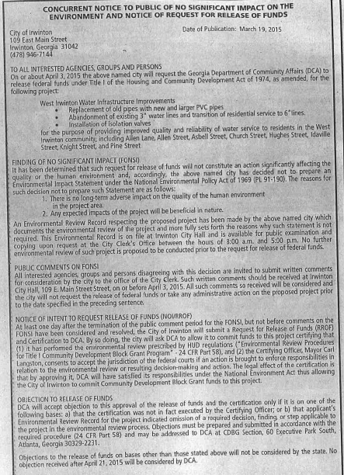
Step 1: Getting Started
Develop a timeline & plan.
Are there waiting periods built into the process?
Ex. Procurement, Public Notices, etc.…
Do you need information from others?
Data/statistics, PER/PAR, Surveys
Organize your grant preparation so you can tackle these items early.

Slide 11
Step 2: Preparing the Application
Identify your budget.
Consult PER/PAR, past projects of similar scale/scope.
Look at labor costs – predict & document amount of time needed.
Consider long-term costs, if applicable.
Required & Additional Match/Leverage
Almost all grants require a cost share.
Some may be more competitive if you go above & beyond.
Need to determine what counts as match/leverage.
Cash only or are in-kind services permissible?
NEED TO GET APPROVAL FROM DECISION-MAKERS!

Slide 12
Step 2: Preparing the Application
Review all necessary instructions. Identify necessary documents, forms, attachments, etc.…
Procure.
Engineering/Architectural/Other Professional Services.
Grant writers/administrators procured now too if need be.
Secure matching funds from the aforementioned slide.
(If necessary)

Slide 13
Step 2: Preparing the Application
Fill out forms.
Identify information you may need.
Know what you don’t know.
Examine content/length, etc.…
If you are unfamiliar with what the form wants:
Read the directions
And if you’re still unsure, contact someone.

Slide 14
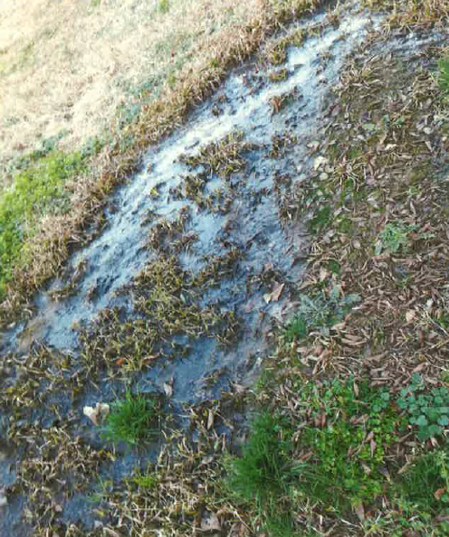
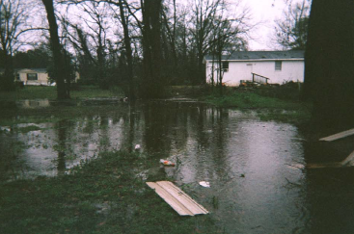
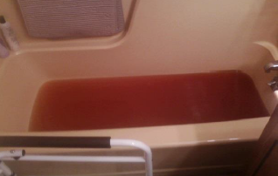
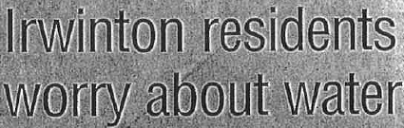
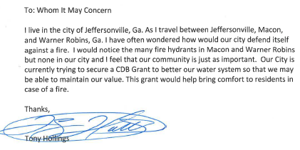
Step 2: Preparing the Application
Document the need, part I: What’s the problem?

Slide 15
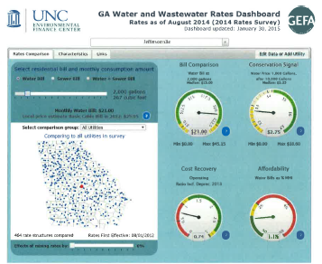
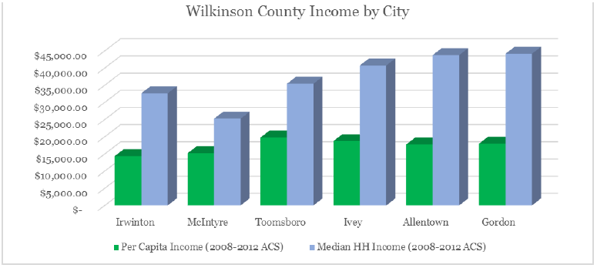
Step 2: Preparing the Application
Document the need, part II: Why should they help you?
http://factfinder.census.gov/
http://www.efc.sog.unc.edu/reslib/item/georgia-water-and-wastewater-rates-dashboard

Slide 16
Step 2: Preparing the Application
Write your narrative(s).
You have to sell your project and your community.
Think and write logically.
Build an argument
A→B→C→$
Be clear, consistent and focused.

Slide 17
Step 3: Submit!
Review thoroughly before submitting.
A peer review is recommended.
Is the application complete?
Any blank spots?
All forms/files attached?
All signatures in place?
Do the numbers match up?
Make copies and review copies if necessary.
SUBMIT EARLY! ANYTHING THAT CAN GO WRONG, WILL.

Slide 18
Grant Administration & Closeout

Slide 19
Administering Your New Grant
First Steps:
Get organized.
Review required elements, deliverables, and regulations.
Develop a plan to finish on time and on budget.
Identify major milestones and who is responsible for getting you there.
Save time for monitoring, reviews, as necessary.
Review this plan regularly.

Slide 20
Administering Your New Grant
Build relationships
Know your grantor. They want you to be successful.
Understand program goals – what do you need to get out of the grant?
Things change.
Ask permission if you need to change your scope of work.
Grants should be win-win for grantor and grantee.
Communicate regularly with project partners.
Keep your team in the loop.

Slide 21
Administering Your New Grant
Stay up-to-date on grant regulations.
Review reporting deadlines and describe your progress honestly.
Do what you said you would do in the application. If you can’t, amend the project scope.
Document, document, document!
Are you required to do something?
Be able to prove that you did it.
Make sure you stay eligible.
This can include more reports than just grant-related ones.

Slide 22
Grant Closeout
Congrats! You’re (almost) done!
Continue to document and compile all necessary files that you’ve acquired throughout the administration process.
Review monitoring requirements and any continued use provisions.
Save essential files in compliance with the applicable state records retention guidelines.
If sensitive materials can be discarded, shred appropriately.

Slide 23
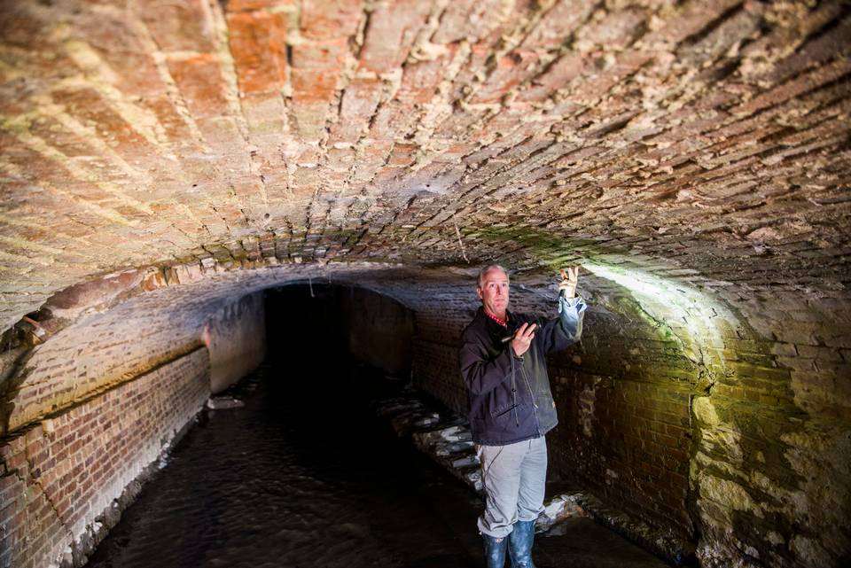
Planning & Maintenance
Now that you’ve received and utilized your grant funds, invest in comprehensive community planning.
Know your capacity for growth and let your infrastructure inform growth.
Inspect and maintain your new infrastructure frequently and consistency.
You WILL be able to head off some issues completely with a bit of proactive thinking.

Slide 24
Questions / Contact
Greg Boike
Senior Government Services Specialist
Middle Georgia Regional Commission
478-751-6160 | gboike@mg-rc.org

