Slide 1



.

Slide 2
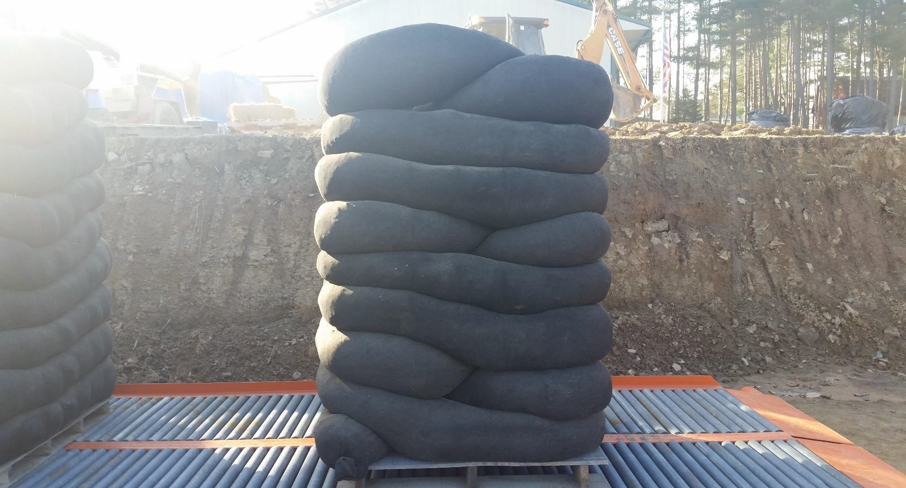
What are Biopreferred Erosion/Filtration Controls?
Biobased products derived from plants & other renewable agricultural materials

Slide 3

BEG Group’s USDA nationally certified biopreferred switchgrass product was established in January, 2017 for the categories for construction and grounds maintenance as part of the USDA Biopreferred Program.
Managed by the U.S. Department of Agriculture (USDA), the goal of the BioPreferred Program is to increase the purchase and use of biobased products. The BioPreferred Program was created by the 2002 Farm Bill and reauthorized and expanded as part of the Agriculture Improvement Act of 2018 (2018 Farm Bill). The Program's purpose is to spur economic development, create new jobs and provide new markets for farm commodities. The increased development, purchase, and use of biobased products reduces our nation's reliance on petroleum, increases the use of renewable agricultural resources, and contributes to reducing adverse environmental and health impacts.

Slide 4

March 8th- National Biobased Products Day
“By designating March 8th as National Biobased Products Day, we honor the 20 years of progress the BioPreferred Program has achieved,” USDA Rural Development Under Secretary Xochitl Torres Small said. “As we look to the future, rural communities are at the forefront of addressing climate change by using biobased innovations to convert feedstocks, such as commodities and agricultural waste, into a multitude of products that will create sustainability, promote job growth and revitalize our rural
economies.”

Slide 5
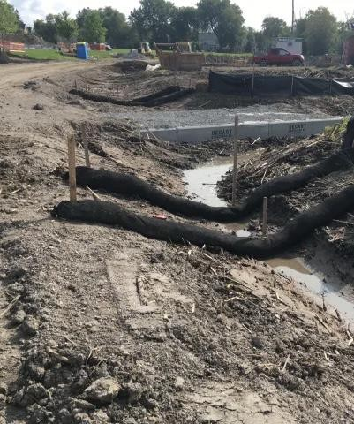
Biopreferred switchgrass controls are made of a sturdy polypropylene geotextile (woven) fabric with 100% biobased content, i.e., Switchgrass Filter, that has been engineered specifically for controlling erosion, plus containing and/or retaining sediment in disturbed areas.
These controls are a mesh tube filled with switchgrass material that is placed perpendicular to sheet-flow runoff and are oval to round in cross section providing a three-dimensional filter that retains sediment and other pollutants (e.g., suspended solids, tannic acid, nitrates and phosphates, to name a few, while allowing the cleaned water to flow through.
These biopreferred switchgrass controls can be used in place of traditional sediment and erosion control tools such as a silt fence, straw bale barrier and mulch socks.
This is an ever-growing market with more and more environmental manufactures joining the
quest to offer green initiatives regarding protecting our natural landscapes.
.

Slide 6


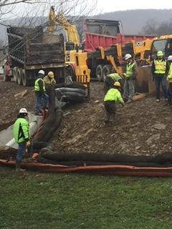
Such controls are generally placed along the perimeter of a site, or at intervals along a slope, to capture and treat stormwater that runs off as sheet flow. They are flexible and can be filled and easily moved into position, making them especially useful on steep or rocky slopes where installation of other erosion control tools is not feasible.
With Biopreferred Erosion/Filtration Controls there is greater surface area contact with soil than typical sediment control devices, thereby reducing the potential for runoff to create rills under the device and/or create channels carrying unfiltered sediment.

Slide 7
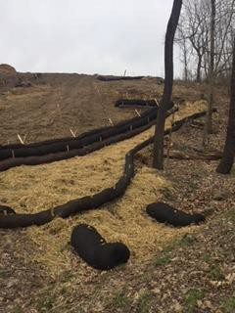
Plus, biodegradable erosion/filtration controls are applicable to construction sites or other disturbed areas where storm water runoff occurs as sheet flow. Common industry practice for erosion/filtration devices is that drainage areas do not exceed 0.25 acre per 100 feet of device length and flow does not exceed one cubic foot per second.

Slide 8
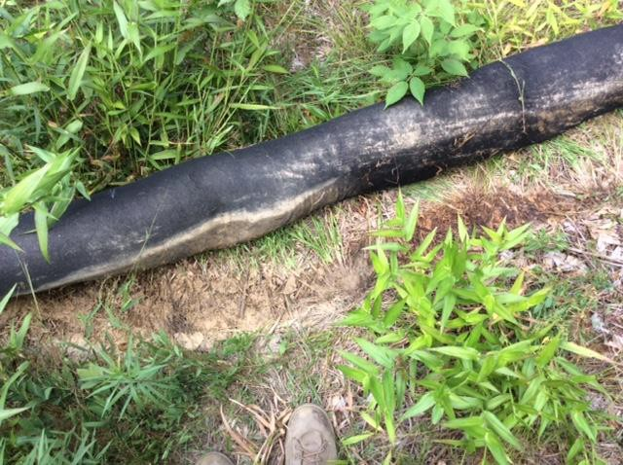
Environmentally Friendly

Slide 9
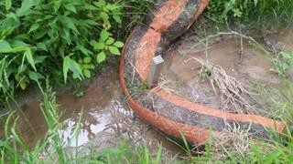
Stream Filtration

Slide 10

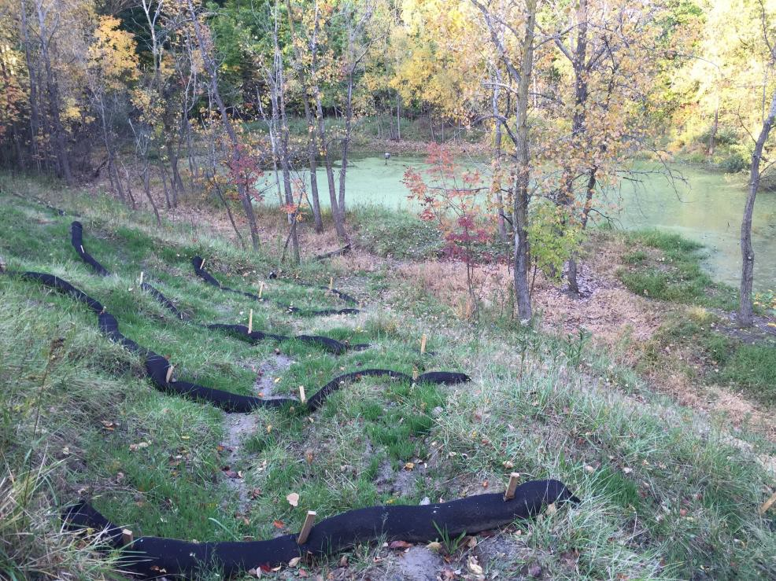
Additionally, these controls can be laid adjacent to each other and perpendicular to storm water flow, to reduce flow velocity and soil erosion.
Switchgrass Filters can also be used for nutrient management protection to filter water flow into highly qualified/exceptionally values watershed areas..
BEG Group’s The Big Switch & Big Switch erosion/filtration controls come in 4, 8, 12, 18, 24 and 32 inches in diameter.

Slide 11

Questions
Joe Greco
President
BEG Group LLC
joe@greco.tc(724) 681-4414

