Slide 1
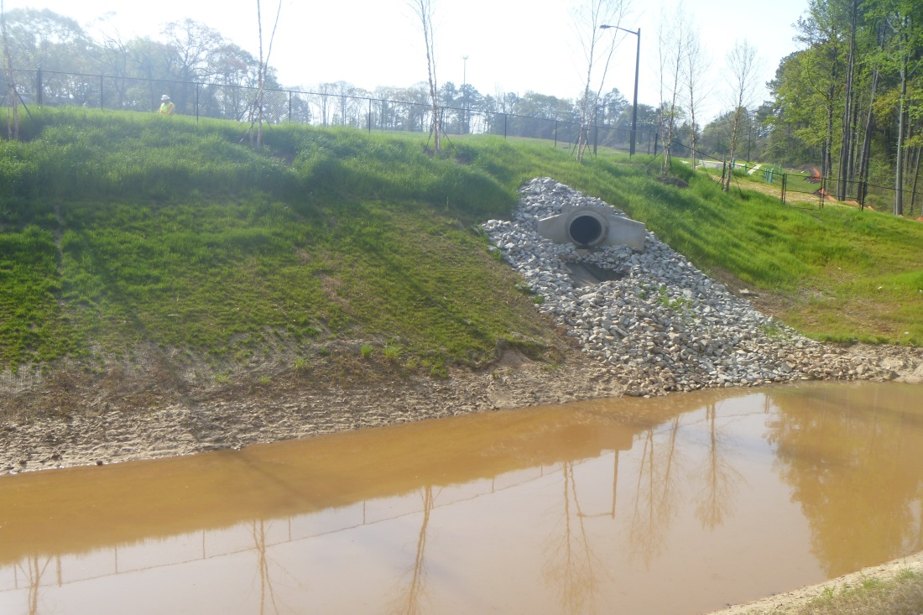
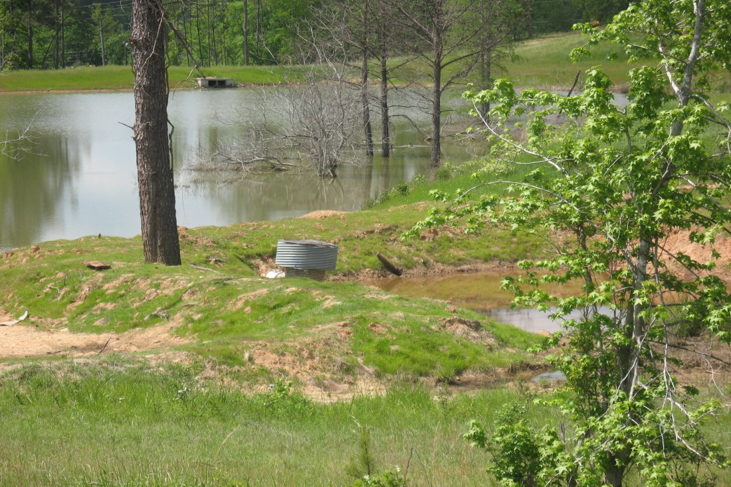
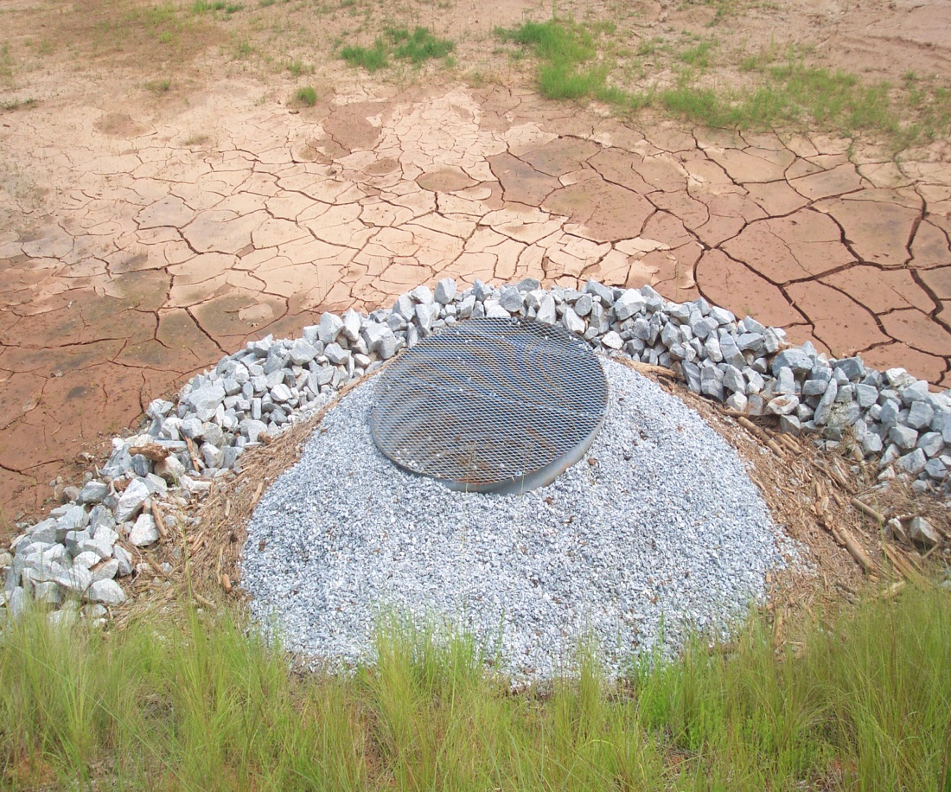
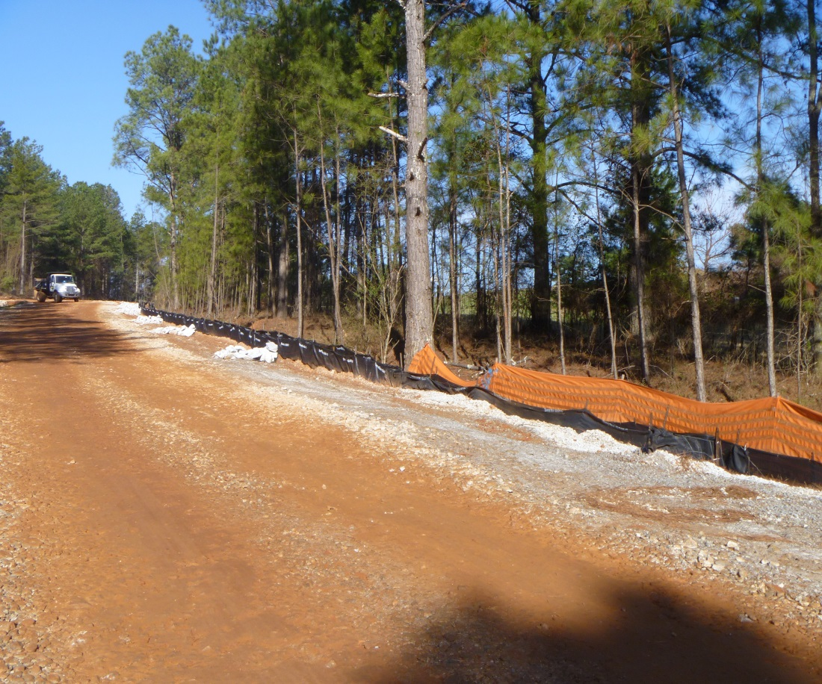

2016 Manual for Erosion and Sediment Control Updates

Slide 2
Why Revise the Manual?
On December 18, 2014, the GSWCC State Board took no official action on the Sixth Edition (2014) of the Manual because of areas of concern and uncertainty
For the calendar year 2015, both the Fifth (2013) and Sixth Editions of the Manual were available for use
Part of a continuing process of revisions

Slide 3
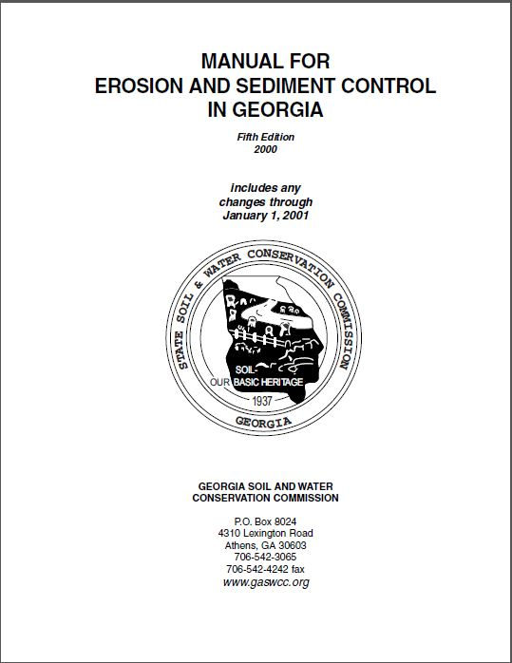
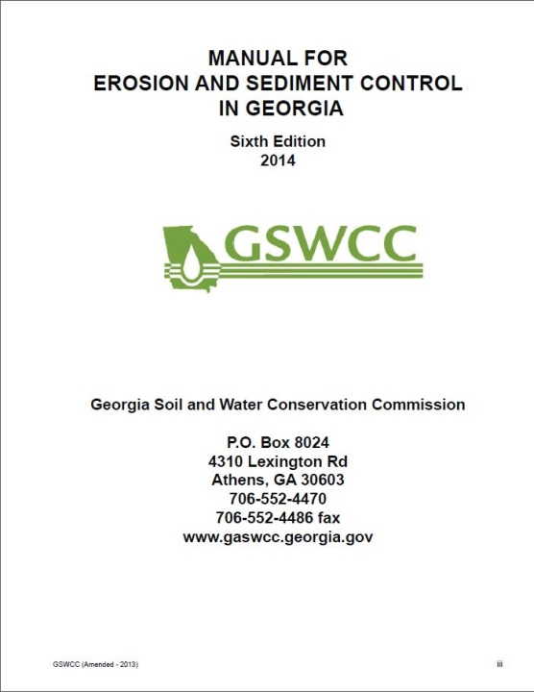
Major Changes: Testing
Both in Effect
Did not include performance evaluation
Included performance evaluation

Slide 4




Revision Process
The Carl Vinson Institute of Government at the University of Georgia was brought in this summer to help consolidate and reconcile the Fifth and Sixth editions, along with a representative from:

Slide 5
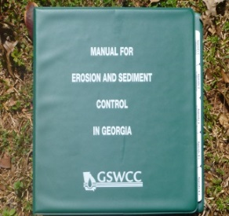
Manual For Erosion and Sediment Control in Georgia
Chapter 1 - The Erosion and Sedimentation Act of 1975
Minor revisions were made to content
Existing pictures were replaced with new ones
Chapter 2 – Sediment and Erosion Control Processes, Principles and Practices
Minor revisions were made to content
Updated to include new Best Management Practices
Existing pictures were replaced with new ones

Slide 6

Manual For Erosion and Sediment Control in Georgia
Chapter 3 - Planning and Plans
Minor revisions were made to existing content
Added two new sections:
  “Coordination of Erosion and Sediment Control with Post-Construction Stormwater Management”
  “Low Impact Development”
The Erosion and Sedimentation and Pollution Control Plan has been updated to reflect requirements of O.C.G.A 12-7-1 and the NPDES Permits

Slide 7
Manual For Erosion and Sediment Control in Georgia
Chapter 4 - Local Programs: Principles and Processes
Minor revisions were made to existing content
Chapter 5 – Sources of Assistance and Resource Information
Contact information and maps have been updated

Slide 8
Manual For Erosion and Sediment Control in Georgia
Chapter 6 – BMP Standards & Specifications
Revised existing BMPs
Added new structural and vegetative BMPs
Remove/added mandatory and advisory conditions (should vs. shall) for BMP criteria

Slide 9
Appendix A-2: Joining the Equivalent BMP List: Background and Purpose
The allowance of the efficient addition of proven BMPs that are at least as stringent as the Manual for Erosion and Sediment Control recognizes the dynamic growth and technological advancements in the area of BMP development.
The use of alternative BMPs whose performance has been documented to be equivalent or superior to conventional BMPs as certified by a Design Professional may be allowed (unless disapproved by EPD or the State Soil and Water Conservation Commission).
The 2016 Manual includes a new process, found in Appendix A-2, in which new BMP’s can be submitted to the GSWCC for inclusion on the Equivalent Best Management Practice List. This list is compiled from BMP’s which have been previously approved by GSWCC and the GADOT prior to January 1st, 2016.

Slide 10
Appendix A-2: Joining the Equivalent BMP List: Alternative BMP Guidance
One page summary detailing why the alternative BMP is equivalent or superior to the conventional BMPs found in the Manual.
Documented side by side testing (alternative BMP vs. conventional BMP) using the appropriate design requirements and specifications contained in the Manual.
Proof that the alternative BMP was previously installed and worked under conditions comparable to the environmental conditions of the proposed site. This can be documented with photographs.
All specifications including the design requirements and the procedures for proper installation and maintenance.

Slide 11

Equivalent BMP Application Pre-notice

Slide 12
Appendix A-2: Joining the Equivalent BMP List: Application and Removal Process
For a BMP to be considered for inclusion on the Equivalent BMP List, a Design Professional must have successfully completed the current process for Alternative BMPs as outlined by the GSWCC Guidance on at least 3 completed projects where EPD’s Notice of Termination Form has been filed.
Geographic dispersion of the project sites is encouraged.
The following materials should be submitted to the GSWCC
  An Application to be on the Equivalent BMP List and a sample of the BMP.
  Three sets -- one for each time the Alter-native BMP was used in three separate projects -- of the required documentation to use the Alternative BMP, based on the current approval process as outlined by GSWCC Guidance. Evidence of repeatable bench and field testing must be included as part of this documentation. Only approved ASTM standards or Overview Council-approved standards will be accepted for repeatable bench testing; working test methods will not be accepted.
  Three sets -- one for each time the Alternative BMP was used in three separate projects -- of the Notice of Termination Form for each project involving the Alternative BMP.
  A Certification Form signed by two individuals -- a Level II certified Design Professional and a Level 1A or Level 1B Certified Personnel -- who evaluated the BMPs performance in the field stating that the Alternative BMP performed as expected throughout the life of each of the three projects.
  Three sets of installation photos -- one for each time the Alternative BMP was used -- of the Alternative BMP utilized in the three projects.
  Three sets of after-storm event photos -- one for each time the Alternative BMP was used -- of the Alternative BMP utilized in the three projects.
  Any post-storm event inspection records as well as inspection and enforcement records made by any federal, state, or local regulatory agency related to this specific BMP on this project.

Slide 13
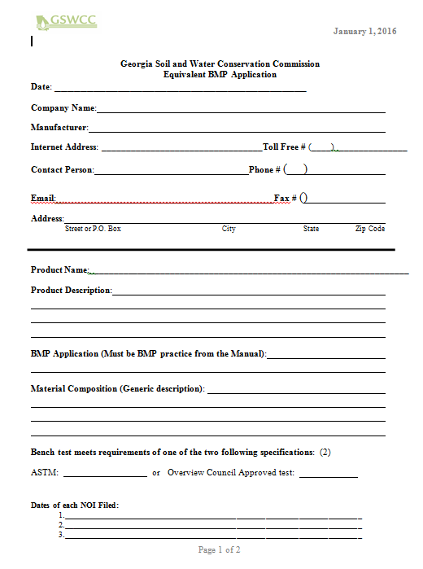

Equivalent BMP List Application

Slide 14
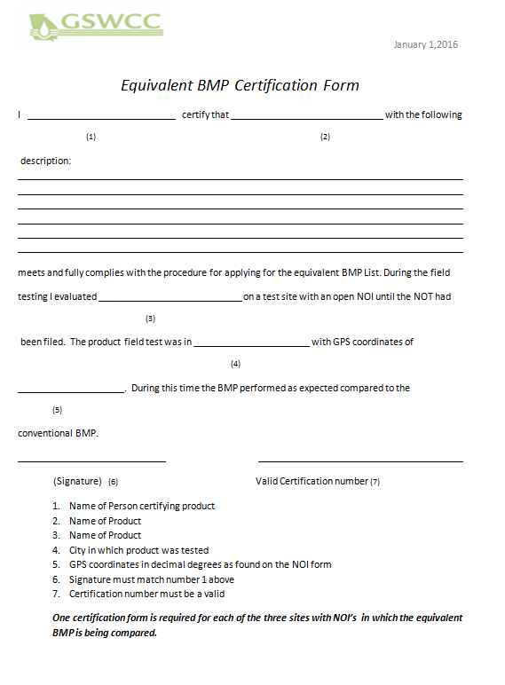
Equivalent BMP Certification Form

Slide 15
Appendix A-2: Joining the Equivalent BMP List: Application and Removal Process
Any individual, local government, or agency may submit to the GSWCC a request that a BMP be removed from the Equivalent BMP List.
The request for removal is encouraged to focus on complaints independent of issues of ordinary installation and maintenance of the BMP.
An applicant with a BMP removed from the Equivalent BMP List may seek review of the GSWCC’s determination from the GSWCC State Board.
An Alternative BMP removed from the Equivalent BMP List may be returned to the list if an applicant successfully completes the Procedure for Applying for the Equivalent BMP List again.

Slide 16
Appendix A-2: Joining the Equivalent BMP List: Transition Period
The Equivalent BMP List became effective January 1, 2016.
Applications for BMPs to be included on the Equivalent BMP list will be based on NOI’S submitted on or after January 1, 2016.
GSWCC’s approval of a BMP, however, does not ensure GDOT’s adoption of that item into their QPL, design policies, or procedures.
As of January 1, 2016, any product that seeks to be on the GDOT QPL List must first go through the Equivalent BMP process.
The first update to the Equivalent BMP list will occur on or after March 31, 2016.

Slide 17
Chapter 6 – BMP Standards and Specifications for Land Disturbing Activities
Revised several BMPs
Tackifiers (Tac) - (Vegetative)
Sediment barriers (Sd1) - (Structural)
Construction Exit (Co) – (Structural)
Matting & Blankets (Mb) - (Vegetative)
Check Dam (Cd) - (Structural)
Channel Stabilization (Ch) - (Vegetative)
Temporary Downdrain Structure (Dn1) – (Structural)
Retrofit (Rt) – (Structural)
Temporary Stream Crossing (Sr) – (Structural)

Slide 18

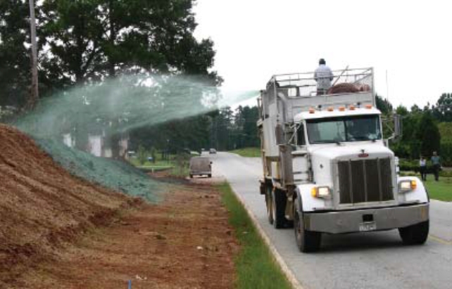
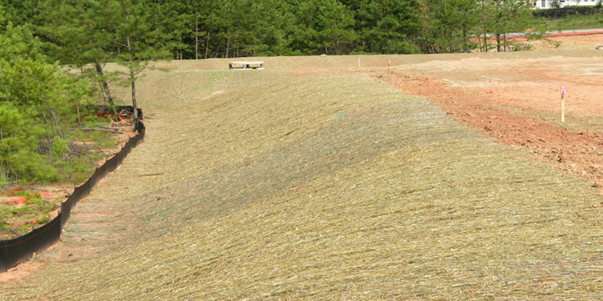
Chapter 6 - Revised BMP
Matting and Blanket (Mb) –No longer a stand alone BMP, it is now called Slope Stabilization (Ss)
  This BMP now incorporates:
    Hydraulic erosion control products (HECP)
    Rolled erosion control products (RECP)

Slide 19

Chapter 6 - Revised BMP
Tackifiers and Binders (Tb) was changed to Tackifiers (Tac).
Tackifiers are used as a tie-down for soil, compost, seed, straw, hay or mulch. Tackifiers hydrate in water and readily blend with other slurry materials to form a homogenous slurry.

Slide 20
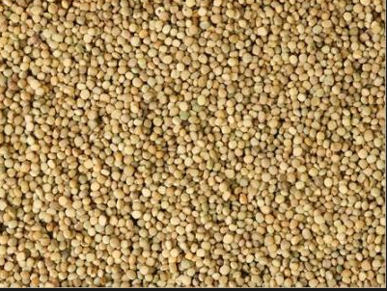
Chapter 6 - Revised BMP
There are five types of Tackifiers. These blends take into account different blends of synesthetic and/or organic polymers.
For general use, the tackifier must meet the specifications in Manual. To be used in other BMP applications, such as Slope Stabilization or Channel Stabilization, please refer to that BMP for specification.
Notes:
Picture of Guar, The Guar or cluster bean (Cyamopsis tetragonoloba) is an annual legume and the source of guar gum. It is also known as Gavar, Guwar or Guvar bean

Slide 21

Chapter 6 - Revised BMP
Sediment Barriers (Sd1)
  The 2016 Manual clarifies the use of Type A,B,C Silt Fences in Non-Sensitive and Sensitive Areas.
  Type C will be classified as Sensitive and Type A and B as Non-Sensitive.
  Type C definition was amended to include wire, or equivalent, reinforcement.
  The 2016 Manual clarifies that mulch berms and compost socks are types of sediment barriers.

Slide 22
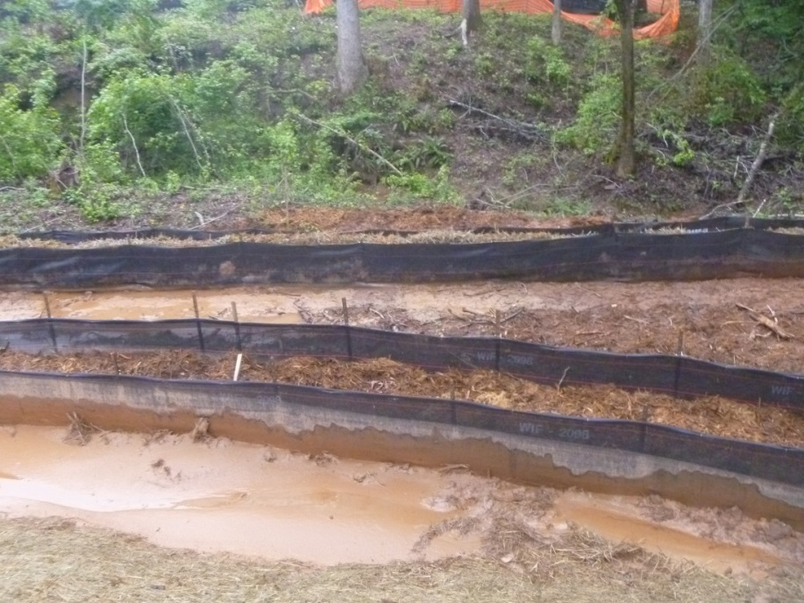
Chapter 6 - Revised BMP
Two rows of type S sediment barrier is still to be used along all state water and sensitive areas but it should be placed at least 36 inches apart.
Information is given about the static slicing and the traditional trenching method.
    This information came directly from EPA.
Sediment barriers shall be replaced whenever they have deteriorated to such an extent that the effectiveness of the product is reduced (approximately six months) or the height of the product is not maintaining 80% of its properly installed height.

Slide 23
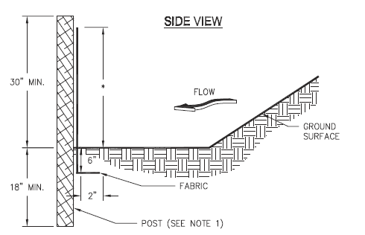
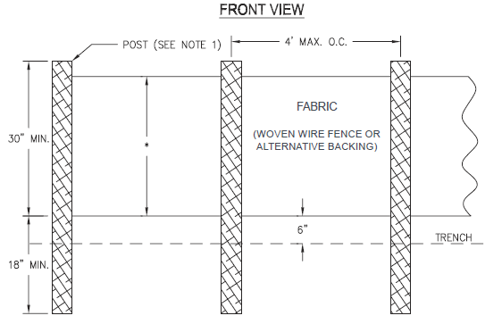
Chapter 6 - Revised BMP
Sediment Barriers (Sd1) incorporate bmps other than silt fence for perimeter control.
When a Sediment Barrier is used, the product height in inches for each barrier being used must be shown on the plans.
Sediment Barriers must be maintained at half their height regardless of size.

Slide 24

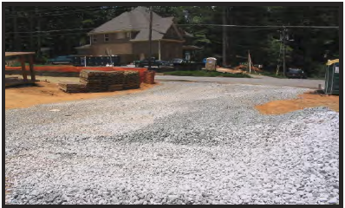
Chapter 6 - Revised BMP
Construction Exit (Co)
  Pad Length – The gravel pad shall have a minimum length of 50 feet. When the construction is less than 50 feet from the paved access, the length shall be from the edge of existing pavement to the permitted building being constructed.

Slide 25
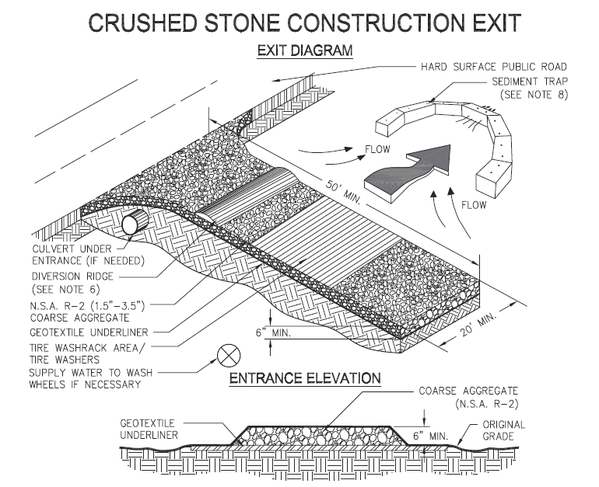
Chapter 6 - Revised BMP

Slide 26

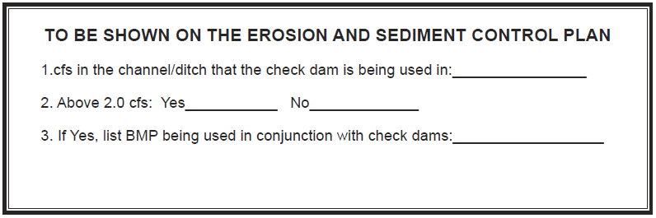
Chapter 6 - Revised BMP
Check Dam (Cd)
  Practices will be categorized as follows
    Stone Check Dams (CD-S)
    Straw-Bale Check Dams (CD-Hb)
    Compost Filter Sock (Cd-Fs)

Slide 27
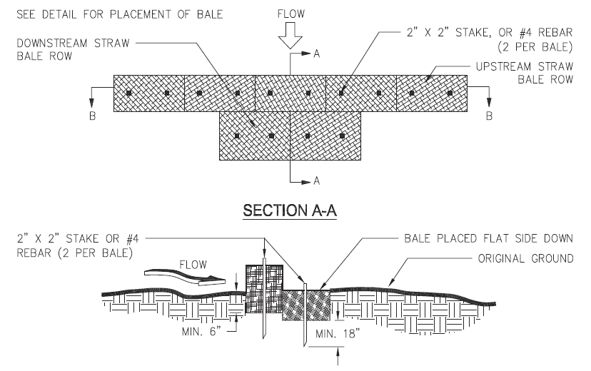
Chapter 6 - Revised BMP
Most notable change in check dams is the installation of the straw bale check dam.

Slide 28

Chapter 6 - Revised BMP
Channel Stabilization (Ch)
Products will be categorized as followed:
Category 1 (0-5 ft/sec) Vegetated Lining with Blankets
Category 2 (5- 10 ft/sec) Vegetated Lining with TRM or Rip Rap Lining
Category 3 (> 10 ft/sec) Concrete Lining
*equivalent shear stress can also be used.
Notes:
Talk about GADOT requirements equal

Slide 29

Chapter 6 - Revised BMP
Temporary Downdrain Structure (Dn1)
  For slopes steeper than 2:1, slope drains should be placed diagonally across the slope, extending the drain beyond the toe of the slope. Curve the outlet uphill and adequately protect the outlet from erosion.

Slide 30

Chapter 6 - Revised BMP
Retrofit (Rt)
  “A device or structure placed in front of a permanent stormwater detention pond outlet or roadway drainage structure to serve as temporary sediment filter.”
Silt Control Gate (Rt-Sg)
  May be used for temporary sediment storage on linear construction projects including roadway construction or maintenance, and utility line installation.
  Drainage area shall not exceed 50 acres.

Slide 31

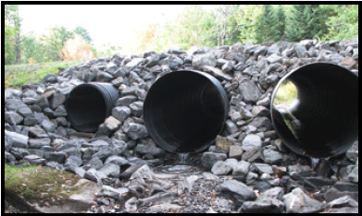
Chapter 6 - Revised BMP
Temporary Stream Crossing (Sr)
  Revised language
    “Temporary stream crossings should not be used on streams with drainage areas greater than one square mile (640 acres), unless specifically designed to accommodate the additional drainage area by the design professional.”

Slide 32
Chapter 6 – BMP Standards and Specifications for Land Disturbing Activities
Added seven new BMPs
Flocculants/Coagulants (Fl-Co) - (Vegetative)
Slope Stabilization (Ss) - (Vegetative)
Filter Surface Skimmer (Sk) - (Structural)
Seep Berm (SpB) - (Structural)
Temporary Sediment Trap (Sd4) - (Structural)
Turbidity Curtain (Tc) - (Structural)
Tree Protection (Tr) - (Structural)

Slide 33

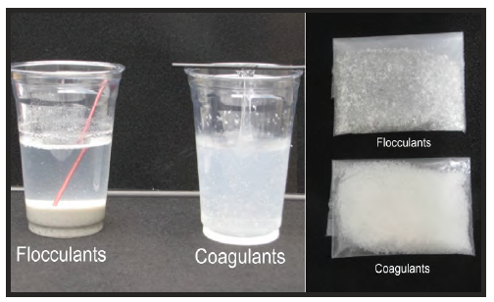
Chapter 6 New BMPs
Flocculants & Coagulants (Fl-Co)
  formulated to assist in the solids/liquid separation of suspended particles.
There will be no Fl-Co on the Equivalent BMP List. Any product may be used as long as it conforms to the criteria set forth in the Manual.
Only anionic forms shall be used.

Slide 34

Chapter 6 New BMPs
Floating Surface Skimmer (Sk):
  A skimmer drains the water from the top allowing cleaner less turbid water to discharge from the ponding area.
  An emergency spillway is required when using a skimmer.
  It should not be used in conjunction with Rt.
  It can replace the riser pipe as the principal spillway.
  If a skimmer cannot be used, a rationale/justification must be given.
Skimmers are 1 option to meet NPDES Part IV.D.3.a(3) requirement

Slide 35
Chapter 6 New BMPs
Floating Surface Skimmers require the following to be shown on the erosion control plan:
  Pond, trap or basin size, length in feet (top and bottom) width in feet (top and bottom) and depth in feet
  Time to Drain (hrs)
  Skimmer Dimensions (orifice and head size in inches)

Slide 36

Chapter 6 New BMPs
Seep Berm (SpB)
  A seep berm is a linear control device constructed as a diversion perpendicular to the direction of the runoff to enhance dissipation and infiltration of runoff, while creating multiple sedimentation chambers with the employment of intermediate dikes.
  To allow the 2 year storm event, 24 hour design storm to seep out while allowing larger flows to be diverted to a sediment storage area.
  If a fill berm is utilized it is very important that it has proper compaction and stabilization.
  Berm storage volumes can be figured as function of berm height and watershed gradient.

Slide 37
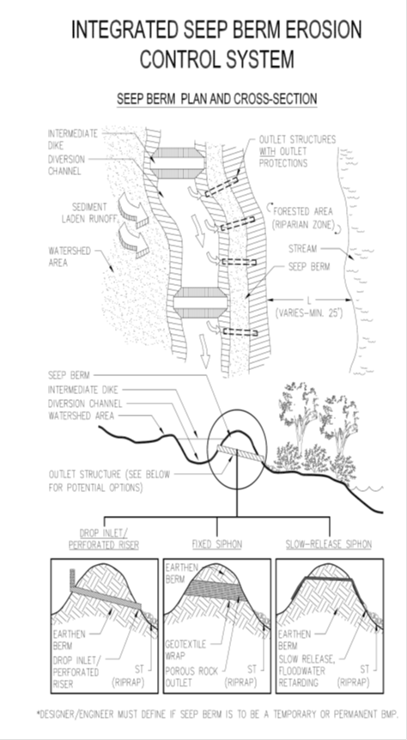
Chapter 6 New BMPs
Seep Berm require the following to be shown on the erosion and sediment control plan:
  A. Top of Berm Elevation*
  B. Bottom of Berm Elevation*
  C. Top of Berm Width *
  D. Height of the Berm*
  E. Seep Hole Diameter*
  F. Distance from the top of the berm to the seep to be placed in accordance with the 2yr-24hr storm*
  G. Type of Seep
PVC Metal Other(specify)
  H. Spacing of Seep Along the Berm*
* shown in feet

Slide 38

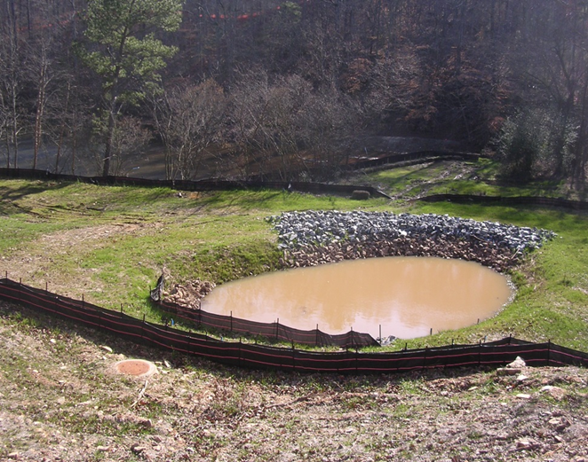
Chapter 6 New BMPs
Temporary Sediment Trap (Sd4)
  This BMP was added to provide sediment storage options for smaller sites.
  This is effective against course sediment, not silt or clay particles that remain suspended.
  All Sd4’s are to be cleaned out at 1/3rd full
  Provides three options:
    1. Temporary Sediment Trap
– Overflow
2. Temporary Sediment Trap
– Combination Outlet
3. Temporary Sediment Trap
– Rock Outlet
V = 0.4 x A x D

Slide 39
Chapter 6 New BMPs
1. Temporary Sediment Trap - Overflow (Sd4-A)
  An overflow temporary sediment trap is limited to small areas less than 1 acre.
  The maximum life span of an overflow trap is 6 months.
  Silt fence, straw bale barriers or grass filter strips are used to “polish” the overflow water as it leaves the sediment trap.

Slide 40
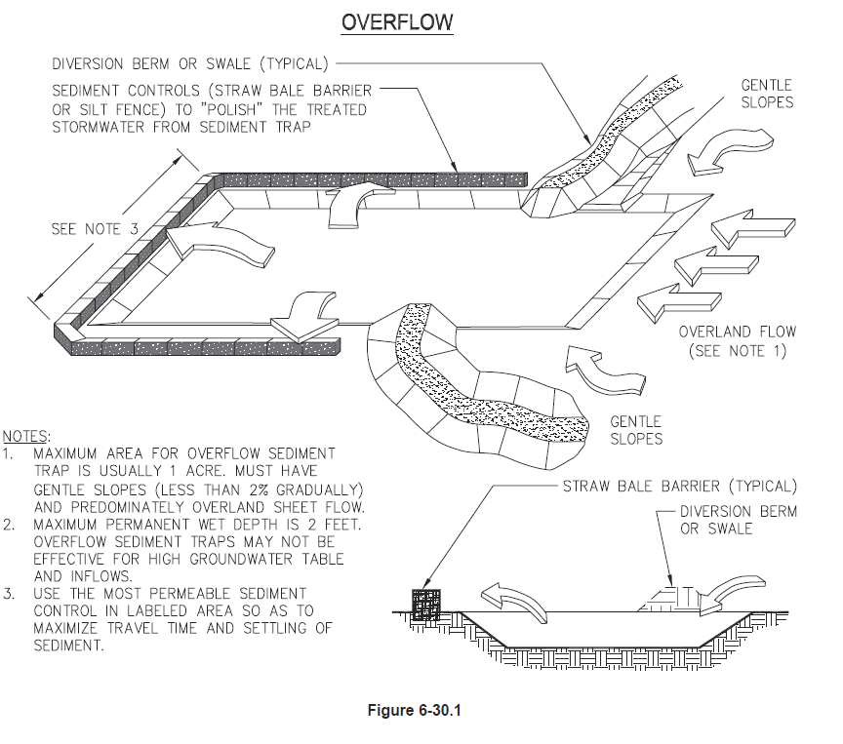
Sd4-A Detail

Slide 41
Chapter 6 New BMPs
2. Temporary Sediment Trap – Combination Outlet (Sd4-B)
  The combination outlet uses straw bales and silt fence to dewater the sediment trap.
  Proper installation and staking of the straw bales, and wire backing on the silt fence are required for the materials to resist 1 foot or more of ponded water.
  The combination straw bale and silt fence outlet is limited to 1 acre total drainage area, and has a life span of less than 1 year.

Slide 42
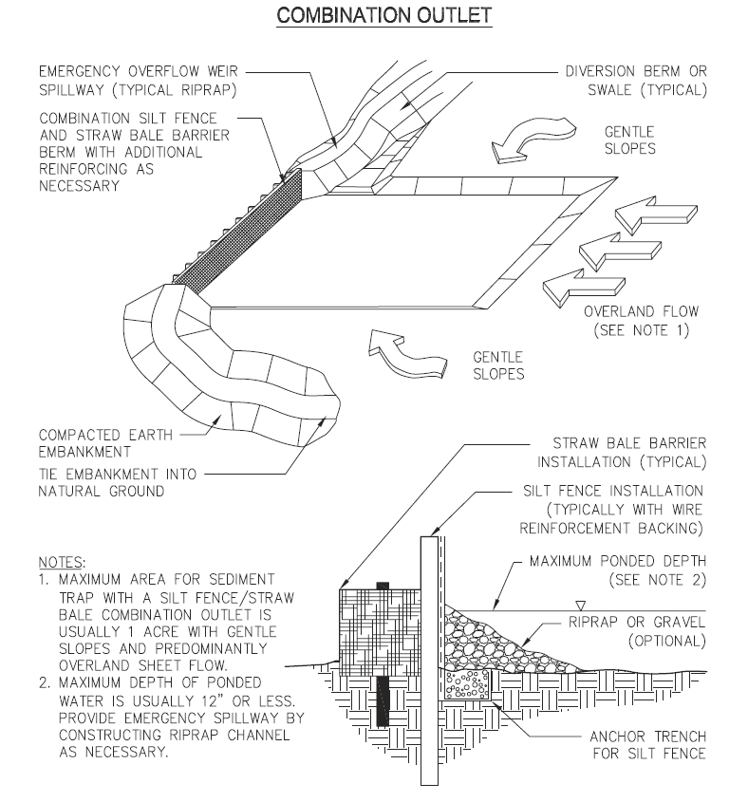
Sd4-B Detail

Slide 43
Chapter 6 New BMPs
3. Temporary Sediment Trap – Rock Outlet (Sd4-C)
  The rock outlet relies on filtering through layers of aggregate, rock or riprap material to dewater the sediment trap.
  It is the most sturdy of the sediment trap designs and generally requires less maintenance.
  It can be used for drainage area up to 5 acres and has a life span of 1 year.

Slide 44
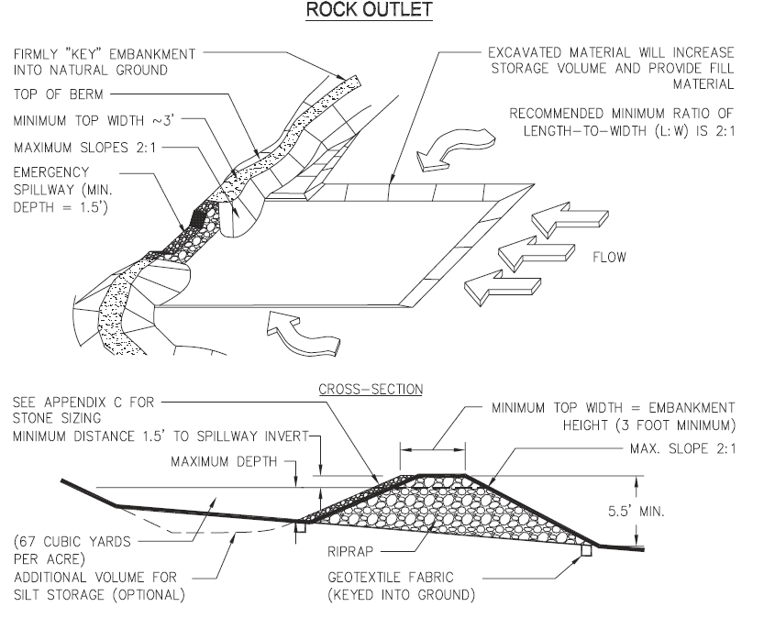
Sd4-C Detail

Slide 45
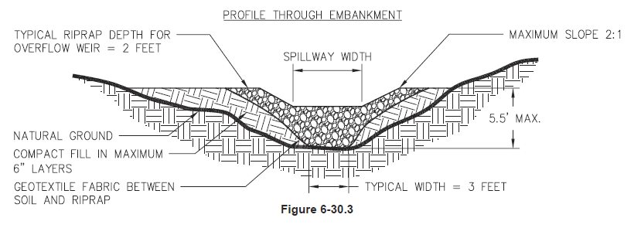
Sd4-C Detail

Slide 46

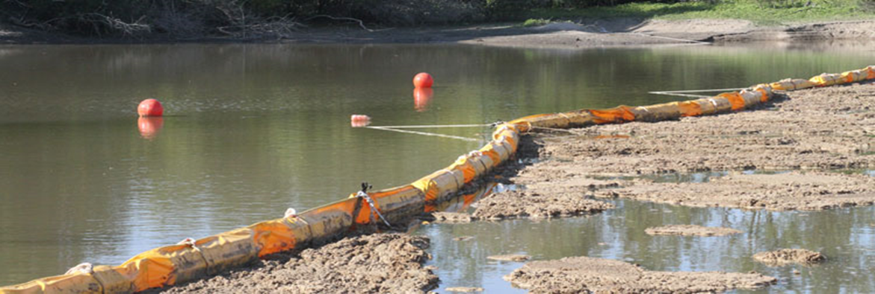
Chapter 6 New BMPs
Turbidity Curtain (Tc)
  A floating or staked barrier installed within the water. (It may also be referred to as a floating boom, silt barrier or silt curtain).
  Not to be used as sediment storage
  Turbidity Curtain is installed to minimize turbidity and silt migration from work occurring within the water or as a supplement to perimeter control BMPs at the water’s edge.
  Silt or turbidity is confined to the area within the boundary created by the installation, such that suspended particles drop out of the water column over time.

Slide 47
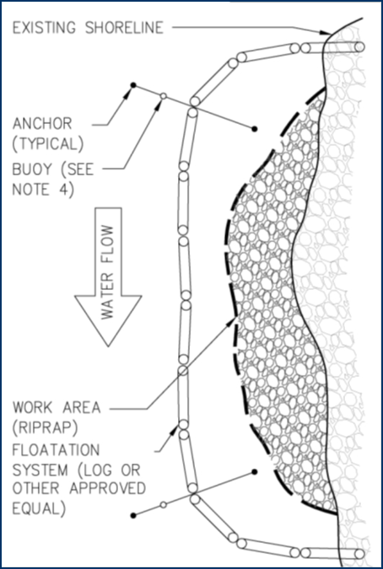
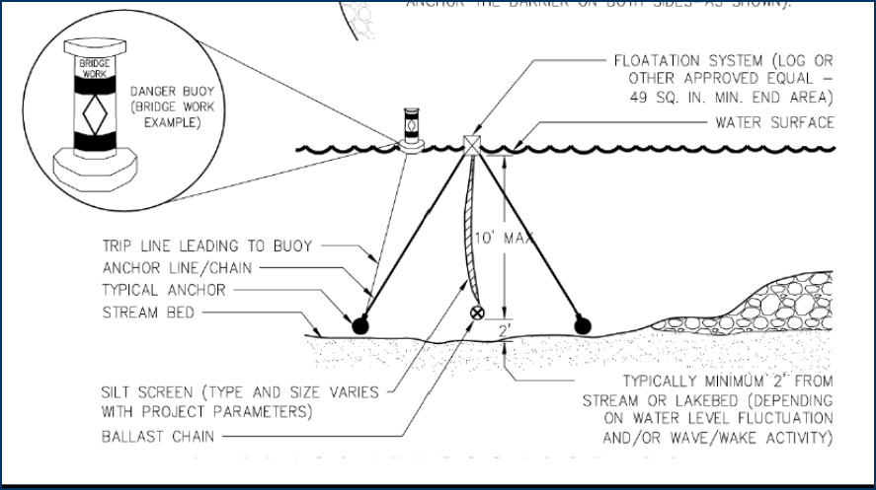
Chapter 6 New BMPs
Floating Turbidity Curtains Tc-F
Staked Turbidity Curtains Tc-S

Slide 48

Chapter 6 New BMPs
Tree Protection (Tr)
  To protect desirable trees from injury during construction activity.
  Tree Protection Zones:
(1) Measure the diameter of the tree trunk in inches at 4.5 feet from the ground. This is called the Diameter Breast Height or DBH.
(2) Multiply this value by1.5. This result is the diameter of the root protection zone in feet. This is also considered the critical rooting distance.

Slide 49
Transition Period – Plan Review
The GSWCC recognizes the need for a transition period to allow individuals time to understand and begin implementing the new requirements.
As part of this transition period, for a 6 month period, beginning January 1, 2016 and ending June 30, 2016, GSWCC will recognize the 5th and 6th Edition of the Manual along with the 2016 edition.
All plans which were completed and sealed prior to July 1st 2016 may utilize the products and practices as specified in the Manual (Fifth and Sixth Editions). These may include previously approved plans with revisions, plans which had not been previously approved but were in the review process, or new plan submittals created prior to July 1st 2016. Any plans received on or after July 1st 2016, are to utilize the new Manual (2016 Edition).
Notes:
Plan reviewer should not minor inconsistencies

Slide 50
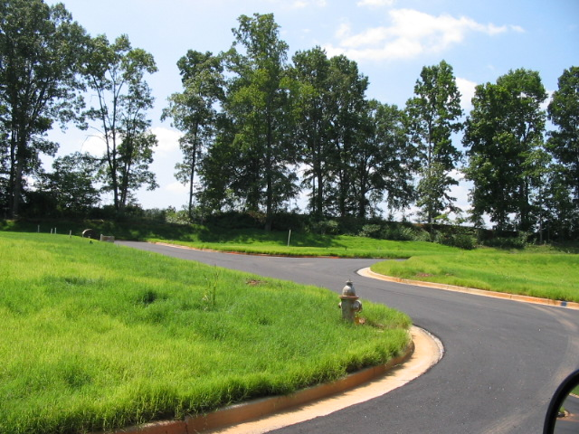
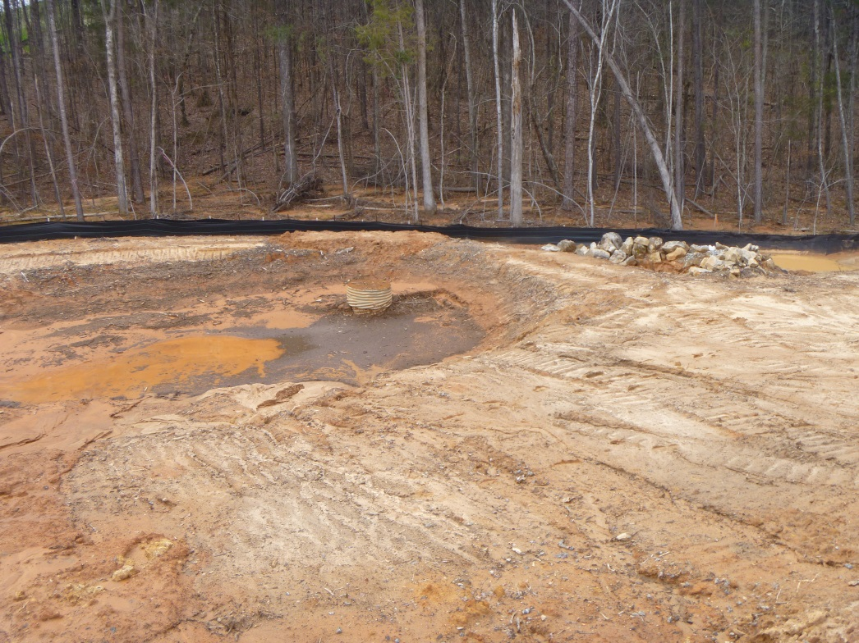
“If it’s green, it’s clean”
BMPs are used in series to provide a defense against erosion on land disturbance sites using both vegetative and structural measures
Notes:
Hard to beat the statement “If it is green it is clean”. Every single one of these bmps talked about and more can be used in a series to promoted clean water and compliance with the Federal and State laws.

Slide 51

Questions?
Urban Program
4310 Lexington Road
Athens, GA 30603
706-552-4474
GSWCC Manual - 2016 Edition

