Slide 1
Build to Last:
Using Geosythetic Cementitious Composite Mats (GCCM) Specified
to ASTM D8364 to Mitigate Stormwater and Erosion Issues
Applications and Case Histories

Slide 2
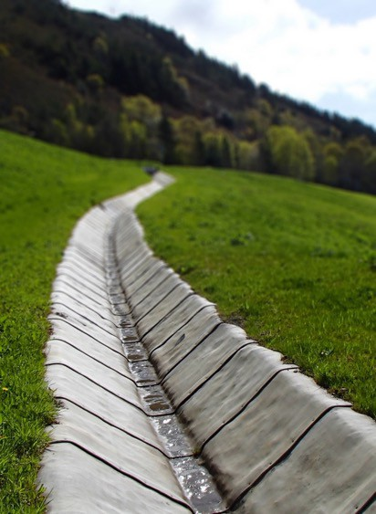
AGENDA
• Introduction to GCCMs
• Design Review – ASTM D8364
• Applications, Installation & Benefits
• 4 Principles
• Case Studies

Slide 3
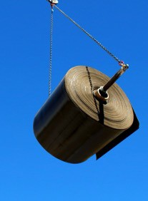
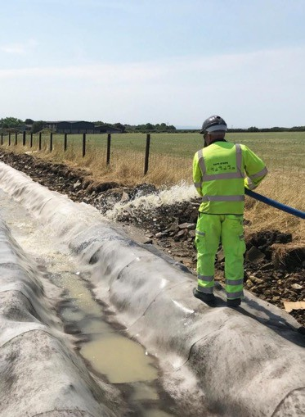
INTRODUCING GCCMs
What is a GCCM - Geosynthetic Cementitious Composite Mat
ASTM D4439:
A factory-assembled geosynthetic composite consisting of a cementitious material contained within layer or layers of geosynthetic materials that becomes hardened when hydrated.
It combines the flexibility of geotextile fabrics with the durability of
hardened concrete!
GCCMs can be used:
• When soft armor protection will NOT work ! (lack of vegetation or
don’t want vegetation)
• When hard armor is required
GCCMs cannot be used:
• Driveways and sidewalks
• Where there is daily traffic

Slide 4
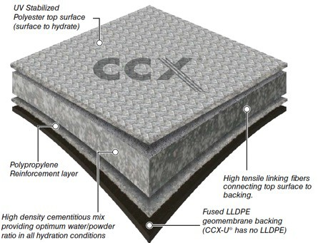
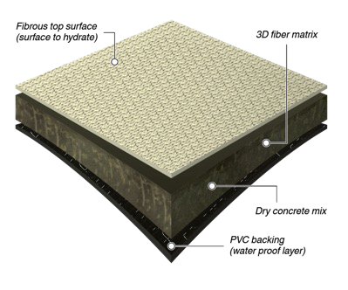
WHAT IS A GCCM ?
A flexible concrete filled geosynthetic that hardens when
hydrated to form a thin, durable waterproof concrete
layer.
GCCMs consists of:
- Dry concrete mix
- Geotextile layer(s)
3D Fiber Matrix
Two Nonwoven geotextiles stitched together
-Water impermeable lower surface
• Concrete is porous. Membrane prevents water
from permeating through the plane of the GCCM
• PVC for erosion control
• LLDPE for containment
It combines the flexibility of geotextile fabrics with the durability of hardened concrete!

Slide 5
AGENDA
• Introduction to GCCMs
• Design Review – ASTM D8364
• Applications, Installation & Benefits
• 4 Principles
• Case Studies

Slide 6
GCCM SPECIFIC STANDARDS
GCCM Specific Standards:
ASTM D8364 “Standard Specification for GCCM Materials”
ASTM D8030 ‘Standard Practice for Sample Preparation for GCCM’
ASTM D8058 ‘Standard Test Method for Determining the Flexural Strength of a GCCM Using the Three-Point Bending Test’
ASTM D8173 ‘Standard Guide for Site Preparation, Layout, Installation, and Hydration of GCCMs
ASTM D8329 ‘Standard Test Method for Determination of Water to Cementitious Materials Ratio for GCCMs and Measurement of the Compressive Strength of the Cementitious Material Contained Within’
ASTM D8479 ‘Standard Test Method for Determining Peel Strength of GCCM Materials’
ASTM D8480 ‘Standard Test Method for Determining Tensile Strength of GCCM Materials’

Slide 7
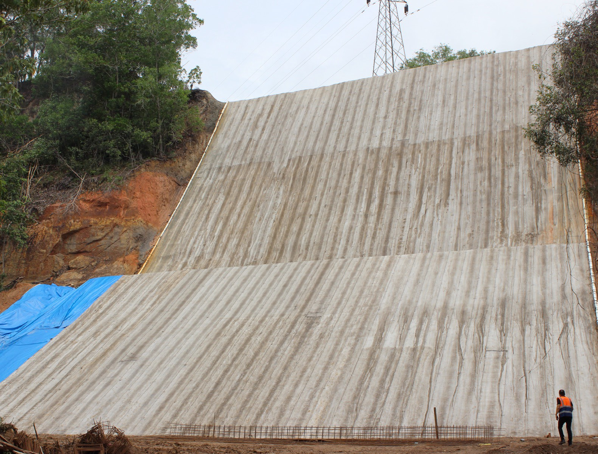
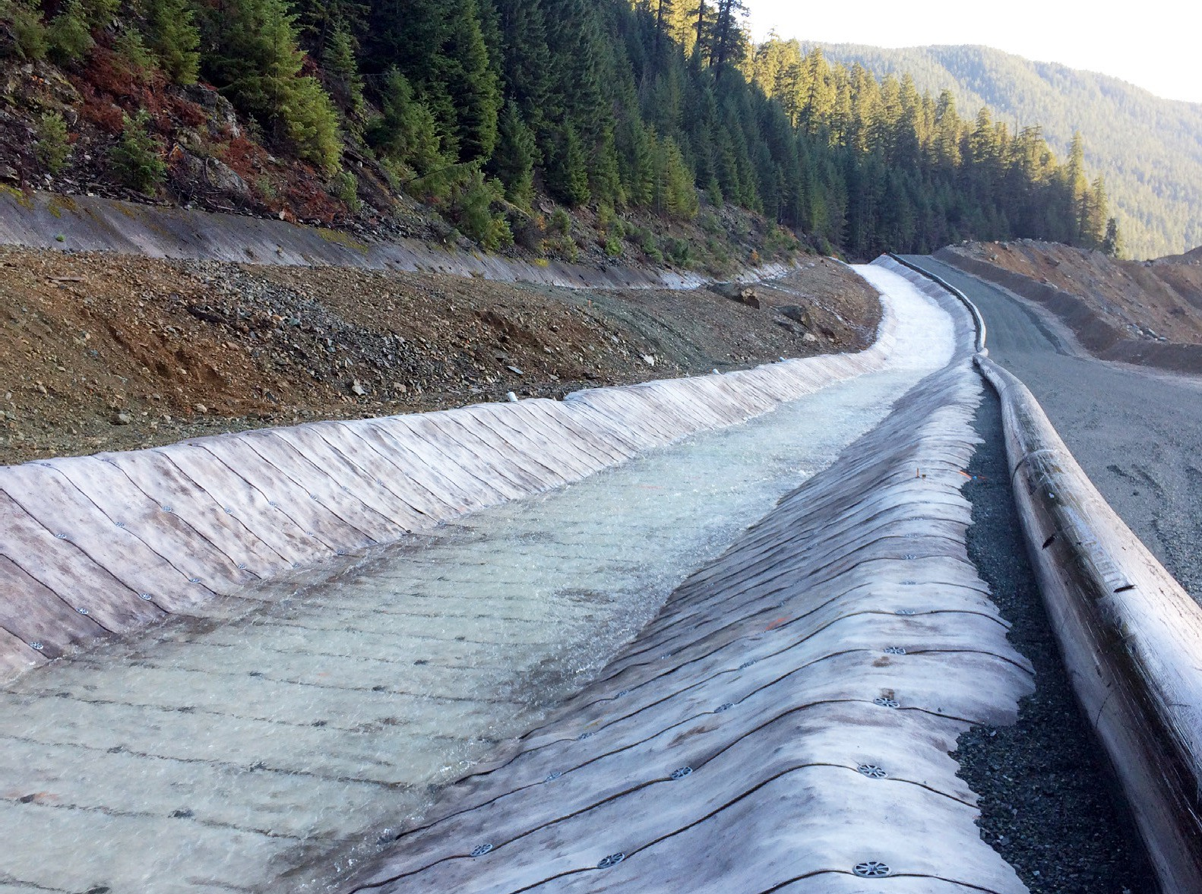
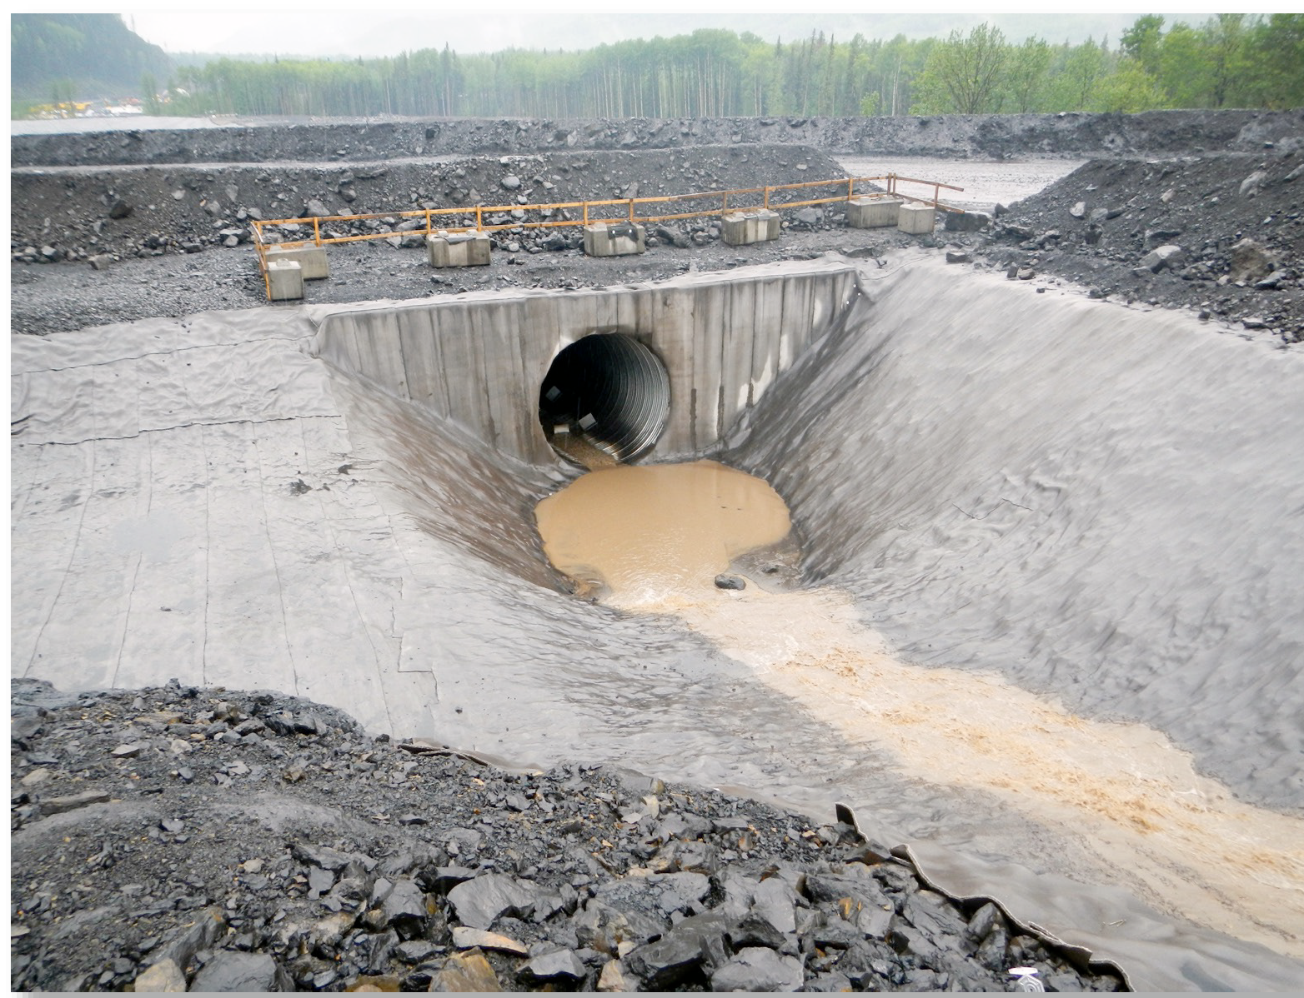
GCCM TYPES DEFINED IN ASTM D8364
Classification of GCCM Materials by Applications
Type I GCCMs:
Lowest requirements for abrasion and wear
For low shear stress and low flow velocity applications
Not subject to impact loads (traffic, heavy debris, wave action)
Installed over dense subgrades (concrete/rock)
Type II GCCMs:
Greater requirements for abrasion and wear
For higher shear stress and flow velocity applications
Subject to impact loads (and wave action)
Installed over medium dense subgrades
Type III GCCMs:
Where additional flexural strength is required due to loose subgrades or for more severe conditions
Higher grade types would be expected to be more durable and longer lasting than lower grade types in the same application, or for debris prevention expected.

Slide 8
PHYSICAL PROPERTIES COMPARISON - OVERVIEW
COMPARISON OF ASTM D8364 – GCCM TEST PROPERTIES
As concrete is a key component of a GCCM, compressive strength is of paramount importance. The compressive strength is directly related to a GCCM performance as it relates to:
Abrasion resistance
Flexural Strength
Freeze-thaw Durability
Chemical resistance
As shown in ASTM D8364, compressive strength below 5,800 psi is not suitable for GCCM applications
It is also important to ensure any compressive strength reported is tested to ASTM D8329 as this method was developed specifically for GCCM to model the worst case behavior of a field hydrated GCCM. It does not consider the best case precision as would be expected in a concrete mixing facility.

Slide 9
PHYSICAL PROPERTIES COMPARISON - OVERVIEW
COMPARISON OF ASTM D8364 – GCCM TEST PROPERTIES
Flexural strength is another important test for assuring a high quality GCCM. The flexural strength provides insight into how the material will perform as it relates to:
Compressive strength
Abrasion resistance
Freeze-thaw durability
GCCM with lower flexural strength are more likely to disintegrate over time due to a weaker concrete mix
GCCM with higher flexural strength are indicative of well constrained product with controlled water to cement ratios.

Slide 10
AGENDA
• Introduction to GCCMs
• Design Review – ASTM D8364
• Applications, Installation & Benefits
• 4 Principles
• Case Studies

Slide 11
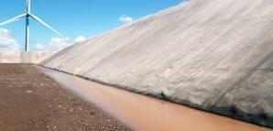
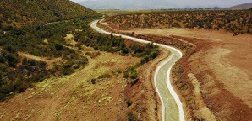
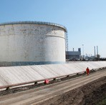
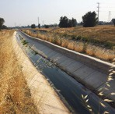
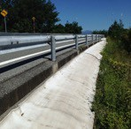
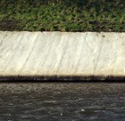
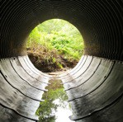
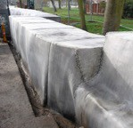
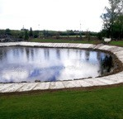
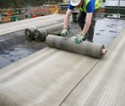
TYPICAL APPLICATIONS
EROSION CONTROL
CONTAINMENT
CHANNEL LINING
BERM LINING
REMEDIATION
WEED SUPPRESSION
SLOPE PROTECTION
CULVERTS
HARD ARMOR
SCOUR
OTHER?

Slide 12
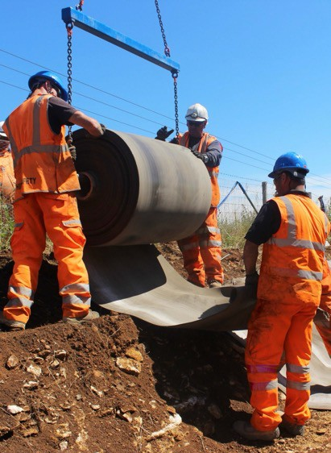
BENEFITS OVER TRADTIONAL METHODS
RAPID INSTALL
Up to 10x faster than conventional concrete. Up to 120 sf/mh (360-480 sf/hr/crew)
EASE OF USE
Minimal training required Low logistical footprint
Install in adverse conditions
LOWER PROJECT COSTS
More cost effective than any other conventional concrete solution
ECO FRIENDLY
Material savings of up to 90% Transport efficient
Low wash out rate, low alkaline reserve Embodied CO2 savings

Slide 13
VALUE PROPOSITION
LOW LOGISTICAL FOOTPRINT
1 Bulk Roll provides the equivalent coverage area of two 17T ready-mix cement trucks
Reduced vehicle movement
Reduced transportation CO2
Reduced health & safety risks

Slide 14
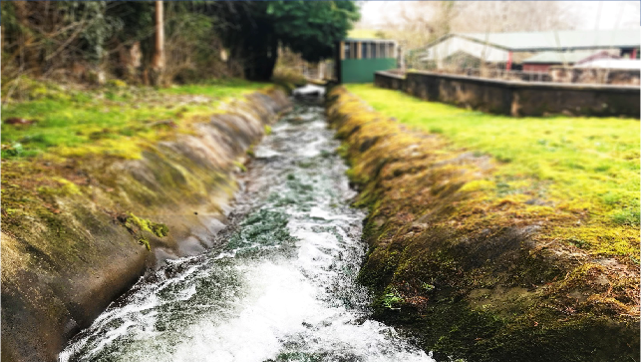
KEY BENEFITS
ECO-FRIENDLY
NRW
CHANNEL LINING
BRECON, WALES
2010
PUBLIC WORKS
Reformation of a creek taking
run-off water from a salmon hatchery in South Wales.
Attracts naturally occurring bio-mass
Organic contours
Safely discharged into adjacent river
Low embodied carbon

Slide 15
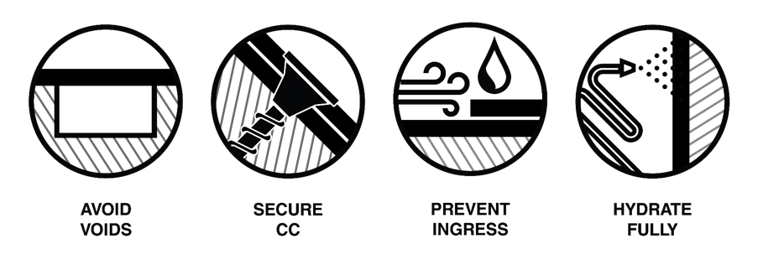
4 INSTALLATION PRINCIPLES - REVIEW

Slide 16
4 INSTALLATION PRINCIPLES - REVIEW

Slide 17
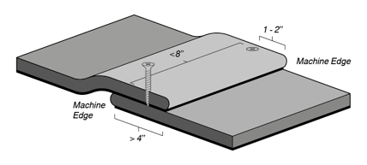
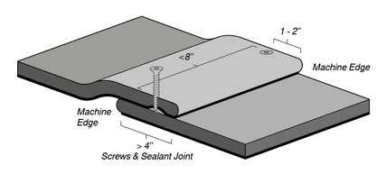
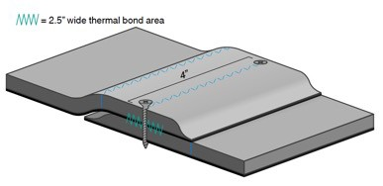
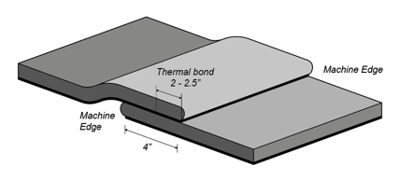
4 INSTALLATION PRINCIPLES - REVIEW
Screwed Joint
Screwed & Sealed Joint
Thermal Bonding with Screws
Thermal Bonding

Slide 18
4 INSTALLATION PRINCIPLES - REVIEW

Slide 19
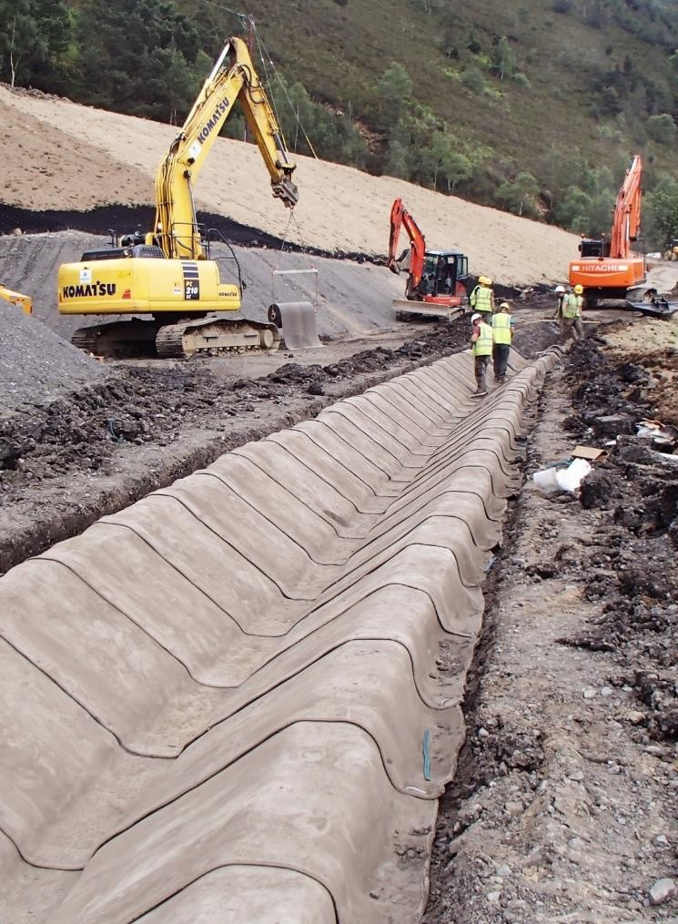
4 INSTALLATION PRINCIPLES - REVIEW
ANCHORS
To a soil substrate;
Pegs
Galvanized J-Pegs
Length of 10”
Inserted through overlapped GCCM layers within anchor trench
Anchor Trenching
Essential for the majority of installations
Prevent undermining from water and wind uplift
Provide a neat termination
Minimum dimensions 6” x 6” x 6”
Typically used in conjunction with pegs
Intermediate Anchors
Required for high load applications or poor ground conditions
Specification by certified geotechnical engineer

Slide 20
4 INSTALLATION PRINCIPLES - REVIEW

Slide 21
METHOD OF HYDRATION
METHOD OF HYDRATION
Spray the fiber surface with water until it feels wet to touch
for several minutes after spraying.
Notes:
GCCM will set underwater. An excess of water is always recommended
GCCM must be actively hydrated. Do not rely on rainfall or snowmelt
Do not jet high pressure water directly onto the GCCM as this may wash the concrete powder contained in the unset GCCM
GCCM has a working time of 1-2 hours after hydration. Do not move or traffic GGCM once it has begun to set
Working time will be reduced in warmer climates and increased in very cold climates
GCCM will set hard in 24 hours but will continue to gain strength over time

Slide 22
AGENDA
• Introduction to GCCMs
• Design Review – ASTM D8364
• Applications, Installation & Benefits
• 4 Principles
• Case Studies

Slide 23
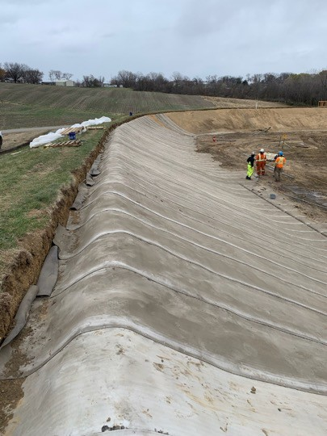
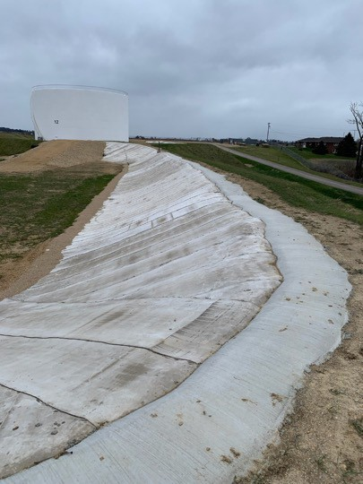
TYPICAL BERM APPLICATION – SECONDARY CONTAINMENT

Slide 24
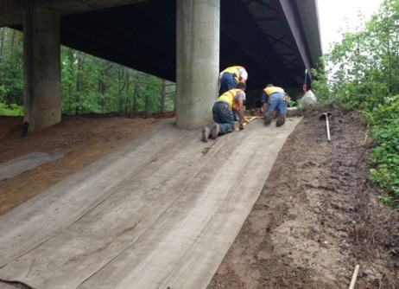
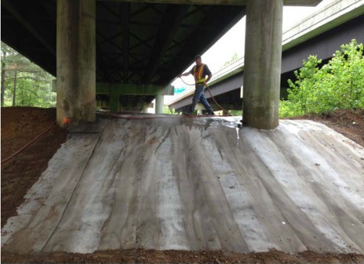
SLOPE PROTECTION APPLICATION
Cumberland County, NC 2013
Type 1
Slope under overpass so unable to get grass established
Preferred over rip-rap as no heavy equipment was required
Were able to use in-house maintenance team for installation
Installation took about 2 hours

Slide 25
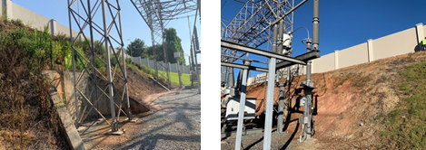
SLOPE PROTECTION / EROSION CONTROL
ENVIRONMENTAL APPLICATIONS
GA Power Project 2023 Norcross GA – 15,000 SF Type 1
Slope had to be graded and vegetation removed.

Slide 26
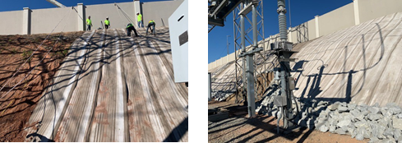
WHAT IS A GCCM ?
SLOPE PROTECTION / EROSION CONTROL
ENVIRONMENTAL APPLICATIONS
GA Power Project 2023 Norcross GA – 15,000 SF Type 1
Difficult to access area. Rolls had to be cut to size behind the 12’ wall and transported over for installation. Installation crew tethered to wall for safety due to steep slope.

Slide 27
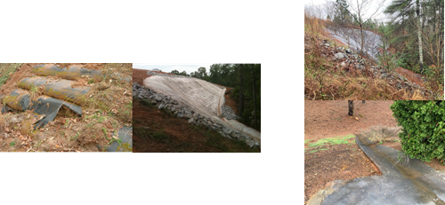
SLOPE PROTECTION – ENVIRONMENTAL APPLICATIONS
Landfill Project, Southeast, SC 2012 - 8,000 SF
Type 2
10 YEARS LATER

Slide 28
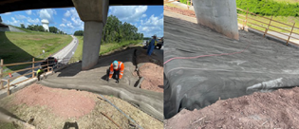
CONCRETE REPAIR AND REMEDIATION
HWY 147, NC 2021
Type 1
3 locations requiring repair or remediation
Type 1 was chosen over concrete due to cost, time, and limited site access

Slide 29
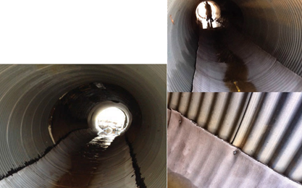
CULVERT REPAIR
Butler County AL 2013
Type 2
72” dia.
3@ 20’ length (60’ total)

Slide 30
WHAT IS A GCCM ?
Drainage channel in residential area
About 180’ long
Became silted up during heavy storms
Installation took less than 4 hours
Other ditches were lined last year after
success of initial pilot project in 2022

Slide 31
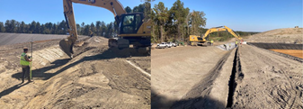
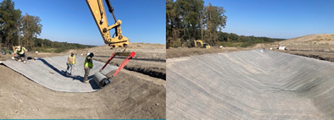
CHANNEL APPLICATION FOR LANDFILL
Installation Process for Landfill in Mansfield LA 2024:
Excavate Channel
Excavate Anchor Trenches
Deploy Material
Join and Anchor Material
Hydrate

Slide 32
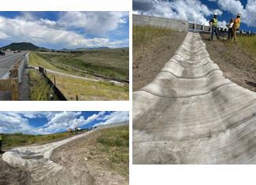
DITCH APPLICATION
DITCH LINING – COLORADO DOT 2022
Larkspur, CO
Type 2
600 SF
Erosion control for runoff highway drainage
GCCM chosen as alternate materials such as piping could clog and GCCM was faster and did not require lane closures like conventional concrete.
Installed in a single day
Filled sandbags were installed under the CCT2
to slow water

Slide 33
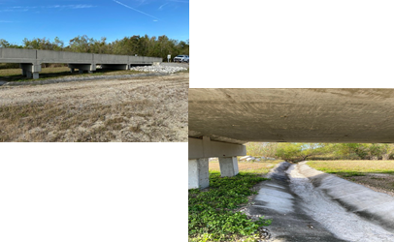
CHANNEL APPLICATION – 5 year aging case study
DITCH LINING
New Orleans Flood Protection Authority 2017
Type 1

Slide 34
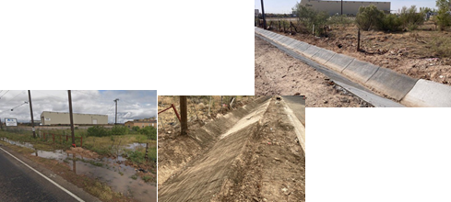
DRAINAGE APPLICATION
HIGHWAY 20 Midland, TX 2023
Type 2
Drainage ditch to divert stormwater along highway
Type 2 GCCM was chosen in lieu of concrete and rip-rap due to cost and speed of installation
Installation of 1,800 sf took 2 hours
Meeting our schedule is very important to us. Some of our products require thousands of cubic yards of concrete for drainage and rip rap applications. GCCM will allow us to greatly speed up the installation process and help us meet our schedule.”
Juan Gasca - Corporate Project Controls Manager, Pulice Construction

Slide 35
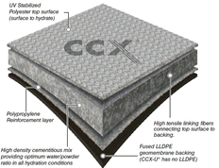
HENRY MILLER IRRIGATION DISTRICT
MATERIAL SELECTION
GCCM was chosen for many reasons:
Faster installation
More cost effective
Able to withstand differential settlement - up to about 15%
Self-installation – no outside contractors, no specialized equipment
Long design life – 50 years

Slide 36
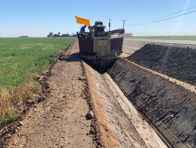
HENRY MILLER IRRIGATION DISTRICT
SITE PREPARATION
The existing concrete was first installed more than 20 years ago and was badly cracked.
As a result, the existing concrete was removed and the canal reprofiled prior to installation.

Slide 37
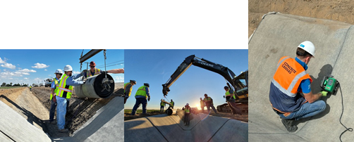
HENRY MILLER IRRIGATION DISTRICT
INSTALLATION
Rolls were deployed across the invert of the canal with a spreader bar and cut to length
Because decreased water loss was the goal, joints were thermally bonded using an automated hot air welder

Slide 38
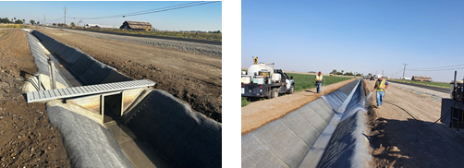
HENRY MILLER IRRIGATION DISTRICT
INSTALLATION
The canal contained gates, valves and termination to existing concrete.
After the rolls were joined and installation was completed for the day, the material was hydrated with a water truck.

Slide 39
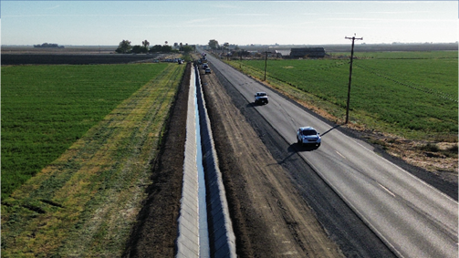
HENRY MILLER IRRIGATION DISTRICT
PROJECT COMPLETE
The installation of 30,000 sf took 3.5 days
The lined canal was 1,440 ft
Testing performed after canal was filled, indicated water loss was reduced by more than 96%

Slide 40
CONCLUSION
DESIGN & BID
Specification & Quoting
INSTALLATION
4 principals
USE ASTM D8364
SPECIFY QUALIFIED INSTALLERS – GCCM AND/OR SIMILAR
LET US KNOW ABOUT THE PROJECT

Slide 41
CONCRETE CANVAS USA Inc.
1350 East Nasa Pkwy
Suite 120
Houston TX 77058
NATHAN IVY
Technical Manager
Cell: 281-761-3766
Email: Nathan.ivy@concretecanvas.com

