Slide 1
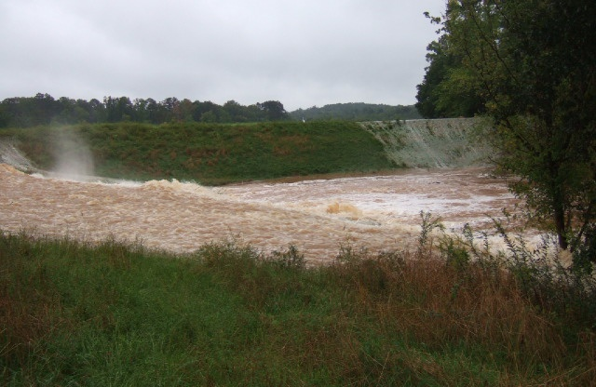
Watershed Dams in Georgia

Slide 2
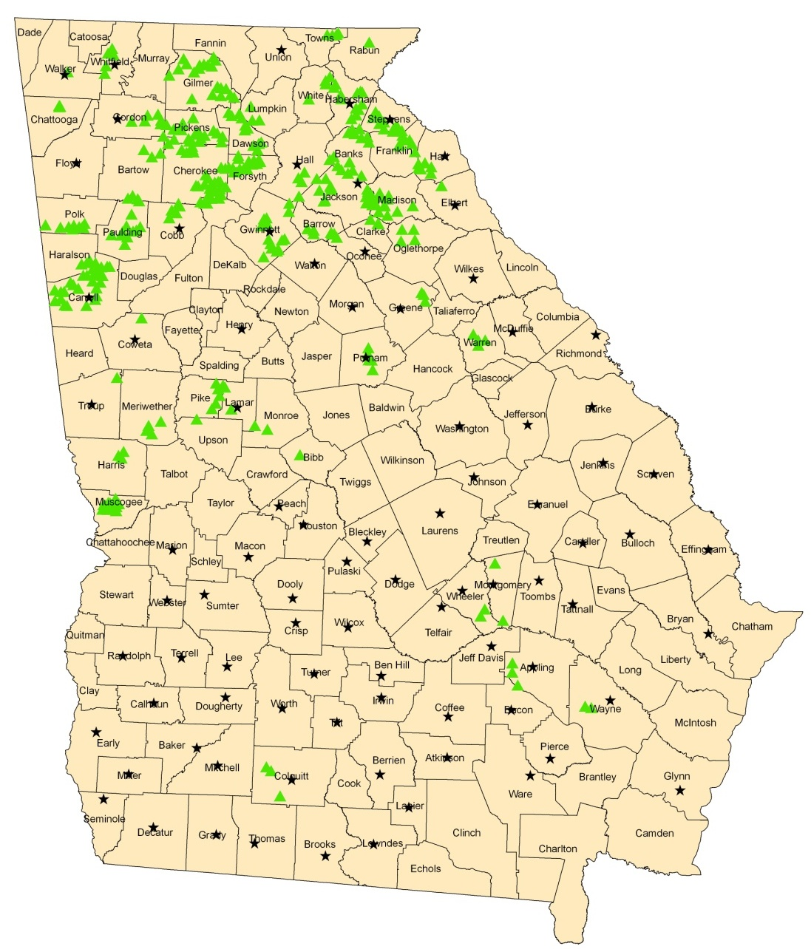
Watershed Dams in Georgia
  357 Total
  195 High Hazard (NRCS)
  NRCS constructed – owned by local sponsors
  Most built between 1950s-1970s for flood control
  NRCS continues to provide technical assistance to sponsors

Slide 3
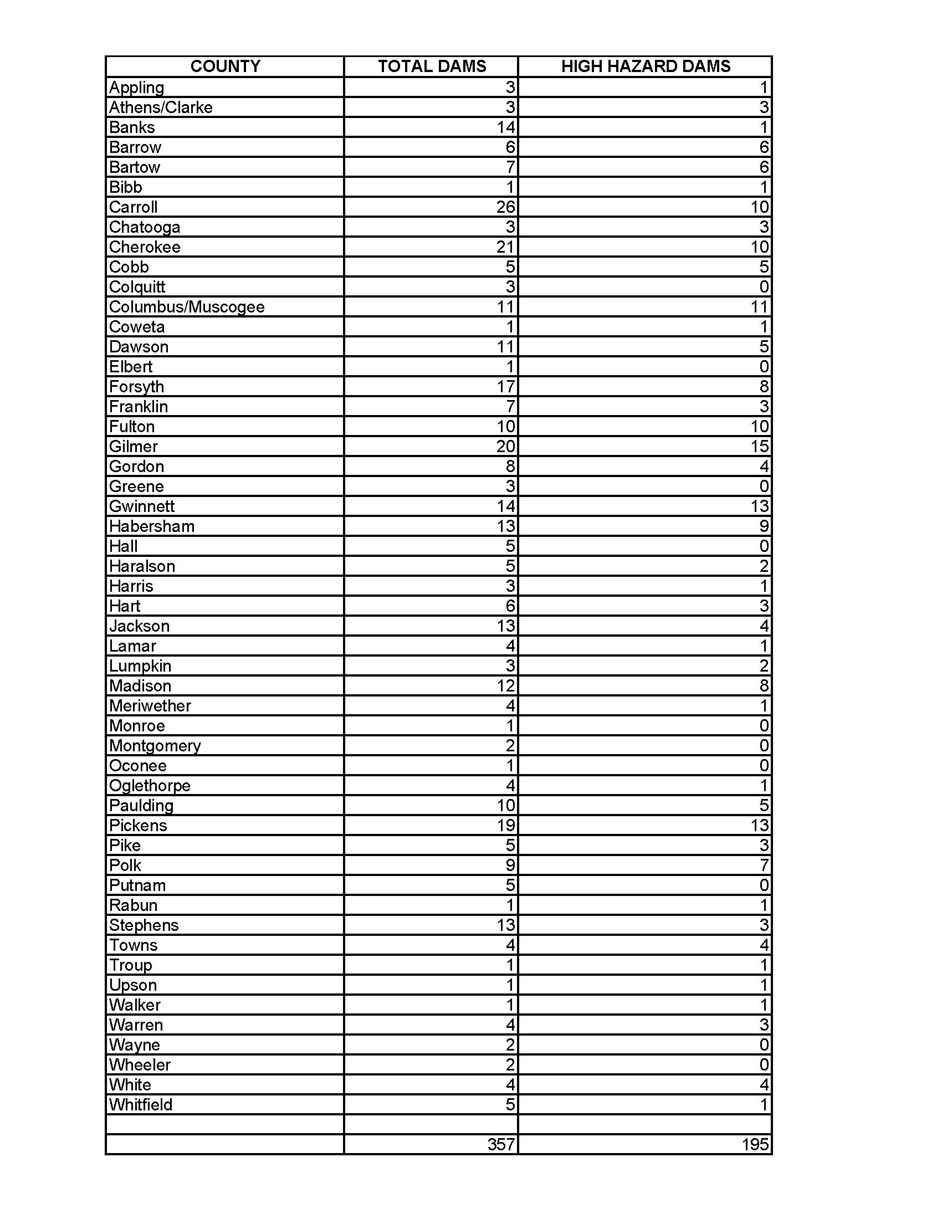

Slide 4
Watershed Dams in Georgia
Estimated $1.5 billion in infrastructure and 3,750 bridges below NRCS watershed dams
277,094 acre-feet of total flood storage
Drainage areas range from 87 to 115,520 acres (average size is 5 square miles or 3200 acres)
Height ranges from 11 to 87 feet

Slide 5
NRCS Policy requires an NRCS engineer to complete a formal engineering inspection every 5 years.
The sponsor responsible for operation and maintenance of the dam should conduct inspections between the formal inspections.

Slide 6
If the watershed dam is a Category I structure (state of Georgia), Georgia Safe Dams will inspect it every other year. Safe Dams expects the sponsors to do inspections 4 times a year on these structures with 1 of those inspections completed by an Engineer of Record.
In addition to the formal inspections NRCS will assist the sponsor(s) with responding to technical questions that arise from Georgia Safe Dams inspections.
However NRCS will not do the yearly inspection of Category I structures.

Slide 7
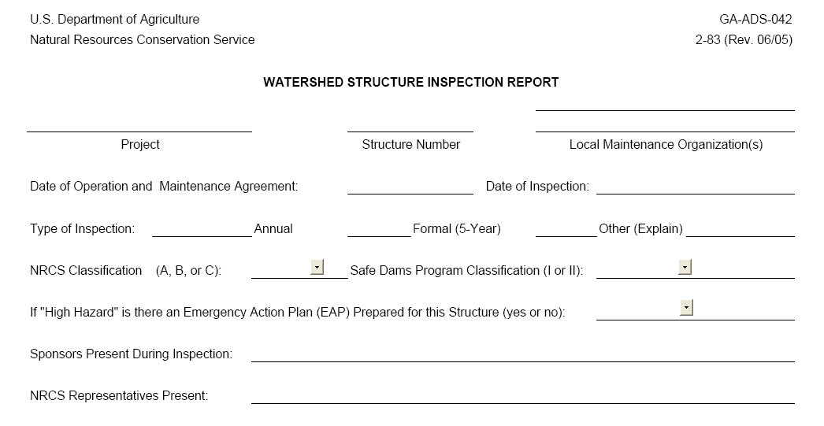

Slide 8
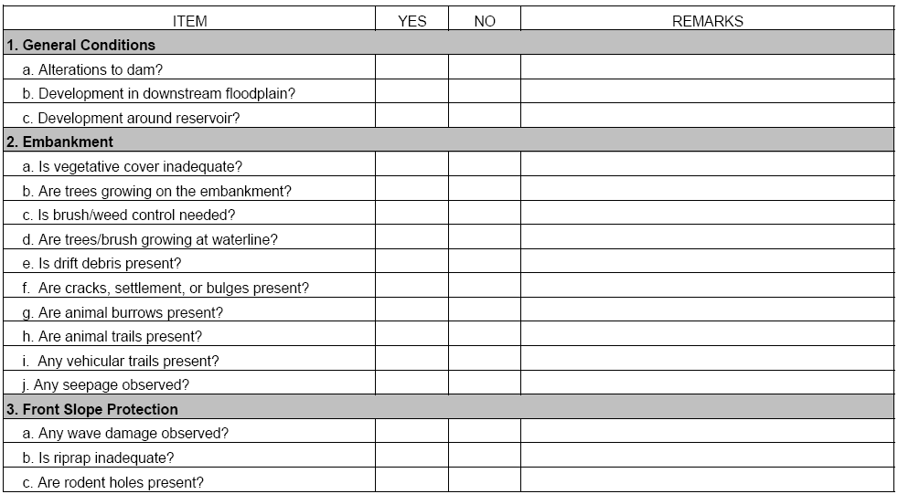

Slide 9
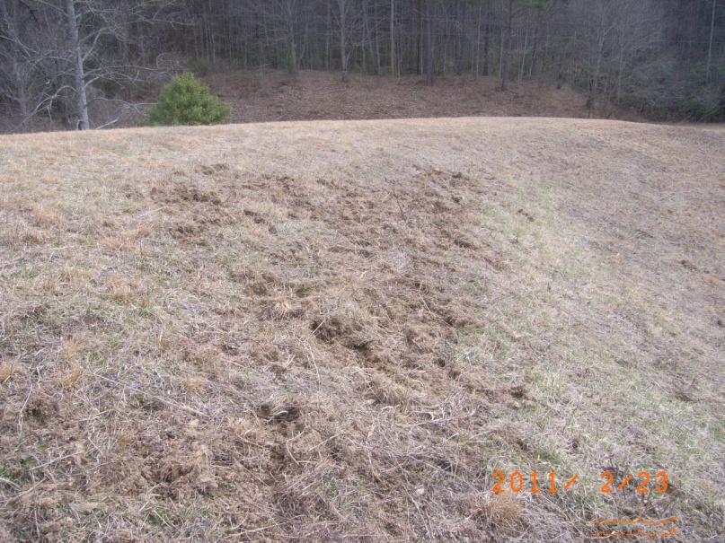
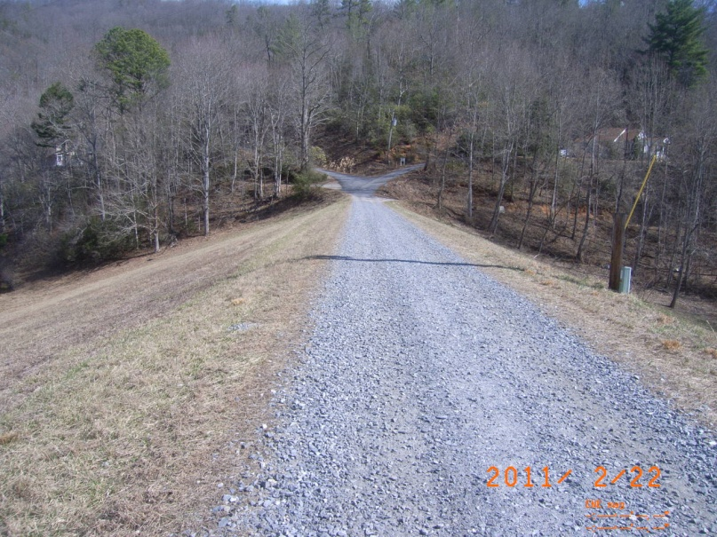
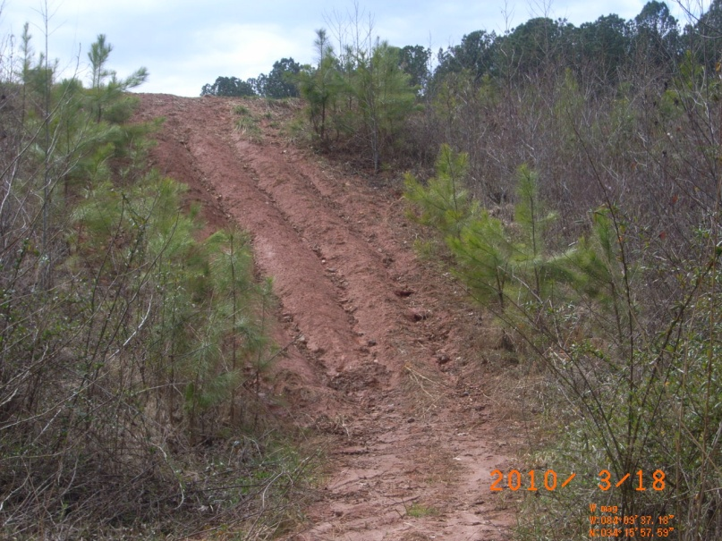
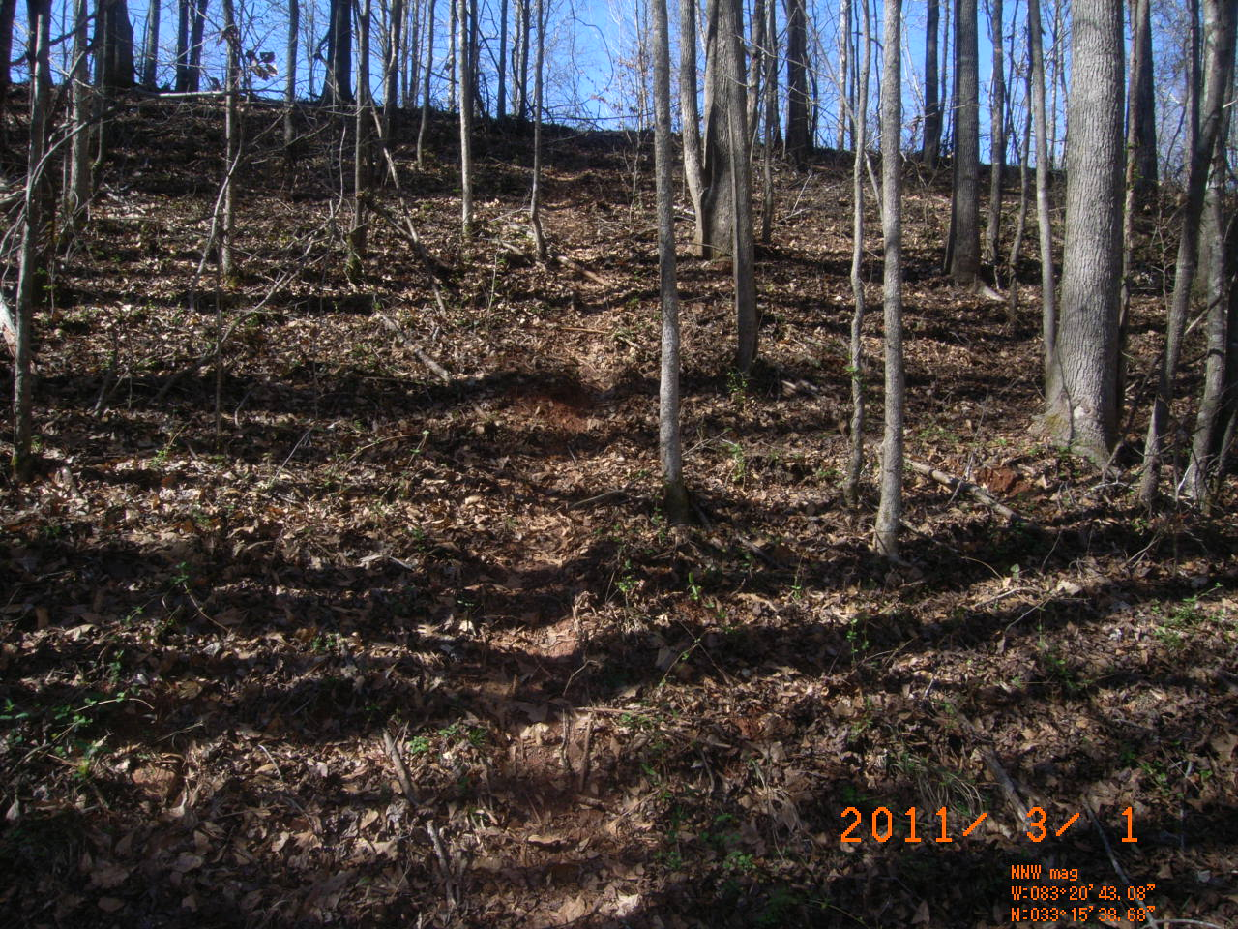
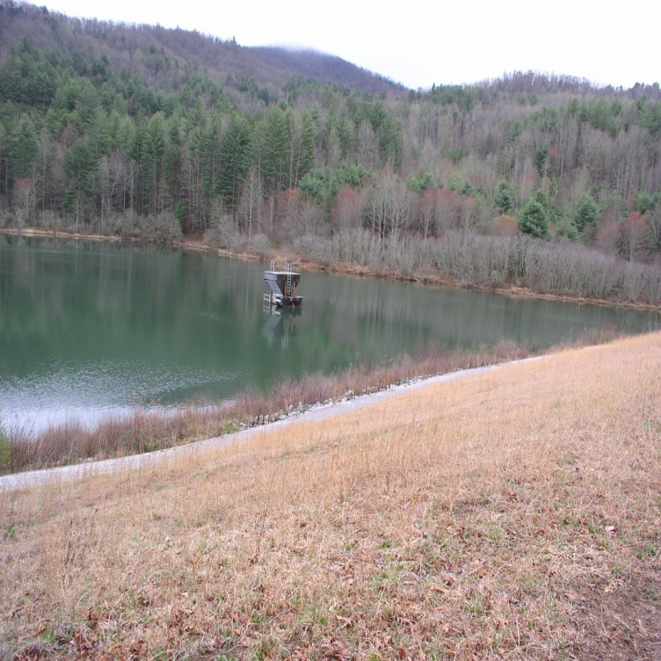
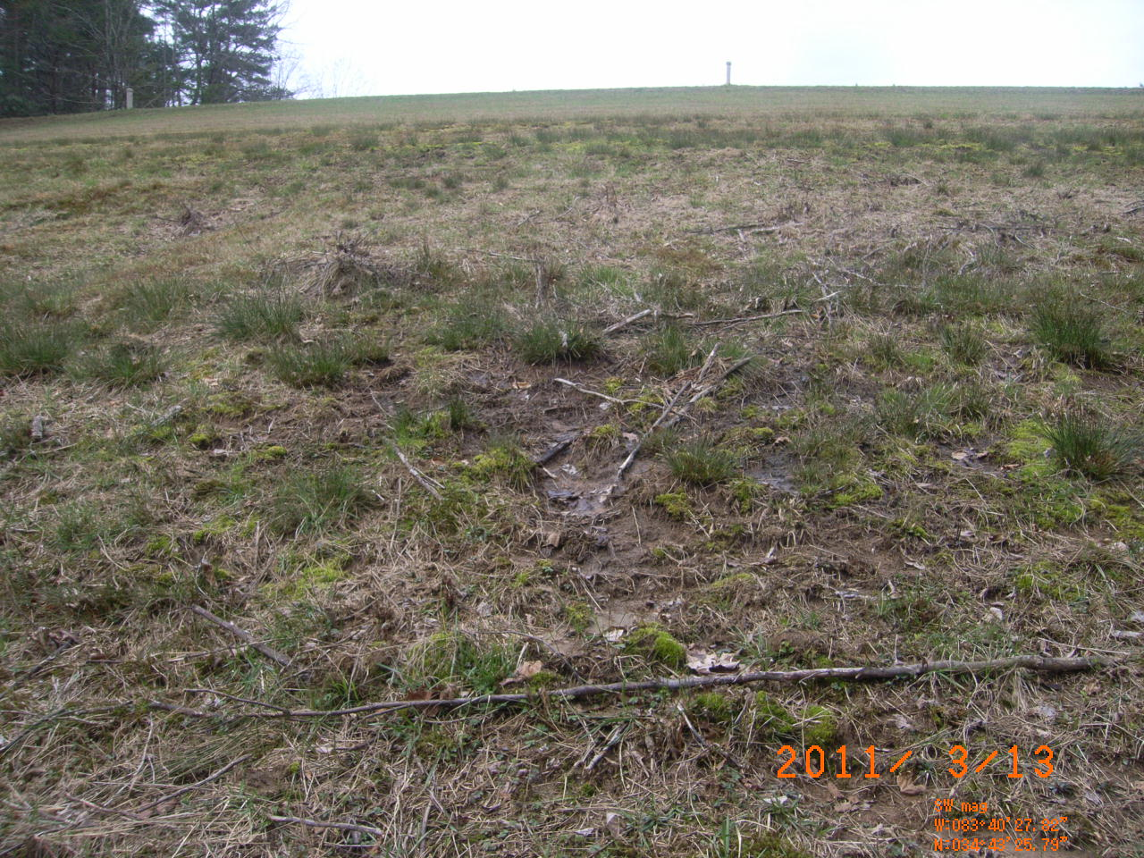

Slide 10
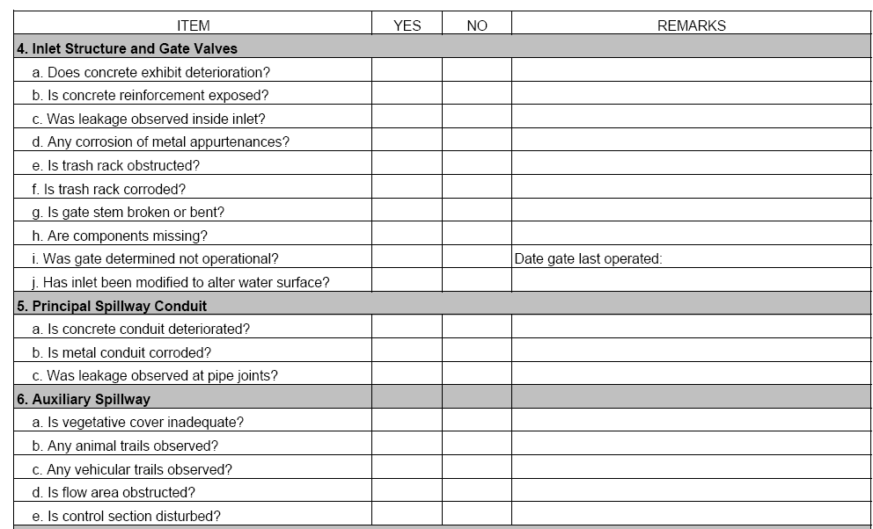

Slide 11
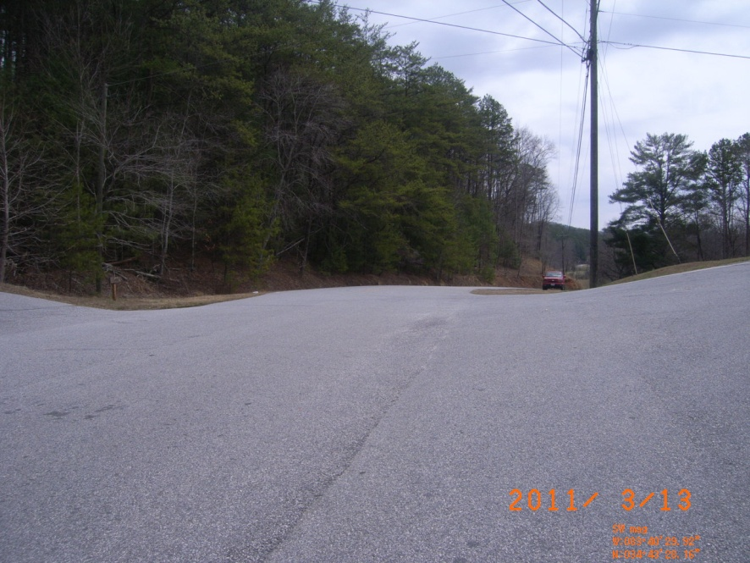
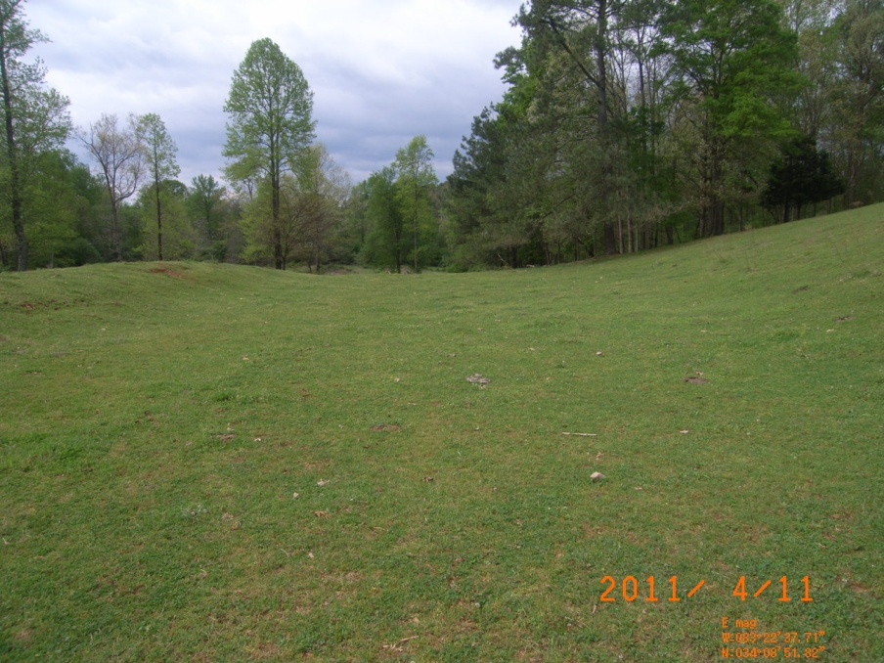
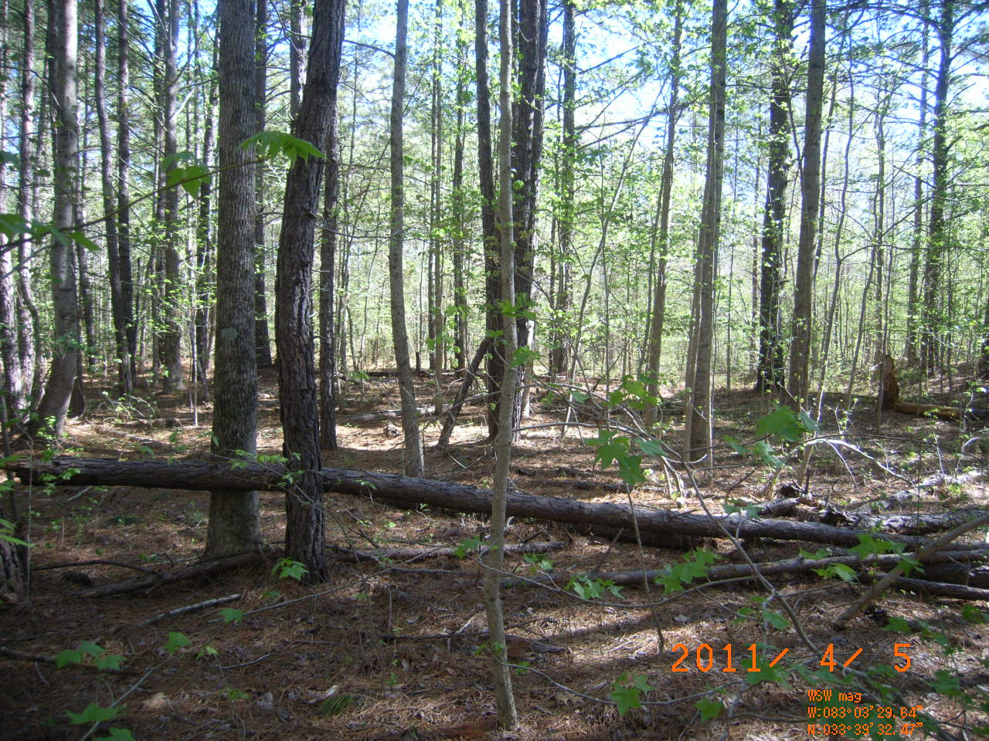
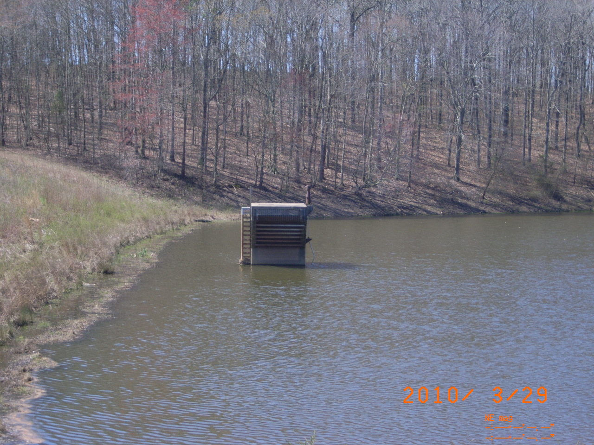
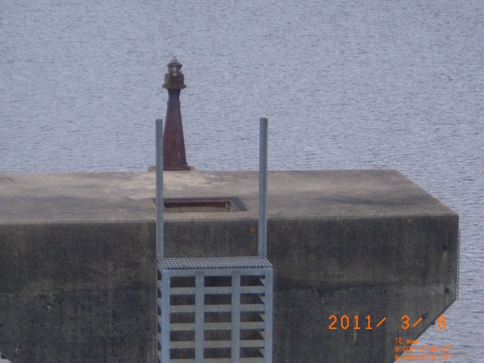
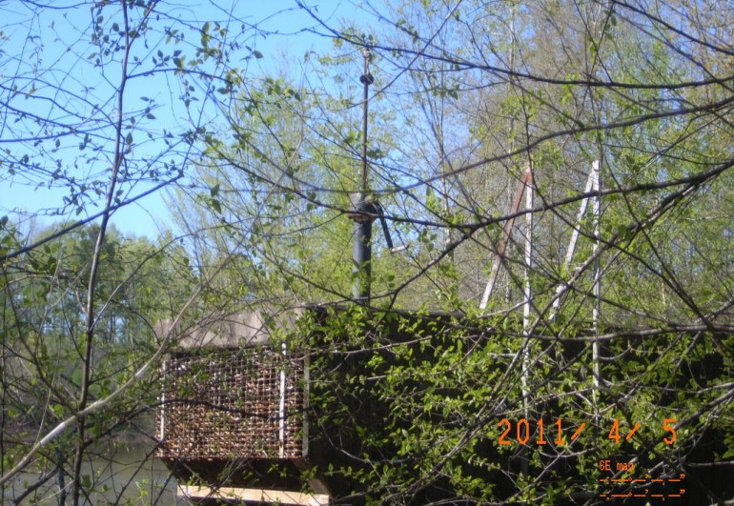

Slide 12
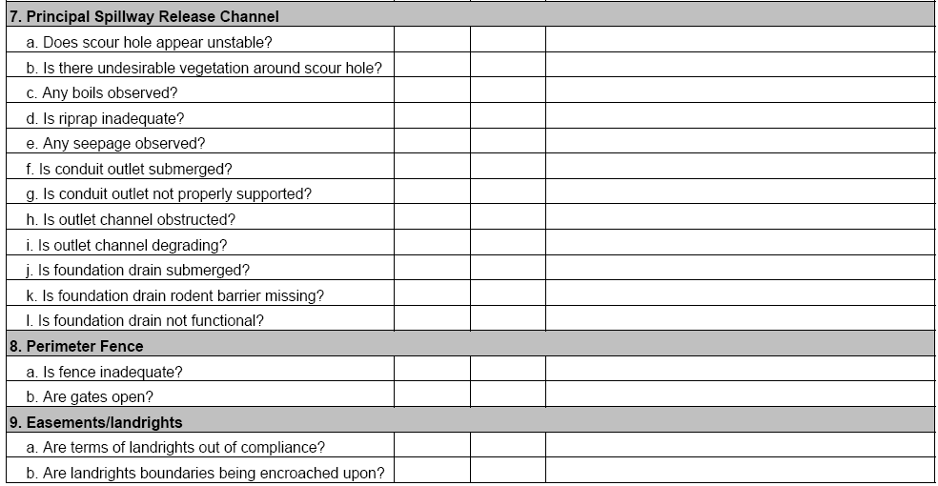

Slide 13
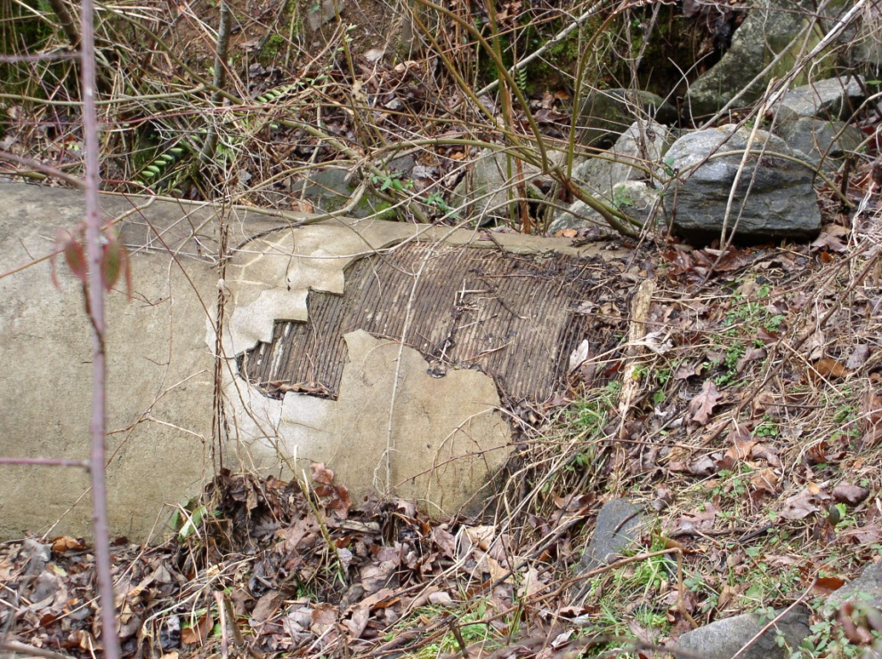
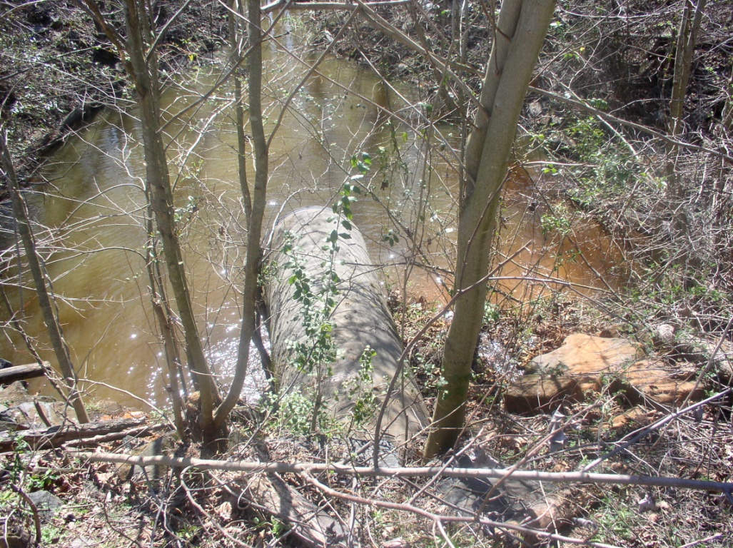
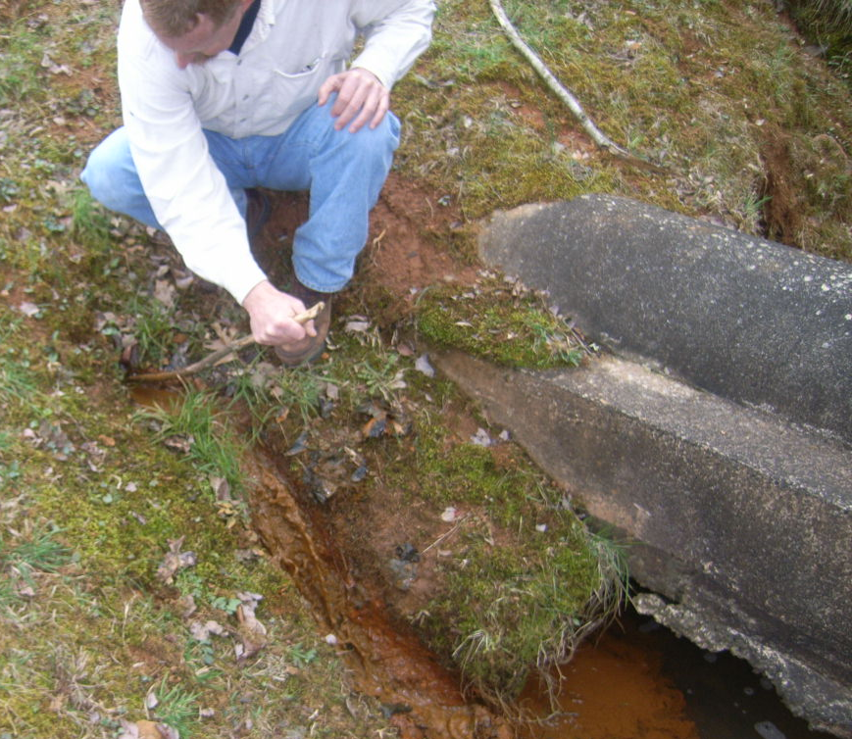
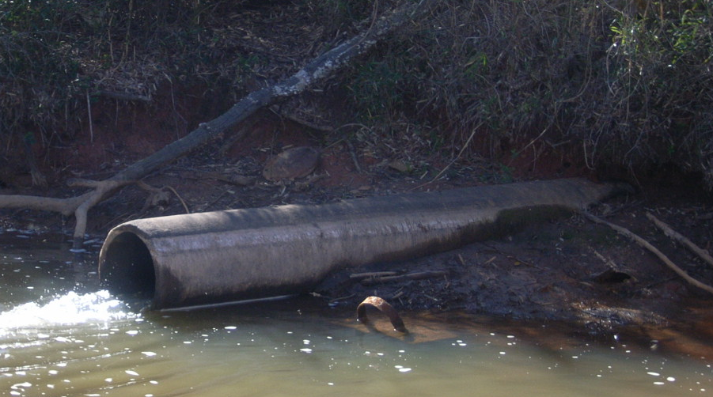

Slide 14
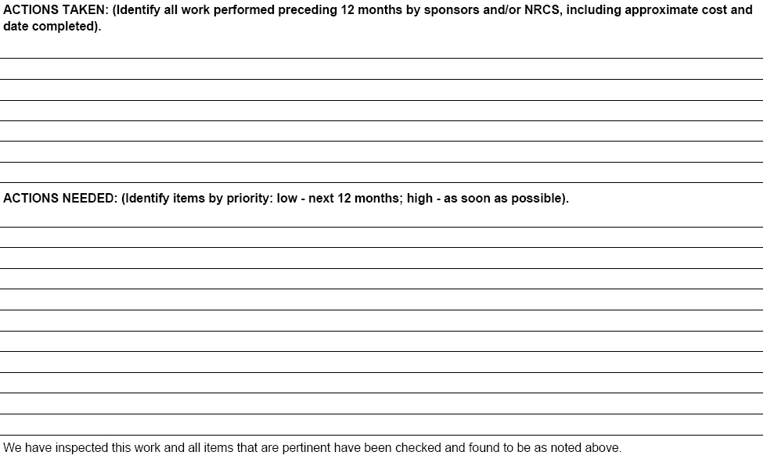

Slide 15
-Mow dam and auxiliary spillway.
-Cut trees and chemically treat stumps to prevent regrowth.
-Remove build-up in front of toe drains to allow water to flow freely.
-Monitor seepage for any changes.
-Remove blockage downstream so toe drains are not submerged.

Slide 16
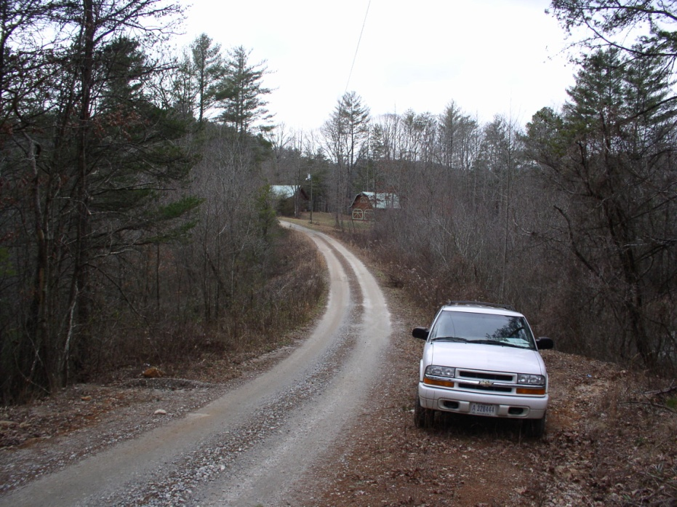
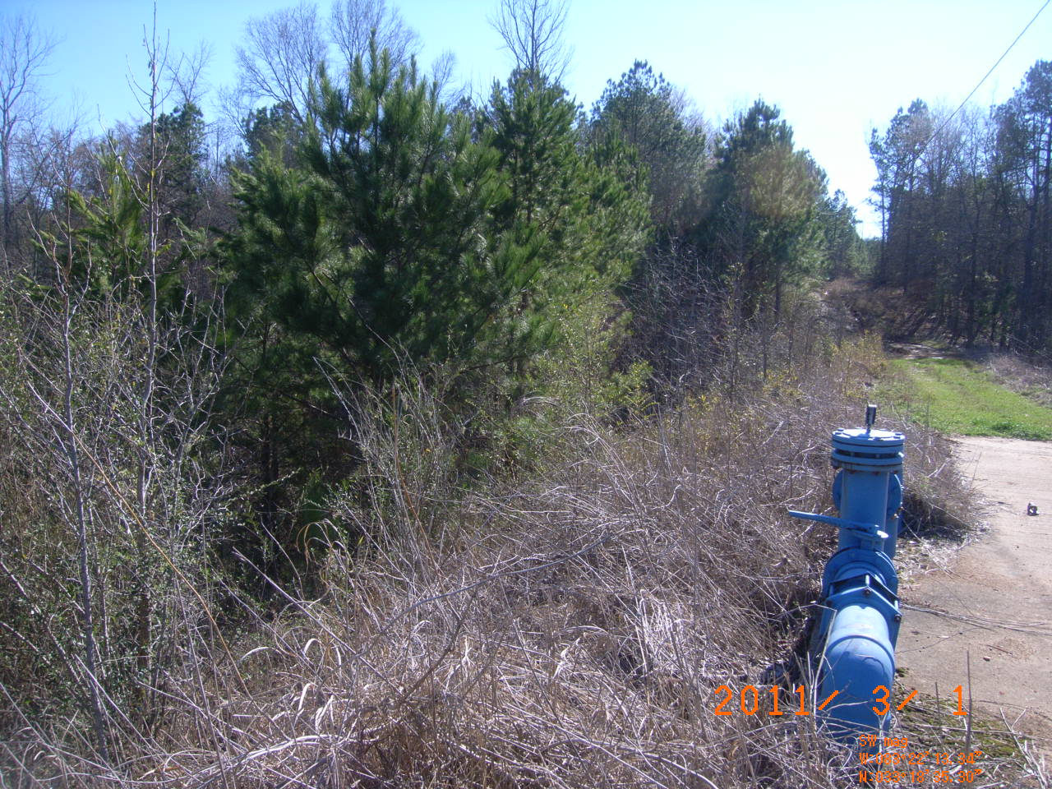
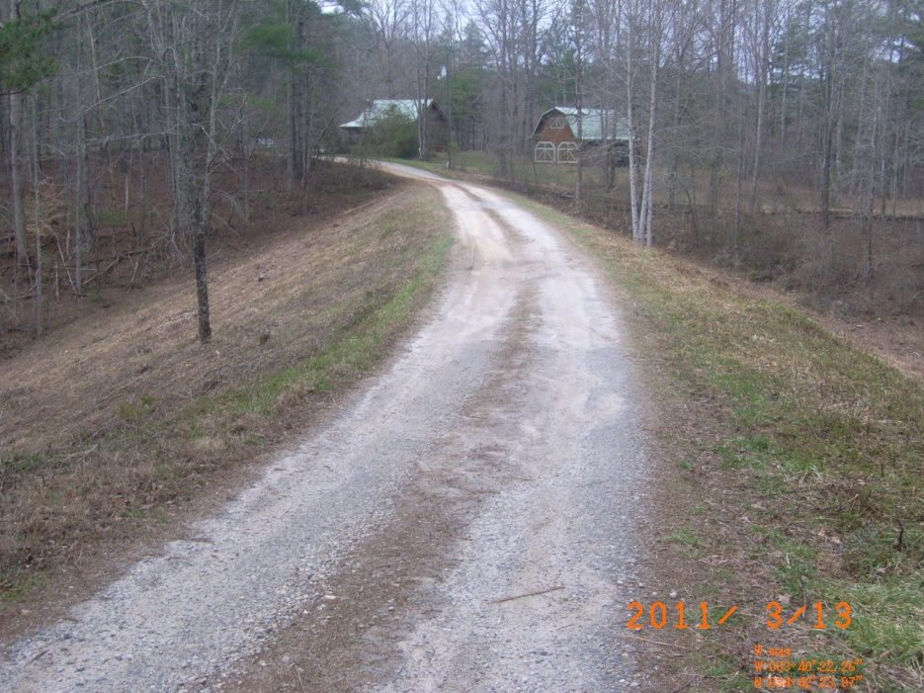
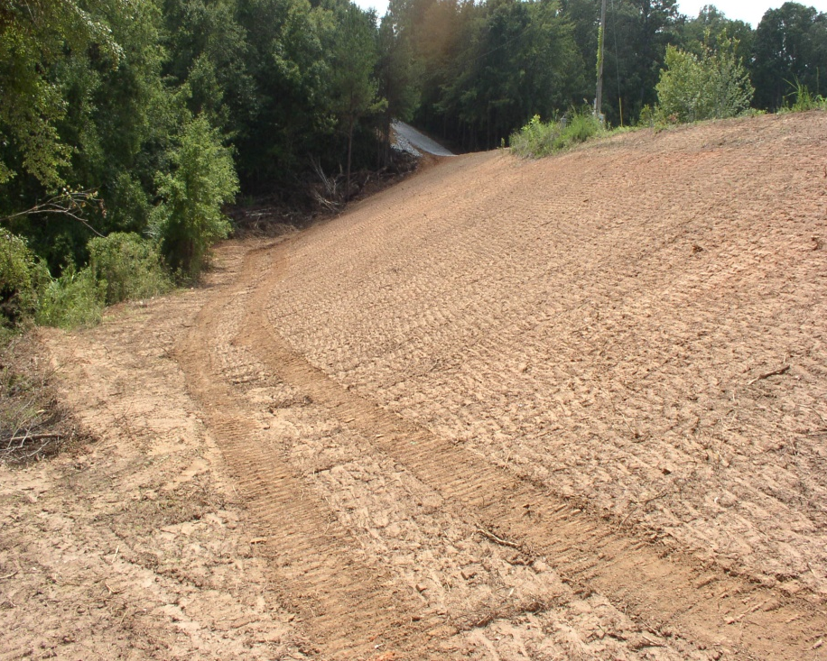

Slide 17
Why Maintenance is Critical
The Great Flood of 2009
A Georgia Case Study

Slide 18
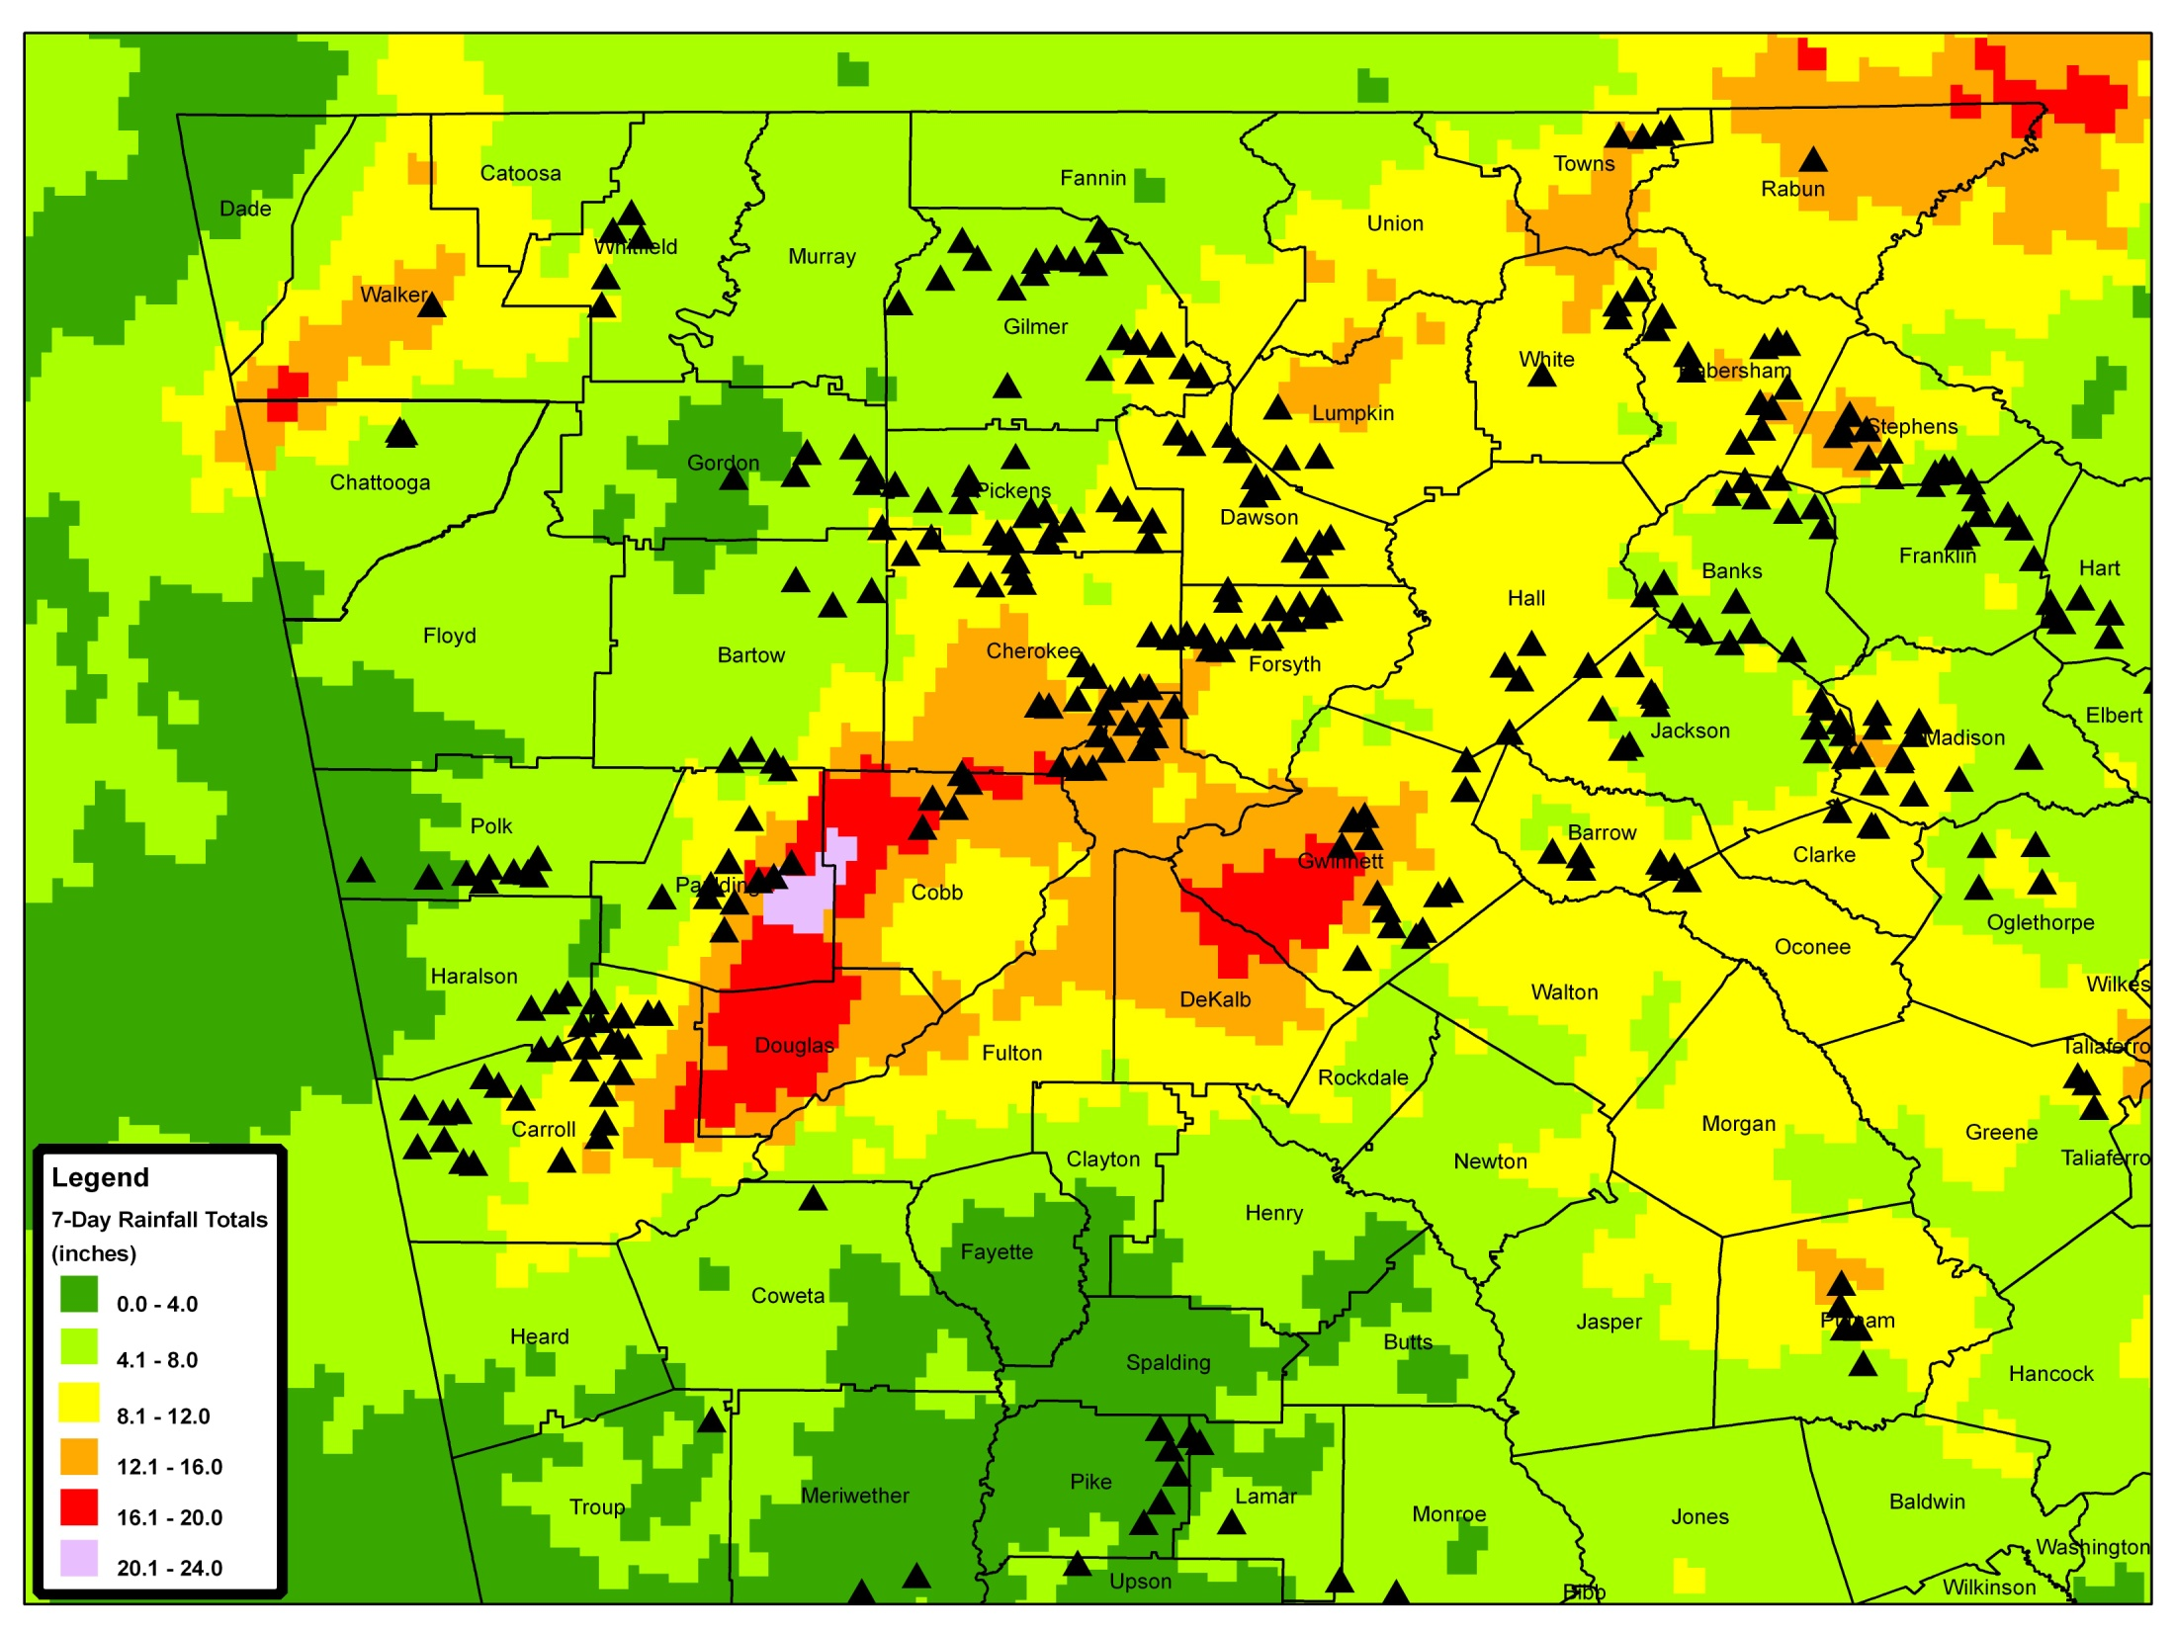

Slide 19
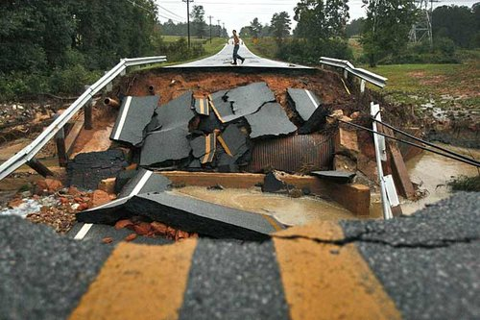
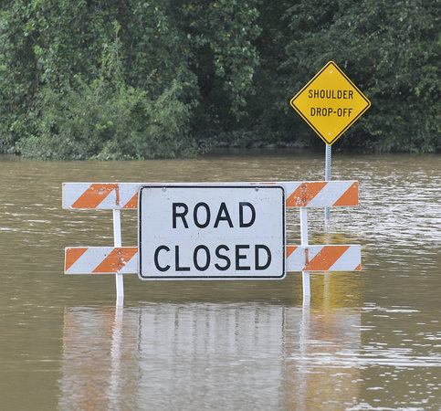

Slide 20
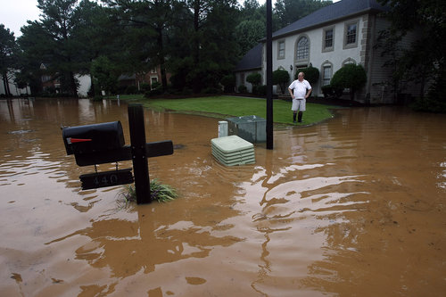
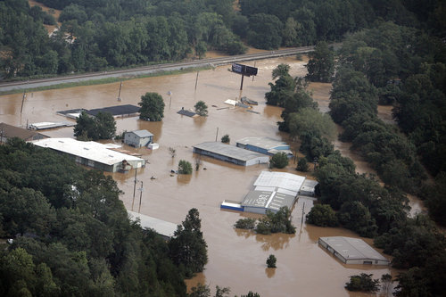
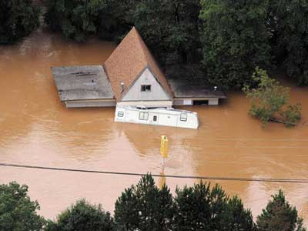
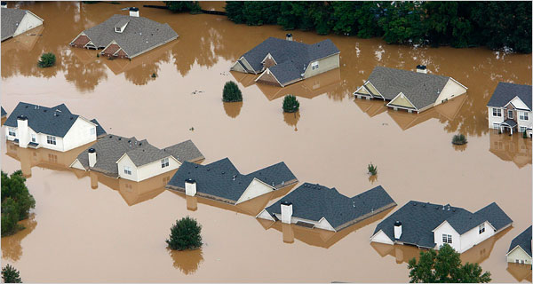

Slide 21
Dam Safety Concerns
Excellent performance of well-maintained dams and spillways
Most damage occurred downstream of the constructed spillway channel
Small flow discontinuities can lead to significant erosion
Structure modifications by landowners and sponsors can lead to increased flooding downstream and dam or spillway failure

Slide 22
Little Tallapoosa River Watershed Dam No. 20, Carroll County
This is one of the first pictures that the NRCS State Office received from the field on September 21st. This dam was overtopped by as much as a foot of water.

Slide 23
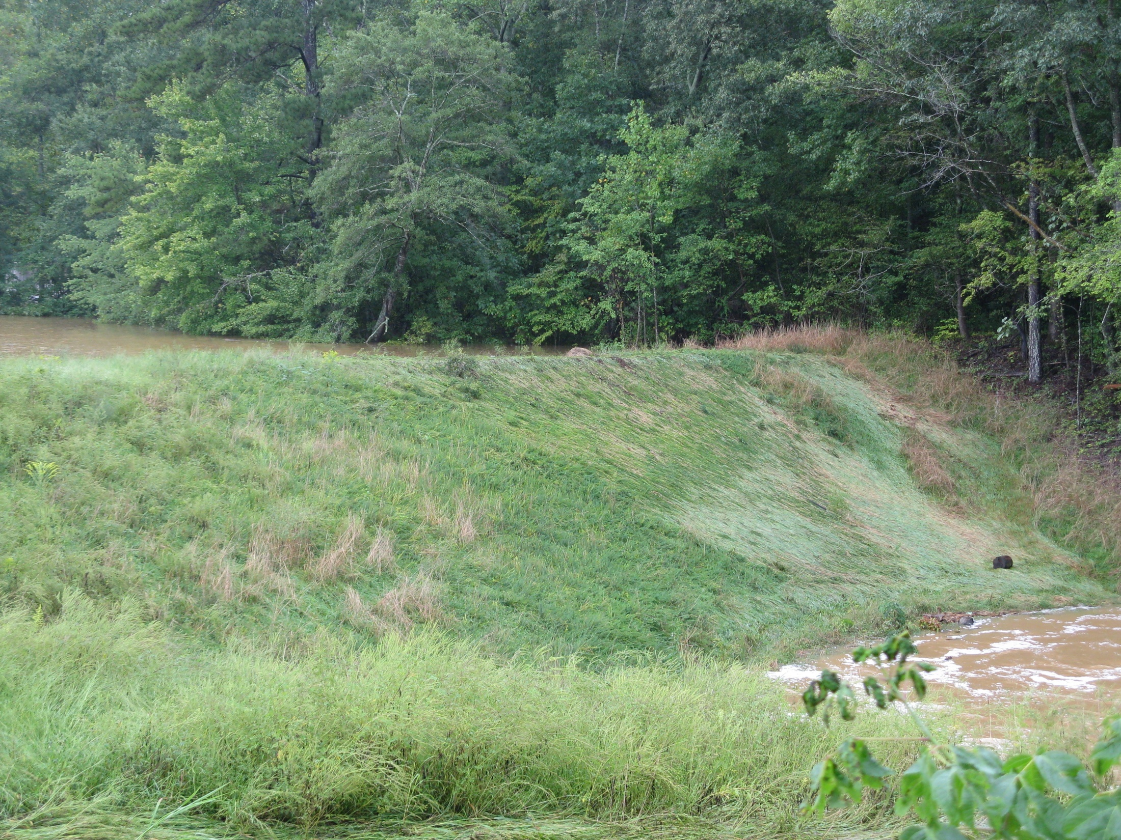
Little Tallapoosa River Watershed Dam No. 20, Carroll County
No damage to embankment during overtopping event.

Slide 24
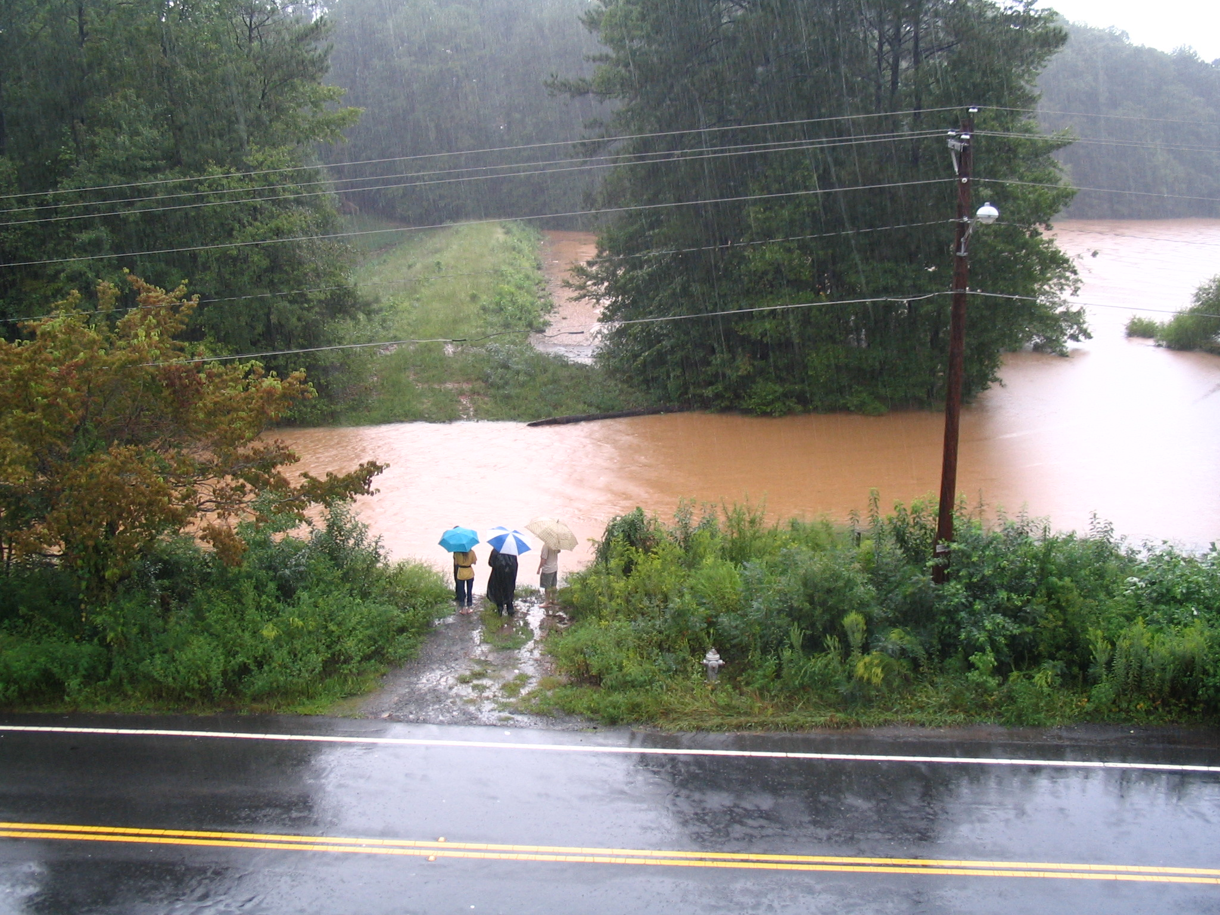
Noonday Creek Watershed Dam No. 15, Cobb County
Working as Designed--Flow through the Auxiliary Spillway. This site is at Kennesaw State University with over 100 people working in offices within 300 yards below the dam.

Slide 25
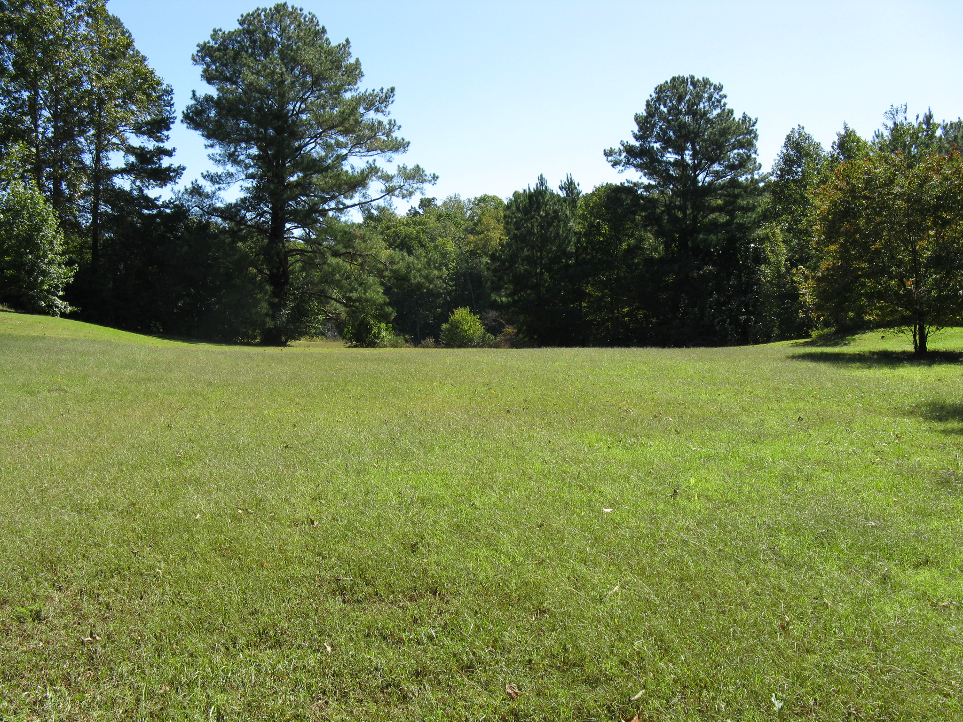
Little River Watershed Dam No. 25, Fulton County
Auxiliary Spillway about a week after the flooding . The Maximum flow depth in this spillway was approximately three feet.

Slide 26
Dam Safety Concerns
Excellent performance of well-maintained dams and spillways
Most damage occurred downstream of the constructed spillway channel
Small flow discontinuities can lead to significant erosion
Structure modifications by landowners and sponsors can lead to increased flooding downstream and dam or spillway failure

Slide 27
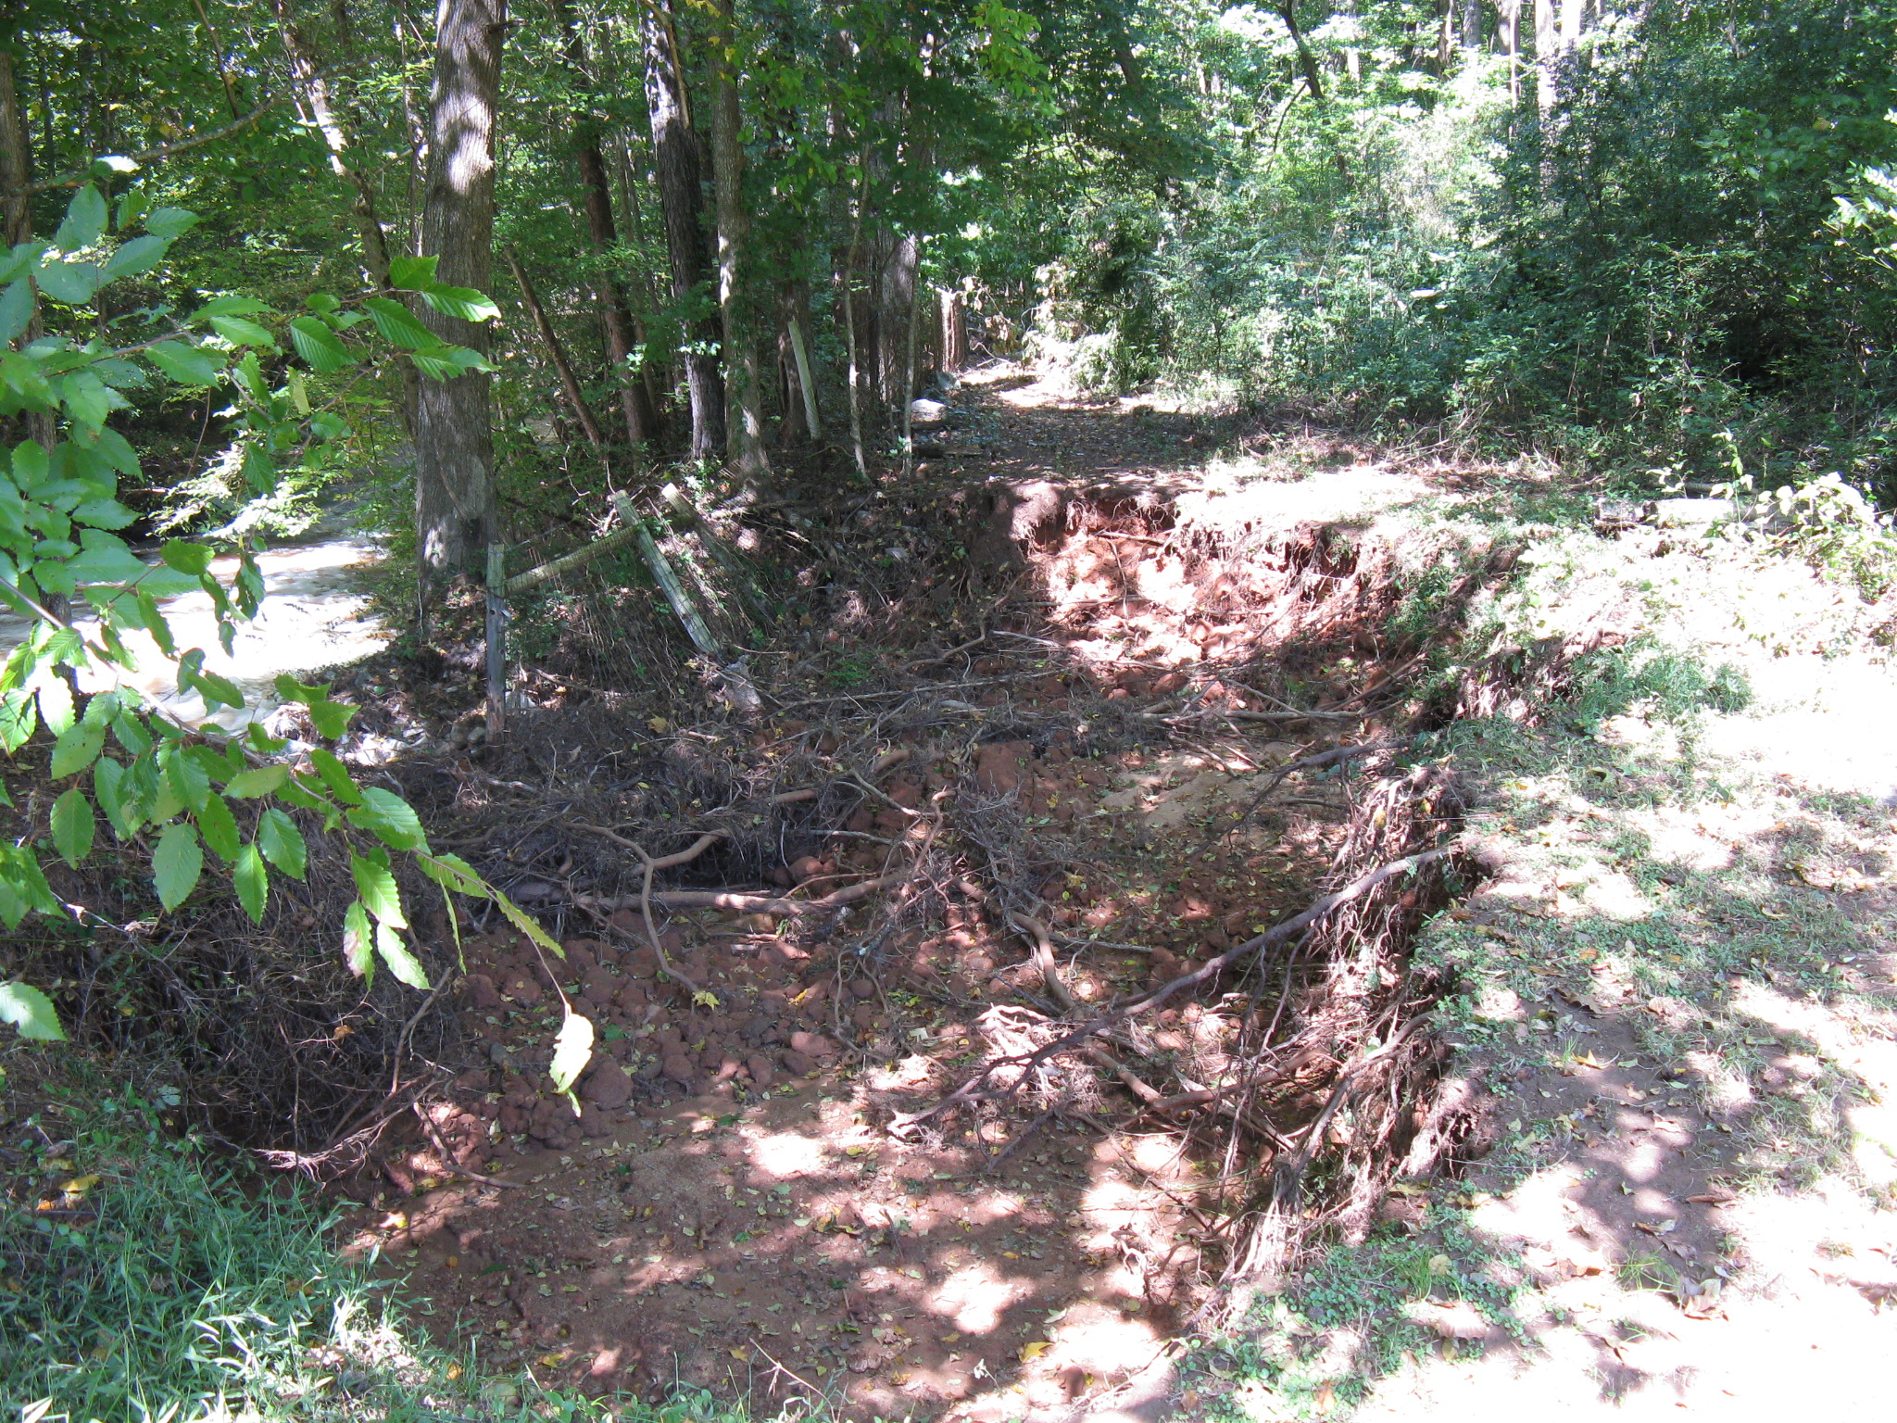
Little River Watershed Dam No. 25, Fulton County
Erosion just downstream from the constructed auxiliary spillway channel.

Slide 28
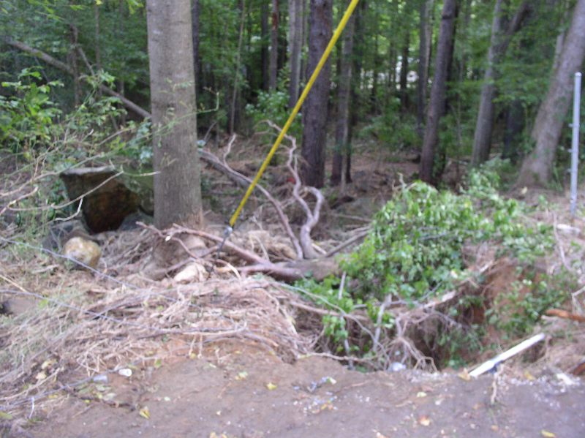
Pumpkinvine Creek Watershed Dam No. 67, Paulding County
Erosion just downstream from the constructed auxiliary spillway channel.

Slide 29
Dam Safety Concerns
Excellent performance of well-maintained dams and spillways
Most damage occurred downstream of the constructed spillway channel
Small flow discontinuities can lead to significant erosion
Structure modifications by landowners and sponsors can lead to increased flooding downstream and dam or spillway failure

Slide 30
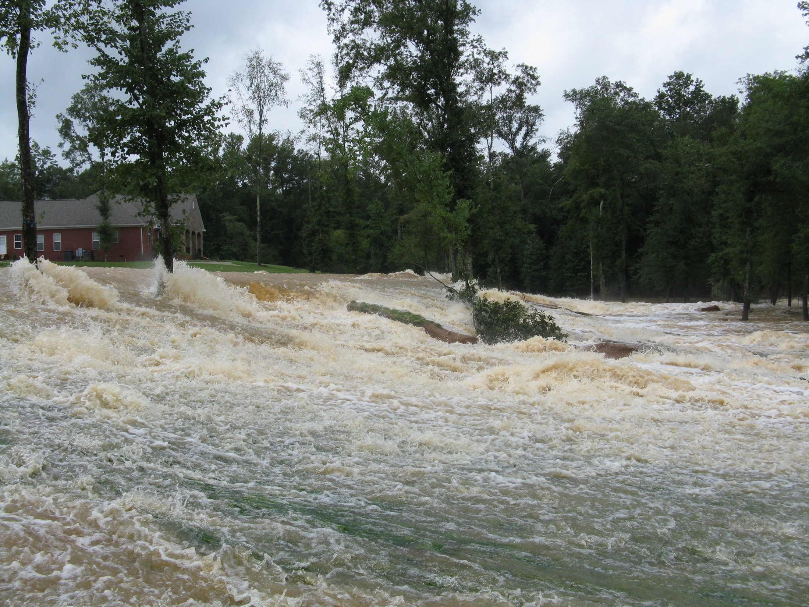
Little Tallapoosa River Watershed Dam No. 19, Carroll County on September 21, 2009

Slide 31
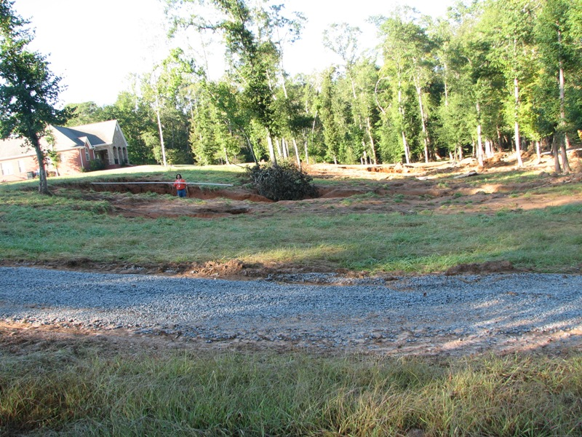
Erosion caused by trees in the auxiliary spillway

Slide 32
Dam Safety Concerns
Excellent performance of well-maintained dams and spillways
Most damage occurred downstream of the constructed spillway channel
Small flow discontinuities can lead to significant erosion
Structure modifications by landowners and sponsors can lead to increased flooding downstream and dam or spillway failure

Slide 33
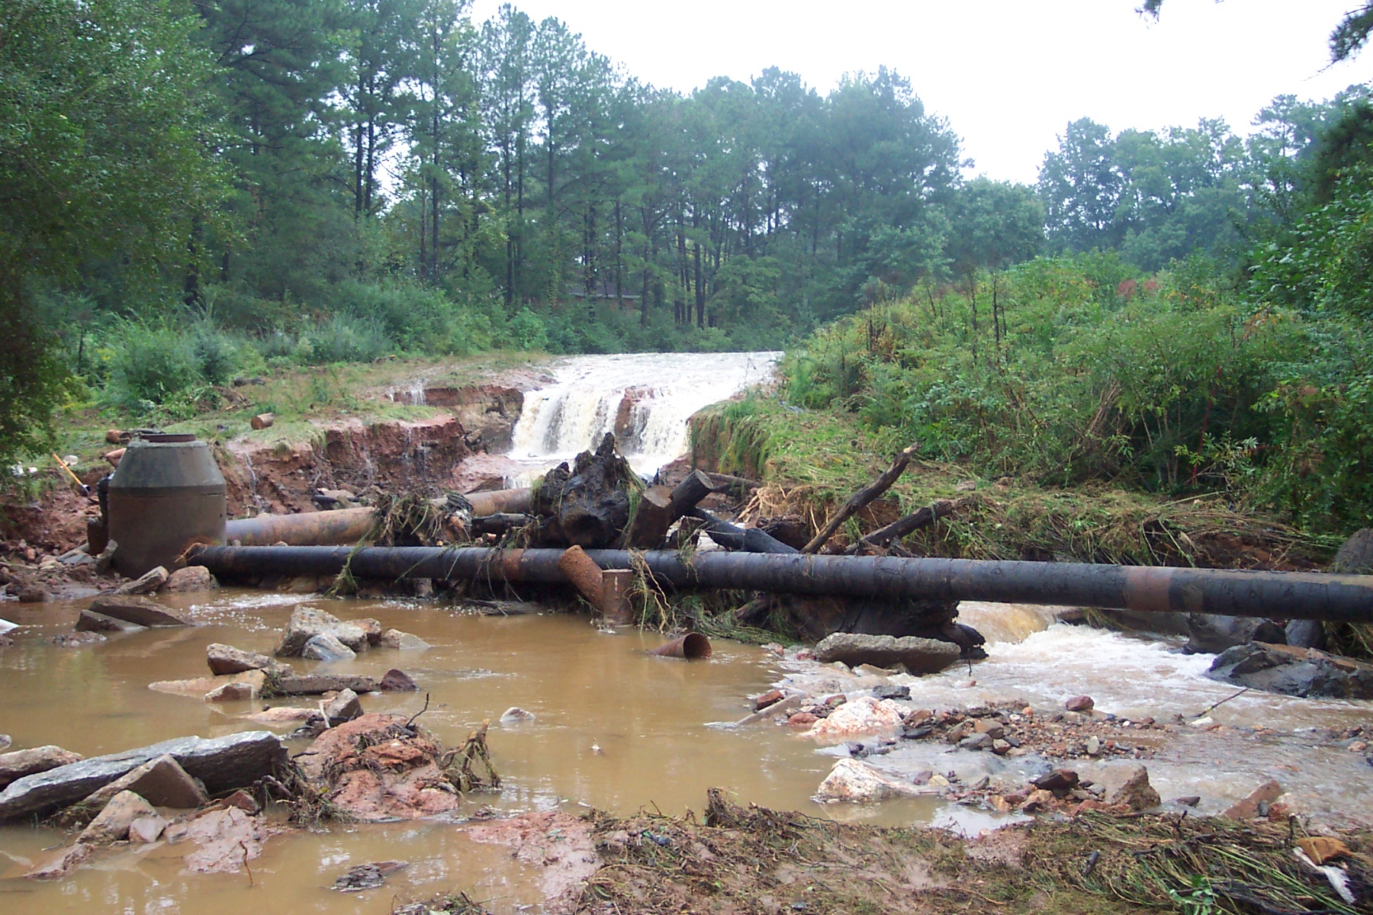
Little River Watershed Dam No. 39, Fulton County
Increased erosion caused by installation of a sewer line in an auxiliary spillway.

Slide 34
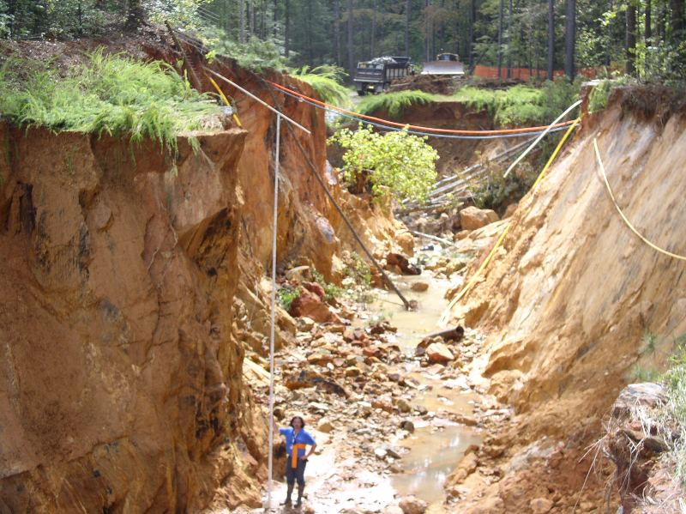
Pumpkinvine Creek Watershed Dam No. 3A
Increased erosion caused by installation of a sewer line in an auxiliary spillway. The left side of the spillway suffered little to no erosion.

Slide 35
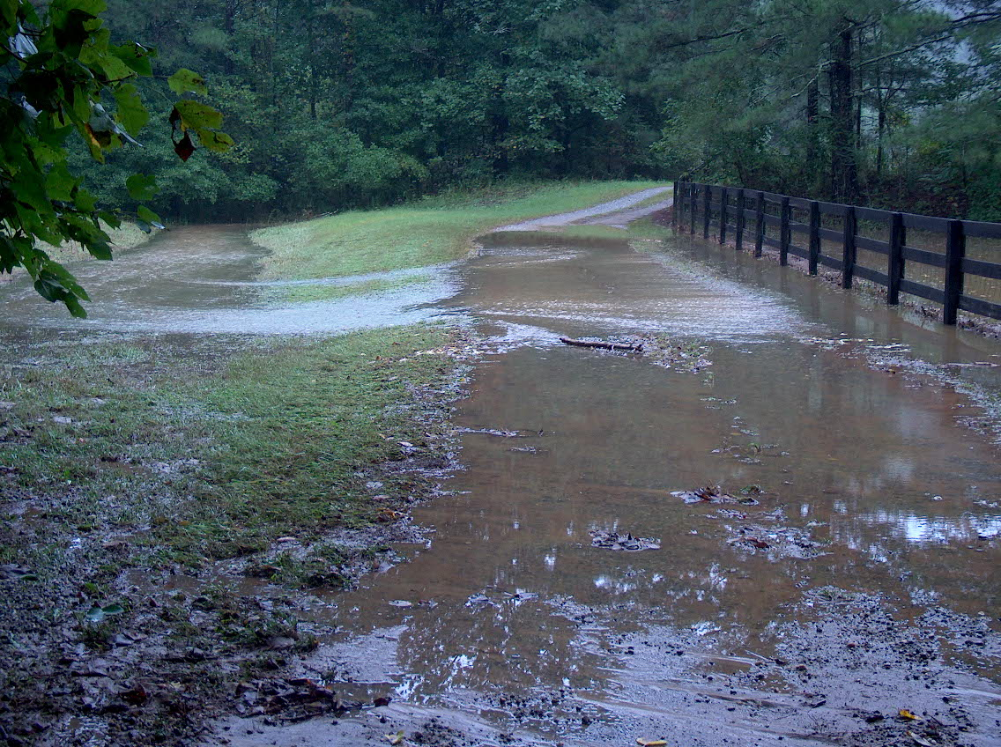
Little River Watershed Dam No. 15, Cherokee County
Auxiliary Spillway altered from grading of a driveway.

Slide 36
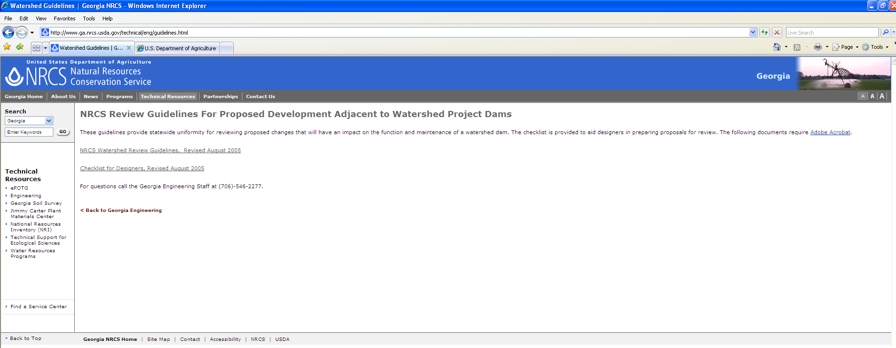
http://www.ga.nrcs.usda.gov/technical/eng/guidelines.html

Slide 37
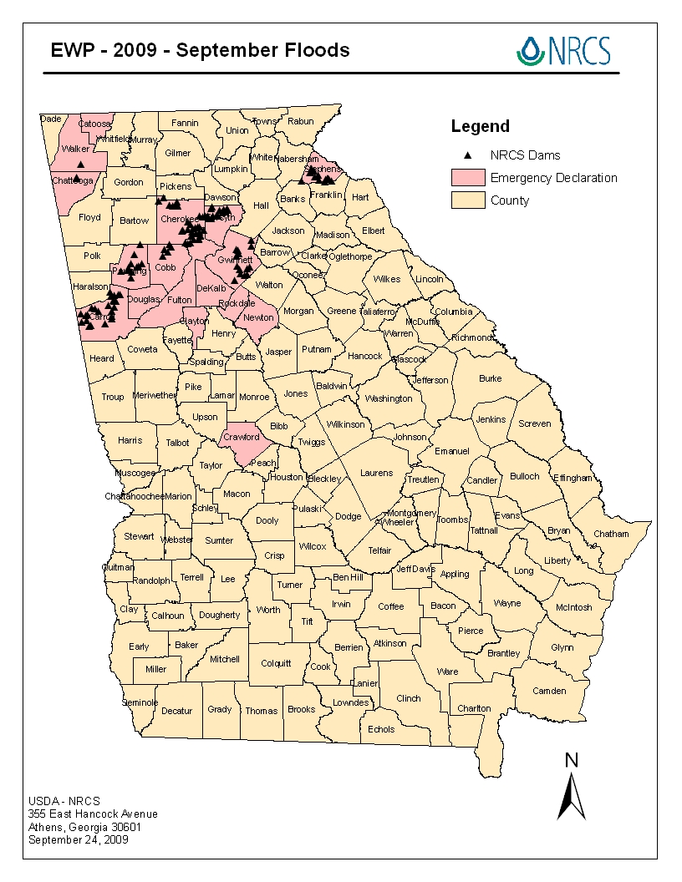
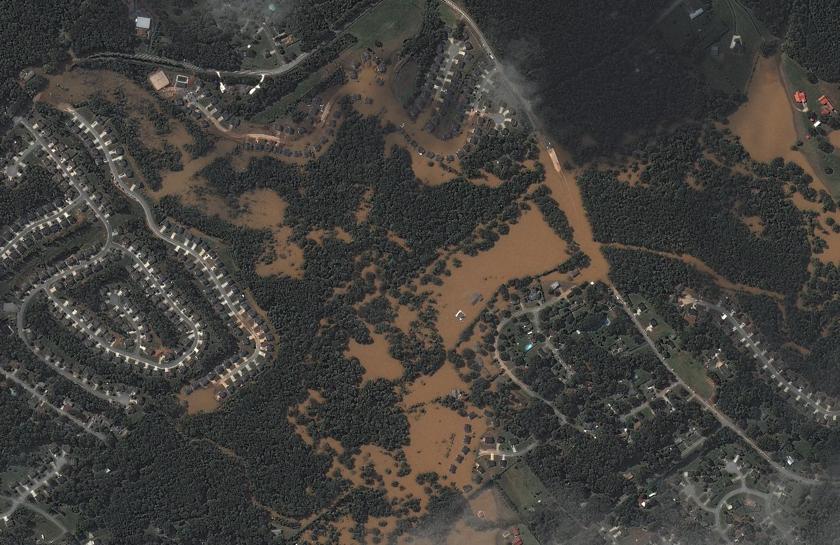
Summary
Some 139 NRCS assisted dams are included in the 23-county disaster area. These dams protected an estimated 1,788 homes valued at $358 million, and 572 road crossings valued at $57 million.

Slide 38
What If Structure Needs More Than Maintenance
Watershed Dam Rehabilitation

Slide 39
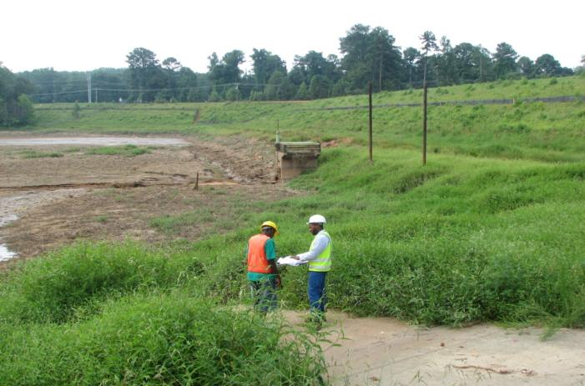
Y-15, Gwinnett County

Slide 40
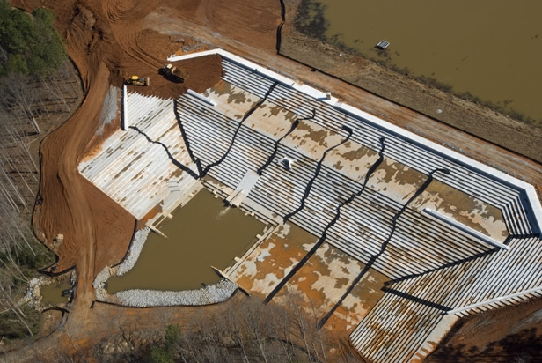

Slide 41





Slide 42
To date in Georgia:
15 dams upgraded to current safety standards
  8 to State Standards
  7 to NRCS Standards

Slide 43
Questions?

