Slide 1
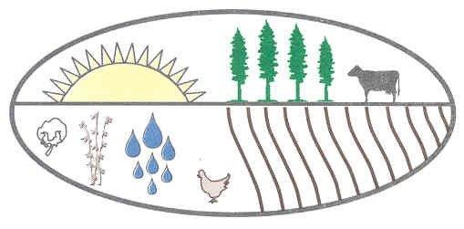
Soil and Water Conservation in Georgia
Improving Georgia’s Natural Resources
to Help People Help the Land
Georgia Association of Georgia Soil and Water
Conservation District Supervisors Conservation Commission

Slide 2
What is a soil and water conservation district?
Locally-led Soil and Water Conservation Districts (SWCD’s) are dedicated to the improvement and conservation of Georgia's natural resources. Districts promote soil and water conservation, educate citizens about the importance of conservation, and inform policy makers about natural resource issues.

Slide 3
What led to the creation of Soil and Water Conservation Districts?
Soil and Water Conservation Districts (SWCDs) were created in 1937 by the Georgia General Assembly to protect the state's soil and water resources following the Dust Bowl of the 1930's.

Slide 4
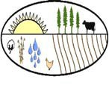
Soil and Water Conservation Districts (SWCDs) provide a way for citizens to set local resource priorities for state and federal assistance programs. Some districts cover a single county, while other districts include two or more counties.
The Georgia Association of Conservation District Supervisors (GACDS) was established in 1943 to support the efforts of Georgia’s soil and water conservation districts in preserving the state’s natural resources.
The Georgia Soil and Water Conservation Commission (GSWCC) was formed to assist local conservation districts in protecting, conserving and improving the soil and water resources of the State of Georgia. The Commission's goal is to make Georgia a better place for its citizens through the wise use and protection of basic soil and water resources and to achieve practical water quality goals.

Slide 5
Success through local leadership
40 Local Districts covering all 159 counties
370 Local District Supervisors who volunteer their time to help their local communities
Each county has at least two supervisor representatives on the District Board of Supervisors, one elected and one appointed. Supervisors provide local leadership to conserve, improve and protect Georgia's natural resources

Slide 6
GACDS is a non-profit organization dedicated to: 1. Exchange information relating to the administration and operation of Georgia’s 40 districts and encourage cooperation among the districts 2. Work with and support the Georgia State Soil and Water Conservation Commission 3. Promote water quality protection 4. Promote retention of prime farmland for producing food and fiber 5. Encourage the interest and activities of civic, educational, and other organizations in soil and water conservation, erosion and sediment control and protection of water quality
Georgia Association of Conservation District Supervisors (GACDS) Objectives

Slide 7
6. Aid in securing and coordinating assistance from all available sources on local, state and national levels 7. Provide aid and guidance in programs for the prevention and control of soil erosion and conservation of soil and water resources 8. Advise legislative groups at the local, state and national levels on needs for conservation legislation 9. Conduct an educational and informational program promoting natural resource conservation
Georgia Association of Conservation District Supervisors (GACDS) Objectives

Slide 8
Soil and Water Conservation means: Exchanging best practices for environmental resource management

Slide 9
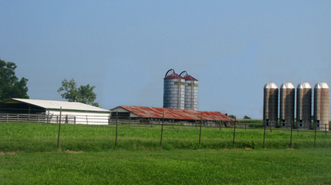
Soil and Water Conservation means: Assisting agricultural producers in improving their soil and water resources for current and future generations

Slide 10
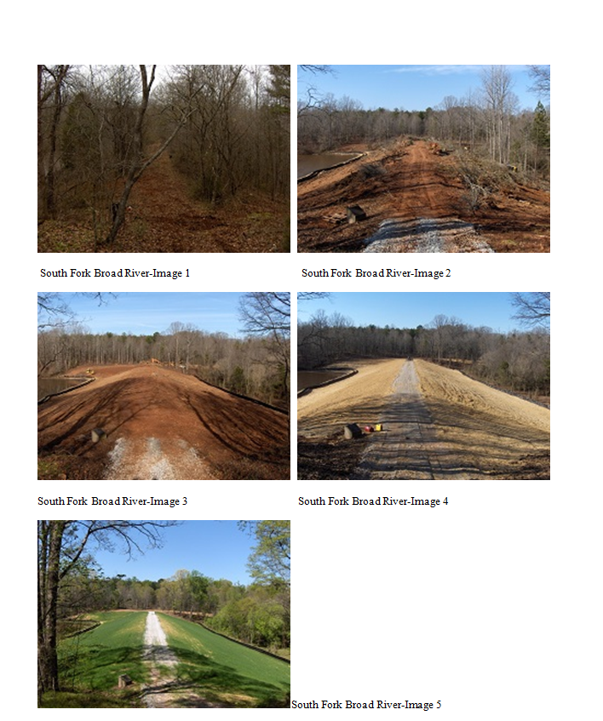
Soil and Water Conservation means: Protecting people and property by ensuring continued maintenance of Georgia’s 357 watershed dams

Slide 11
Soil and Water Conservation means: Better data on agricultural irrigation water usage
Collect and provide data on agricultural irrigation water use to help state policy makers better understand the requirements of Georgia’s agricultural producers.

Slide 12
Soil and Water Conservation means: Helping agricultural producers protect and improve their water resources
Conservation Districts assist farmers in developing nutrient management plans to protect water quality
Mobile Irrigation Lab helps agricultural producers to increase the uniformity and efficiency of their irrigation systems

Slide 13
Soil and Water Conservation means: Reviewing development plans to minimize soil erosion and control sediment runoff from urban development sites

Slide 14
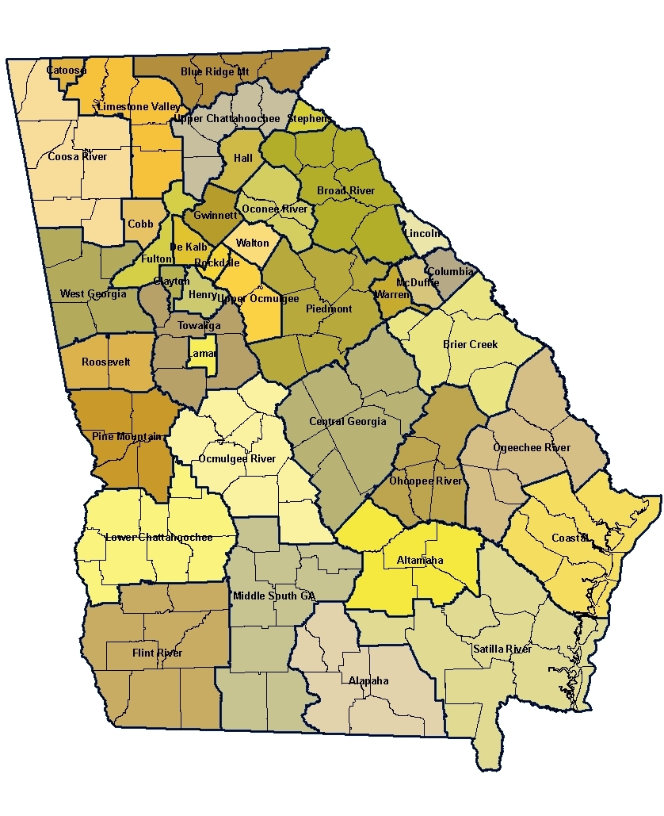
If you live in Georgia, you live in one of 40 Soil and Water Conservation Districts

Slide 15
What is happening in my local district?
Districts hold regular monthly meetings to plan their work and determine local needs for soil and water conservation and resource development. Soil and Water Conservation Districts work on a local level to promote statewide conservation goals
District meetings are announced at http://gaswcc.georgia.gov/soil-water-conservation-districts

Slide 16
Get your neighbors involved Develop and participate in field days and media events for legislators (local, state and national), local business leaders, and the public Generate policy papers outlining GACDS conservation program objectives Help local legislators better understand the role that conservation plays in their community development
GACDS Recommendations

Slide 17
Support Local Working Groups that recommend conservation priorities for USDA-NRCS funding Plan for the future of the Districts by encouraging broad participation in District activities and leadership Commit to the possibilities
GACDS Recommendations

Slide 18
Interested in becoming a District Supervisor?
Supervisors are both elected and appointed.
40 Local Districts covering all 159 counties.
370 Local District Supervisors
Each county has at least two supervisor representatives on the District Board of Supervisors, one elected and one appointed
Supervisors provide leadership to conserve, improve and protect Georgia's natural resources

Slide 19
How do I become a District Supervisor?
For information on becoming an elected or appointed District Supervisor, go to
http://gaswcc.georgia.gov/how-do-i-become-swcd-supervisor-2014-elections

Slide 20
More information on conserving Georgia’s natural resources is available at http://gaswcc.georgia.gov and http://www.gacds.org
Georgia Association of Georgia Soil and Water
Conservation District Supervisors Conservation Commission

