Slide 1
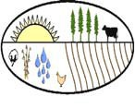
Soil and Water Conservation Districts in Georgia

Slide 2
Soil and Water Conservation Districts (SWCDs) were created in 1937 by the Georgia General Assembly to protect the state's soil and water resources following the Dust Bowl of the 1930's. Districts provide a way for citizens to set local resource priorities for state and federal assistance programs. Some districts cover a single county, while other districts include two or more counties.
The Georgia Association of Conservation District Supervisors (GACDS) was established in 1943 to support the efforts of Georgia’s soil and water conservation districts in preserving the state’s natural resources.
The Georgia Soil and Water Conservation Commission (GSWCC) was formed to assist local conservation districts in protecting, conserving and improving the soil and water resources of the State of Georgia. The Commission's goal is to make Georgia a better place for its citizens through the wise use and protection of basic soil and water resources and to achieve practical water quality goals.

Slide 3
Success through local leadership
40 Local Districts covering all 159 counties.
370 Local District Supervisors who volunteer their time to help their local communities.
Each county has at least two supervisor representatives on the District Board of Supervisors, one elected and one appointed.
Supervisors provide local leadership to conserve, improve and protect Georgia's natural resources.

Slide 4
Soil and Water Conservation means: Exchanging best practices for environmental resource management

Slide 5
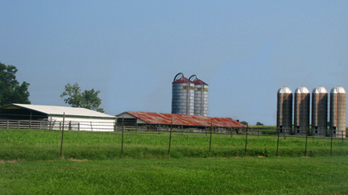
Soil and Water Conservation means: Assisting agricultural producers in improving their soil and water resources for current and future generations

Slide 6
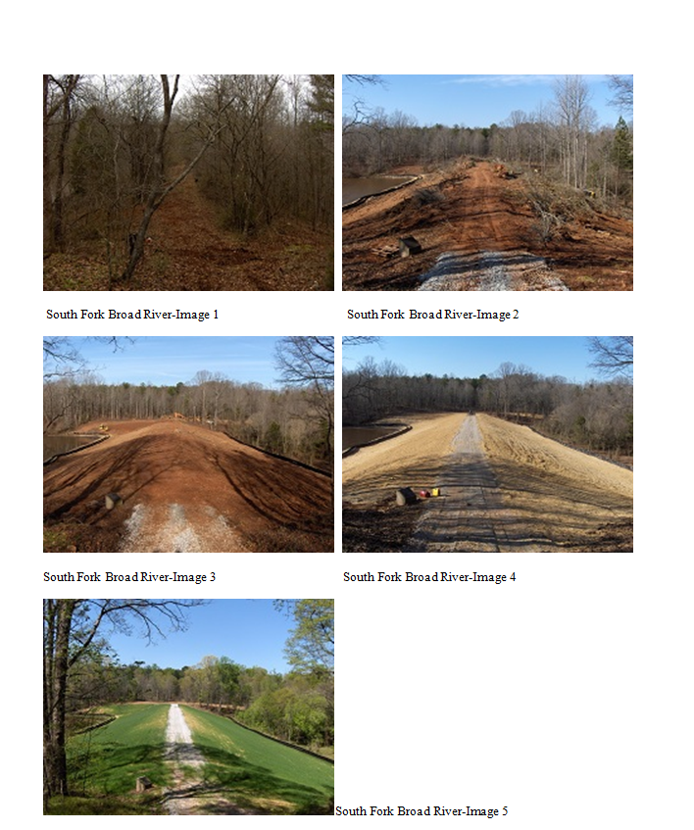
Soil and Water Conservation means: Protecting watersheds by ensuring continued maintenance of the state’s dams

Slide 7
Soil and Water Conservation means: Better data on agricultural water usage
Collect and provide data on agricultural water use to help state policy makers better understand the requirements of Georgia’s agricultural producers.

Slide 8
Soil and Water Conservation means: Helping agricultural producers understand water use and conserving existing water resources
The Agricultural Water Conservation Initiative was created to:
Assist agricultural water users in quantifying water use.
Help producers to increase the uniformity and efficiency of their irrigation systems.

Slide 9
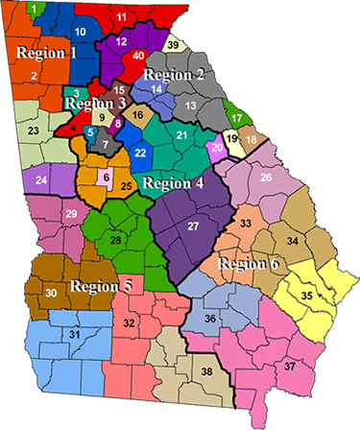
If you live in Georgia, you live in one of 40 soil and water conservation districts

Slide 10
What is happening in my local district?
Districts hold regular monthly meetings to plan their work and determine local needs for soil and water conservation and resource development. Soil and Water Conservation Districts work on a local level to promote statewide conservation goals.
District meetings are announced at http://gaswcc.georgia.gov/regional-offices .

Slide 11
How do I become a District Supervisor?
Supervisors are both elected and appointed.
40 Local Districts covering all 159 counties.
370 Local District Supervisors.
Each county has at least two supervisor representatives on the District Board of Supervisors, one elected and one appointed.
Supervisors provide leadership to conserve, improve and protect Georgia's natural resources.

Slide 12
How do I become a District Supervisor?
For information on becoming an elected or appointed District Supervisor, go to
http://gaswcc.georgia.gov/how-do-i-become-swcd-supervisor

Slide 13
Information on soil and water conservation is available at http://gaswcc.georgia.gov/

